Slide 1
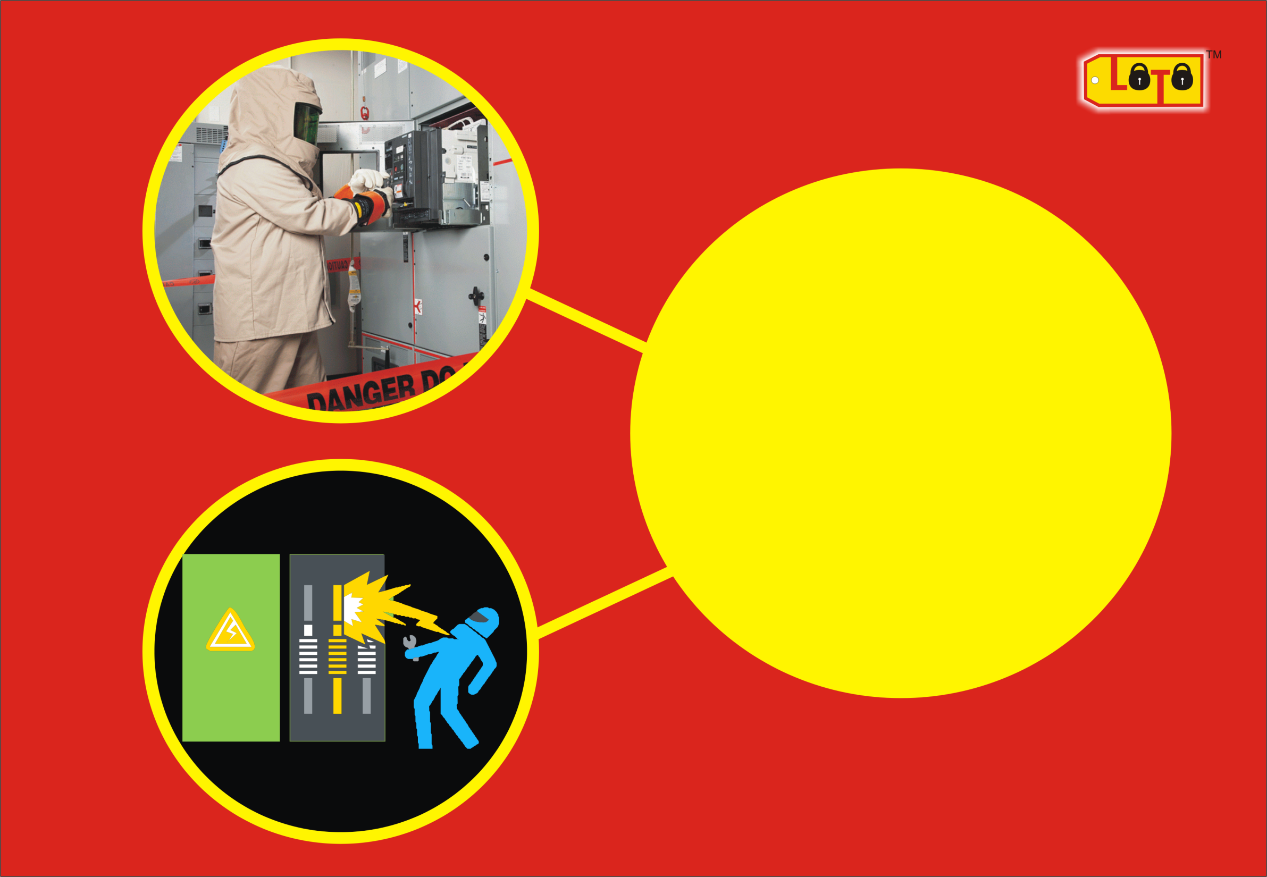
PART TWO
ELECTRICAL
SAFETY

Slide 2

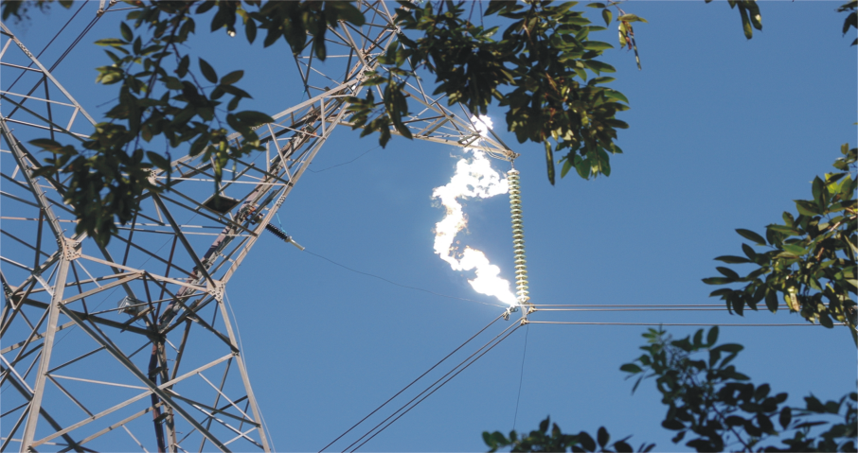
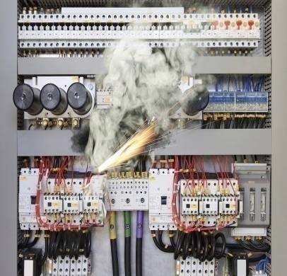
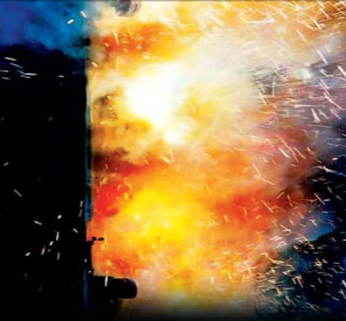
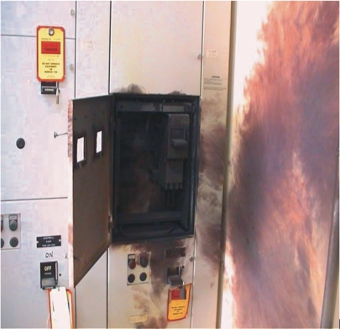
WHAT IS AN ELECTRIC ARC?
“An Electric arc is a short circuit current passing through the air”
WHAT IS AN ARC FLASH?
“A dangerous condition associated with the release of energy caused by an electric arc”

Slide 3
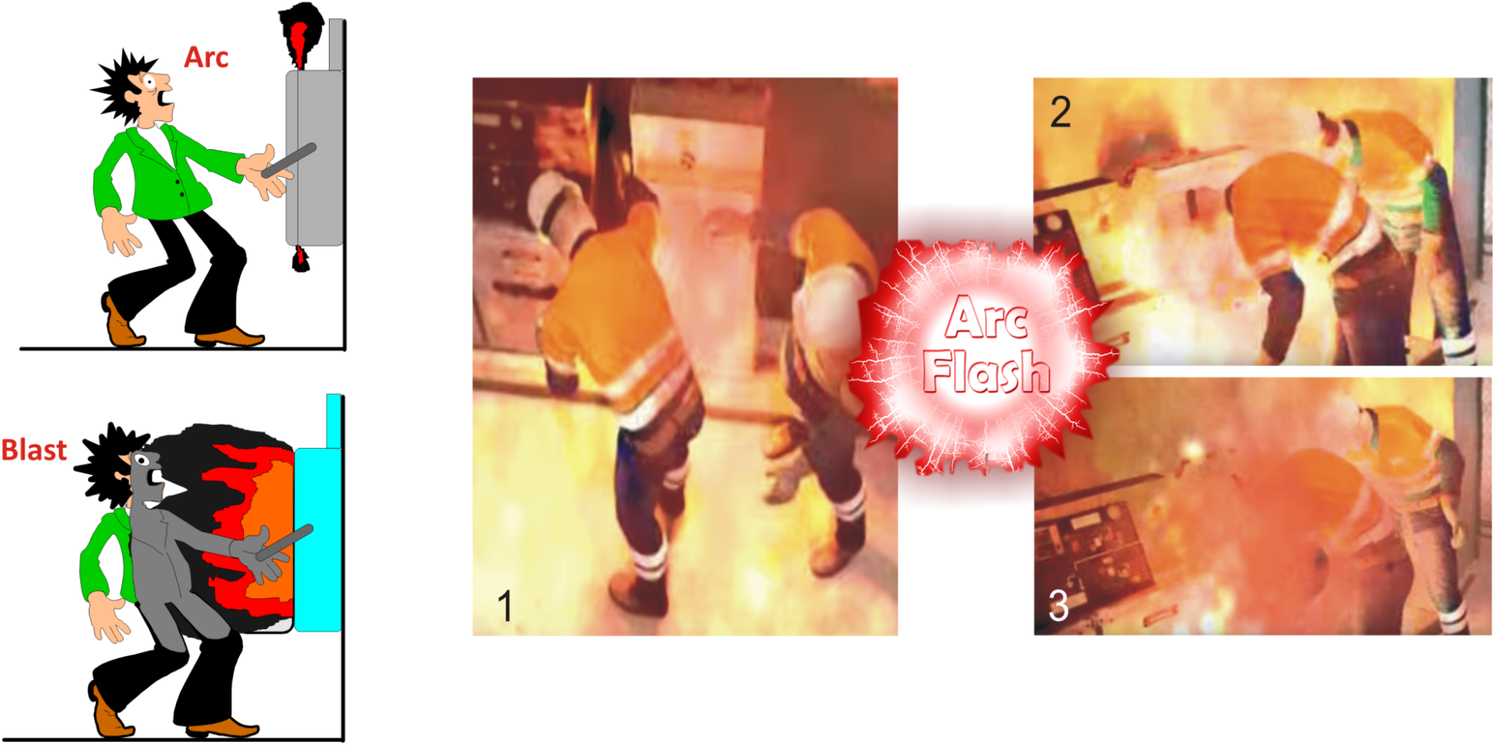
An arc flash occurs when electricity “jumps” or “arcs” through the air.
An arc flash starts with an arcing fault. An arcing fault can be defined as the flow of current through a path where it is not intended to flow.

Slide 4
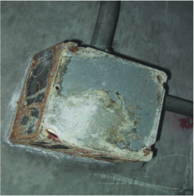
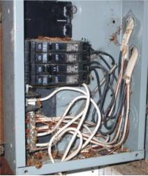
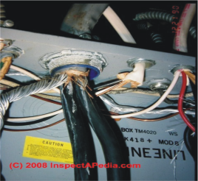
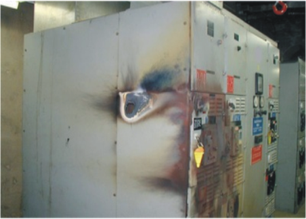
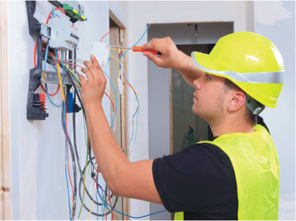
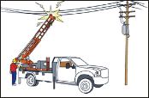
WHAT STARTS THE ARC?
WE ARE AT THE GREATEST RISK OF CAUSING AN ARC WHEN WE CHANGE THE “STATE OF A CIRCUIT”.
Arcs can be initiated by:
Glow to Arc Discharge
Dust & Impurities
Corrosion
Condensation of Vapor & Water
Spark Discharge
Accidental contact with energized part
Dropping Tools
Over Voltages across narrow-gaps
Failure of Insulating materials
Wirings Errors
Improperly designed or Utilized Eqpt.
Improper Work Procedure

Slide 5
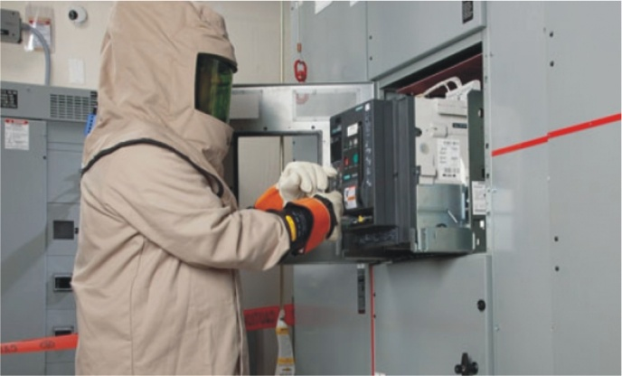
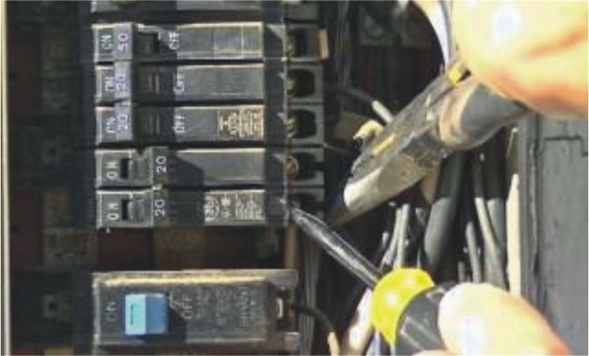
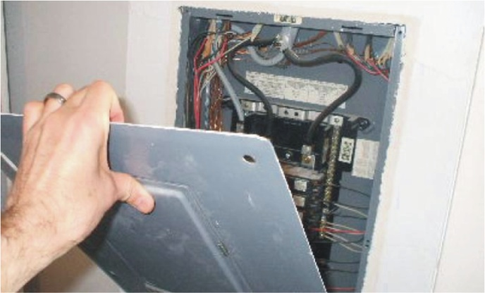
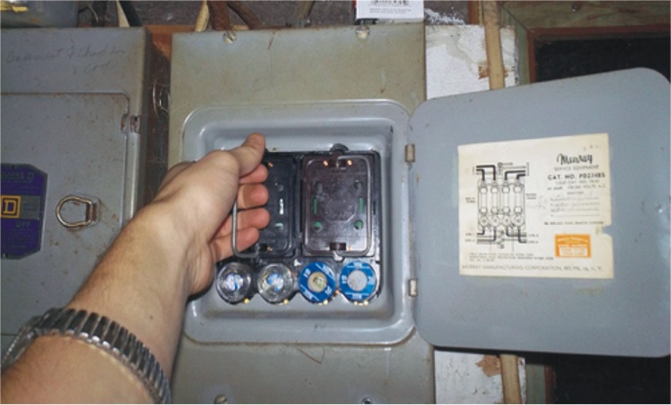
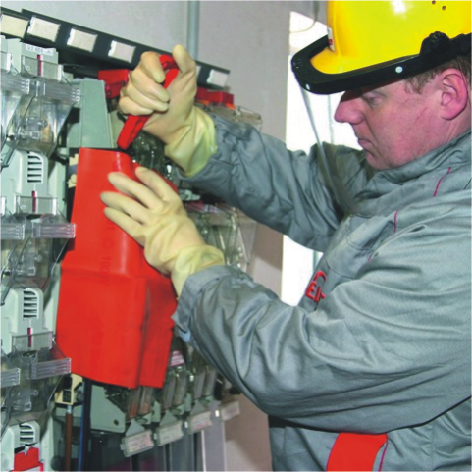
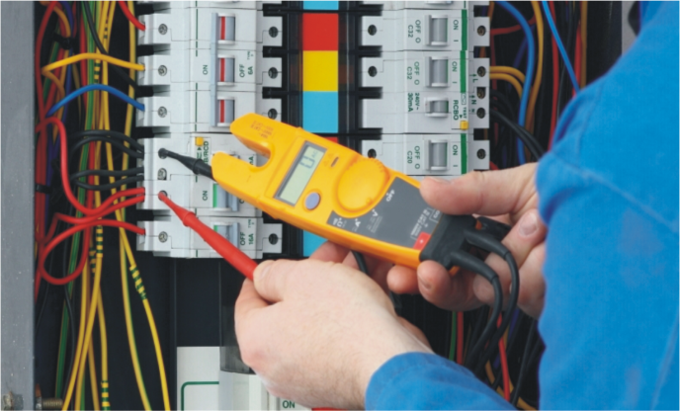
WHAT ARE THE RISK EXPOSURE ACTIVITIES?
Activities which involve Arc Flash Risks are:
Racking in and out of draw-out
circuit breakers.
Removing or installing
Circuit Breakers
Removing panel covers for
inspections.
Removing or installing
Fuses
Applying safety guards.
Low voltage testing and
Diagnostics.

Slide 6
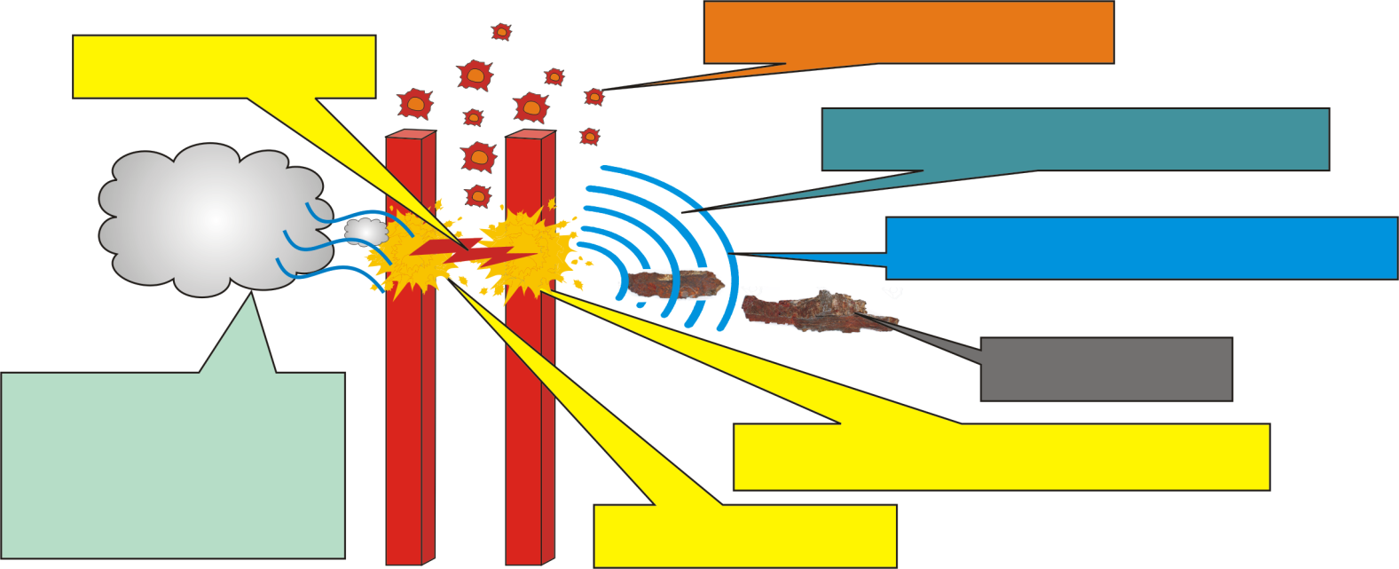
WHAT ARE THE POTENTIAL HAZARDS?
Electrical Arc
Molten Metal
12,000 Degree C
Pressure Shock Waves
Deafening Sound Waves
Copper Vapor
Solid to Vapor
Expands
67,000 times
Shrapnel
Hot Toxic Air - Rapid Expansion
Blinding Light
The danger from an arc flash can be one or more of several different hazards.
Extreme temperatures up to 12000 deg C. at the core.
Explosive forces (pressure wave).
High noise levels.
Very bright light including Ultra Violet light.
Emission of plasma.
Toxic smoke and fumes.
Fast moving debris.
Hot liquids (in oil cooled or insulated equipment).

Slide 7
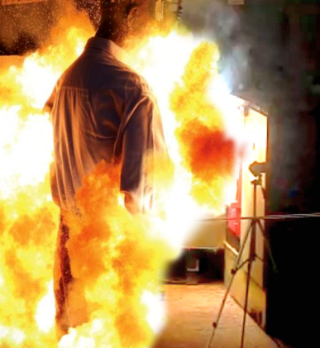
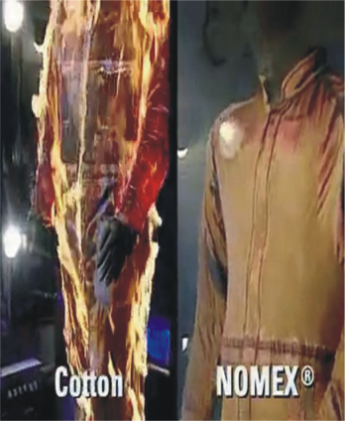
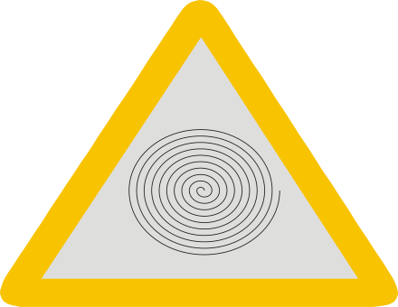
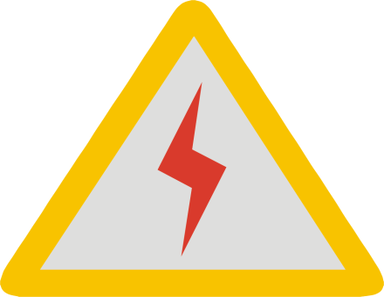
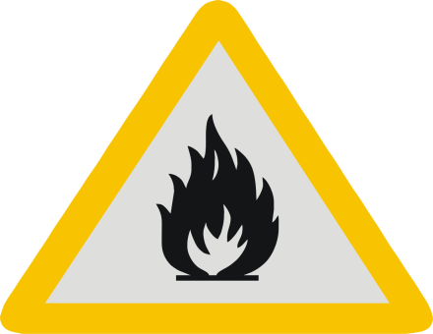
STAGED ARC FLASH TEST
Primary – Heat and Light
Intense UV Light – Blindness.
Intense Heat – Severe Burns & Lung
damage due to inhalation of extremely
Hot air, Molten metal and Toxic fumes.
Secondary – Pressure, Auditory and Projectile
Intense Pressure (2000lb/ft2).
Throws workers across the room.
Intense Sound Blast (160 dB).
Deafness, Memory loss and Brain Damage.
High Velocity Projectiles (700mph).
Blast shrapnel can penetrate the body.
Bright, intense flash
engulfs the worker on
exposure to arc blast
Non FR clothing
Burns after
arc exposure
Shockwave:
Electrocution:
Burn:
Compression of air from circuits
and other equipment can injure
via eardrum rupture
Energy emitting from arc flashes
causes serious injury
Igneous materials emanating
from arc flashes injure with
flames up to 20 feet away

Slide 8
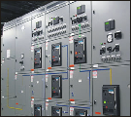
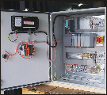
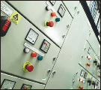
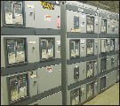
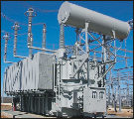
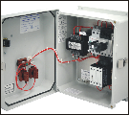
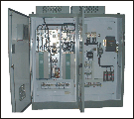
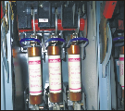
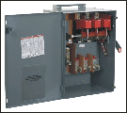
WHERE CAN AN ARC FLASH OCCUR?
A Hazardous Arc Flash can occur anywhere that electricity is present in high enough voltage to sustain an arc.
That means that there are a lot of places that you need to protect yourself.
Panel boards
Switchboards
MCC‘s
Switchgear
Transformers
Motor starters
Drive cabinets
Fused Disconnects
Busway/Plugs

Slide 9
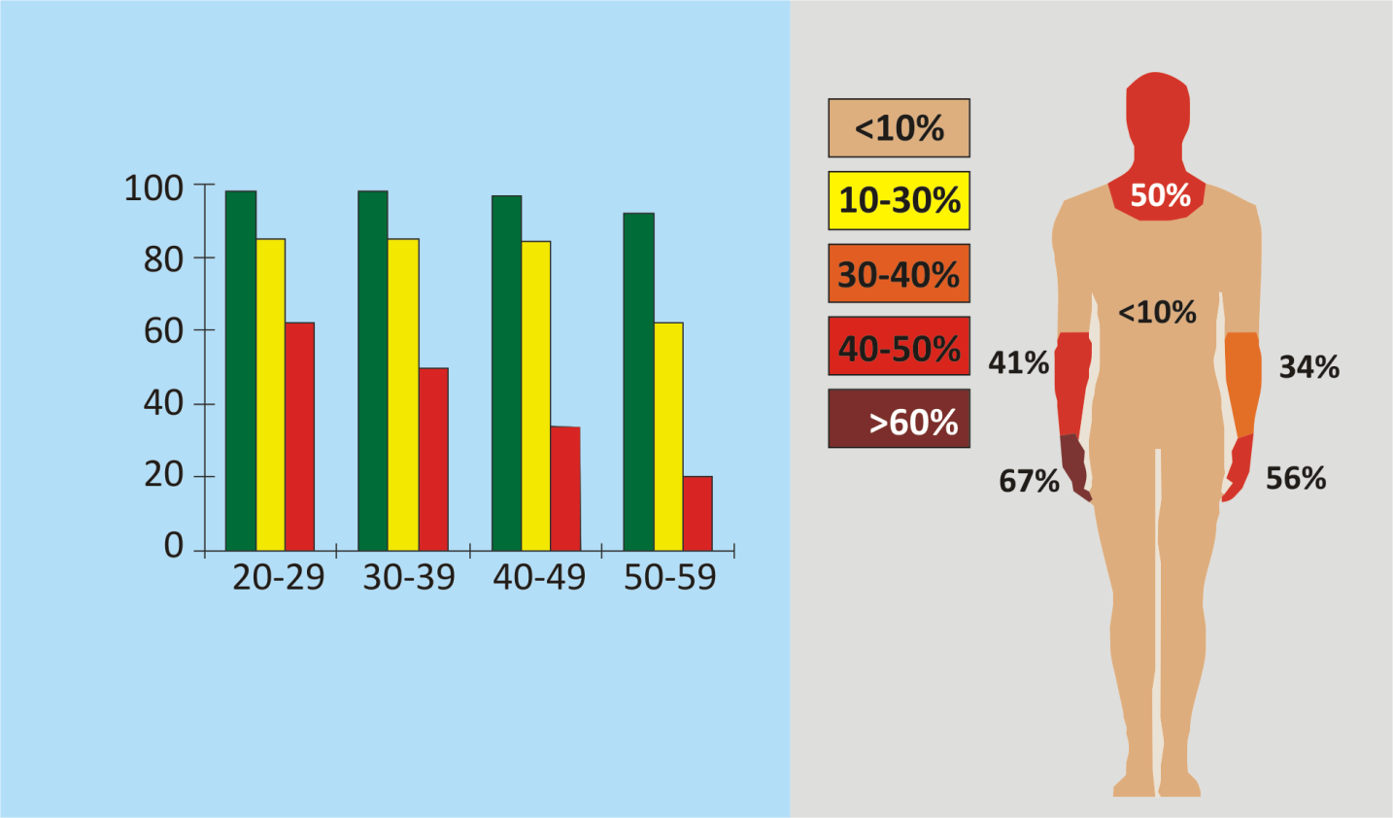
THE COSTS OF BURN INJURY
Personal and Financial
Burn injuries from electric arc exposures can be fatal OR can severely injure the worker.
Burns are one of the most painful injuries a human can experience.
Burn victims often seek psychological care.
Rehabilitation is a slow and difficult process.
Medical costs quickly accumulate due to years of treatment.
Burn Injury
Chances of Survival
Distribution of Thermal Injuries
% Chance of Survival
Age Range, Years
25% Body Burn 50% Body Burn 75% Body Burn
Source: American Burn Association (1991-1993 Study)

Slide 10
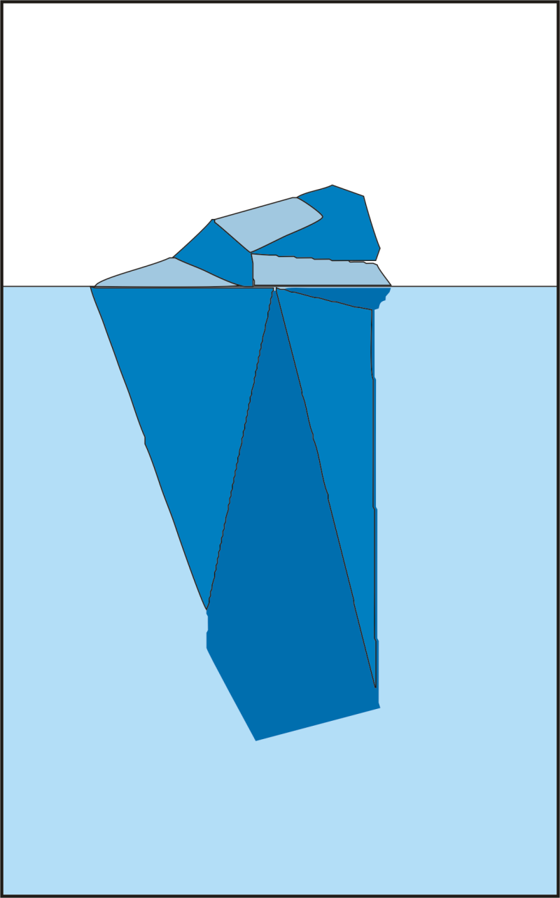
ACCIDENTS COST - ICEBERG
Cost to Company – Insured Cost
Insured Cost
Covering Injury
ILL Health
Damage
Cost to Company – Uninsured Cost
Wages for injured worker over period
Loss of production/remedial work required
Over time wages to cover lost production
Wages for replacement worker
Loss of time of Manager/MD
Legal expenses
Uninsured Cost
Fines and Court costs
Source: HSC UK
Insurance premiums

Slide 11
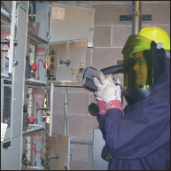
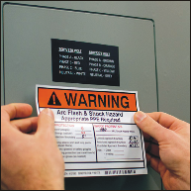
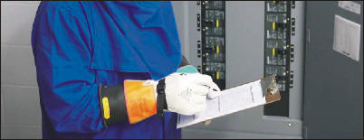
WHAT SHOULD YOU DO TO PROTECT YOURSELF?
Anywhere that you have identified an Arc Flash Hazard potential, you need to have an Arc Flash Hazard analysis done. The panel, transformer or switchboard should be labeled according to the arc flash level.
Establish appropriate safety rules to protect anyone who is working in the hazard zone.
Arc Flash Hazard Analysis and Labeling

Slide 12

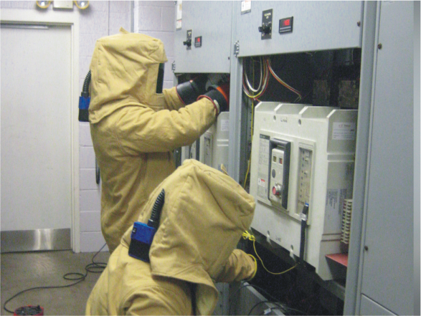
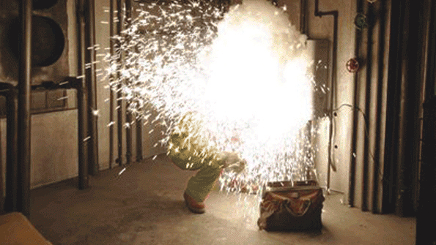
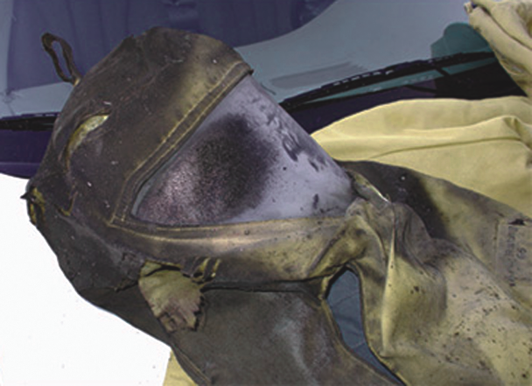
WHAT SHOULD YOU DO TO PROTECT YOURSELF?
Based on known electrical parameters and work practices, Arc Exposure Intensity can be estimated for the hazard appropriate protective clothing selections can be made to minimize worker burn injury levels in the event of an electric arc accident.
ALWAYS wear the appropriate Arc Flash PPE for the level of arc flash present. Current NFPA70E OR EN 61482-1-1 standards for Arc Flash Protection should be followed.
Hearing
Protection
Flame Resistant Hat
Arc Rated Face Shield
Arc Rated Balaclava
Insulated & Leather
Protector Gloves
Arc Flash Coverall
Electric Shock
Resistant (ESR)
Leather Safety Shoes
Text source: National Safety Council

Slide 13
A facility must provide, and be able to demonstrate a safety program with:
Calculations for the degree of arc flash hazard.
Correct personal protective equipment (PPE) for workers.
Training for workers on the hazards of arc flash.
Appropriate tools for safe working.
Warning labels on equipment.
Definitions:
ARC RATING – The maximum incident energy resistance demonstrated by a material PRIOR TO BREAK OPEN OR AT THE ONSET OF A SECOND DEGREE BURN. A 1st Degree Burn or less is the goal during an electrical arc flash.
HRC – Hazard Risk Category. Current categories that apply to workers are Level 0-4. Remember 4, 8, 25, 40 Cal / cm
CALORIE/CM² – This is a measurement of ENERGY. A Cigarette lighter placed under your finger for 1 second equals roughly a 1 calorie burn.
2

Slide 14
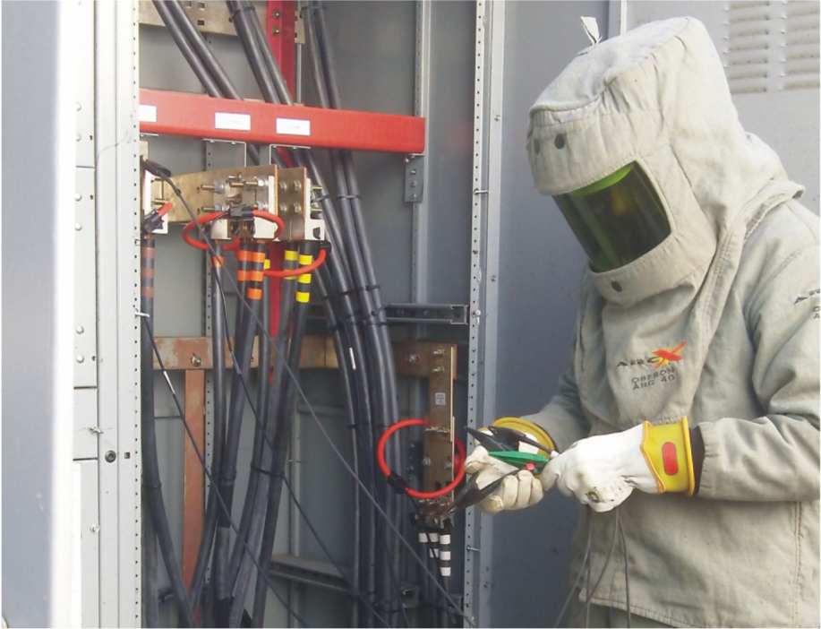
WORKING ON ENERGIZED EQUIPMENT PROCEDURES
Every effort shall be made to ensure live parts are de-energized before beginning work. Working on or near live parts shall be a last resort in the workplace, after all other opportunities for establishing an electrically safe condition have been exhausted. The overall goal is to work on everything de-energized. If this is not possible, a live work permit shall be filled out and an approved in order to work on the system live (exemptions, testing, diagnostic testing, and voltage measuring).
No work above a Category 2 shall ever be performed on live equipment by any trade with the exception of the Electricians. NFPA Table 130.7(C)(15)(a) and (b) contains details for these tasks.

Slide 15
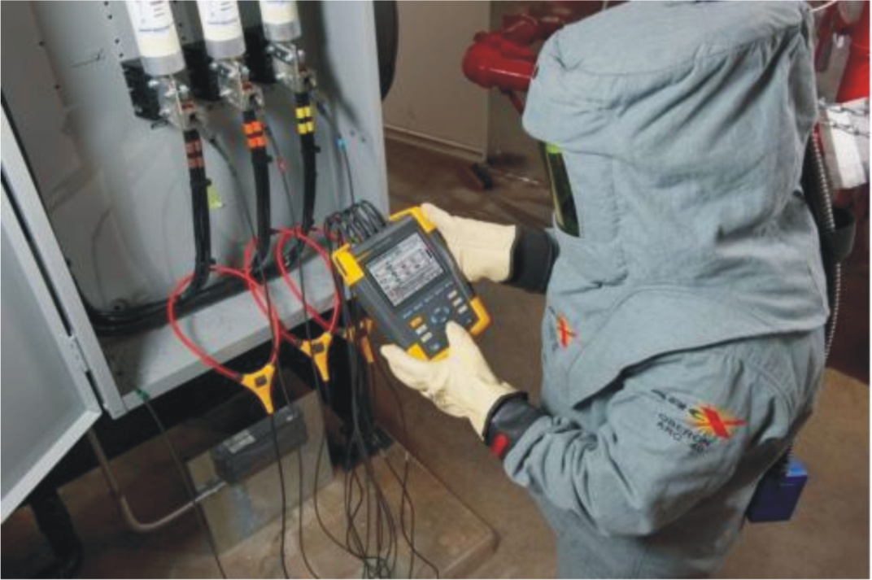
Electrical equipment is considered energized until:
It has been isolated from all sources of supply by opening the properly rated disconnect switches, circuit breakers, cutouts, or contactors.
A properly rated and operable sensing device has been brought into close proximity to, or touched to, a bare component to confirm that it is de-energized; and a properly rated temporary ground connection has been applied OR the company lockout tagout policy has been complied with.

Slide 16
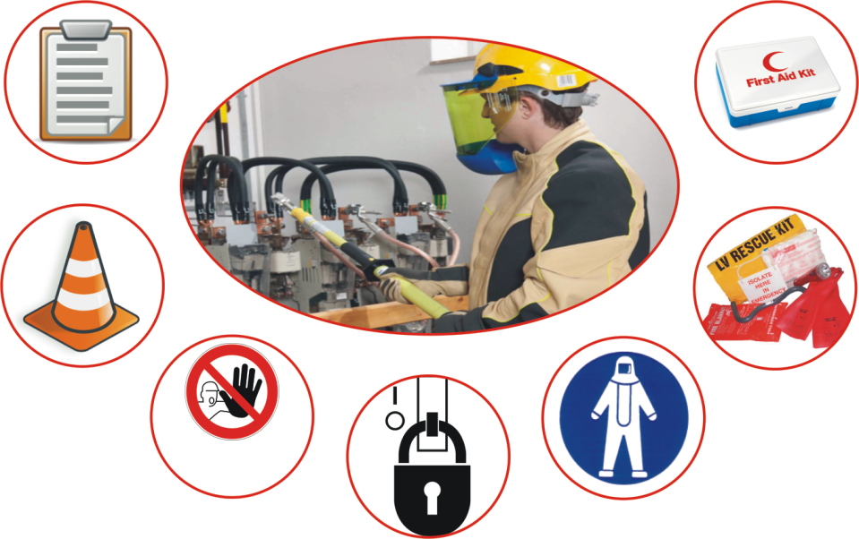
ENERGIZED ELECTRICAL WORK PERMIT
Any work on energized equipment, other than testing and troubleshooting shall have an Energized Work Permit.
All work on or near energized conductors requires a permit. The Energized Electrical Work Permit form will be signed and approved by the Job Supervisor after the task and procedure is discussed with the worker.
If the exposed live parts are not de-energized (i.e., for reasons of increased or additional hazards or infeasibility), other safety-related work practices shall be used to protect employees who may be exposed to the electrical hazards involved. Such work practices shall protect employees against contact with energized circuit parts directly with any part of their body or indirectly through some other conductive object.
The work practices that are used shall be suitable for the conditions under which the
Work is to be performed and for the voltage level of the exposed electric conductors or circuit parts. NFPA 70E regulations OR safety procedures and policies defined by your organization or country should be followed.
Guidelines should be established by which the hazard classification of electrical energized work may be determined and Approach Boundaries around the energized electrical equipment defined.
PTW
FIRST-AID
BARRICADE
RESCUE
DO NOT
ENTER
SIGNAGE
PPE
LO/TO

Slide 17
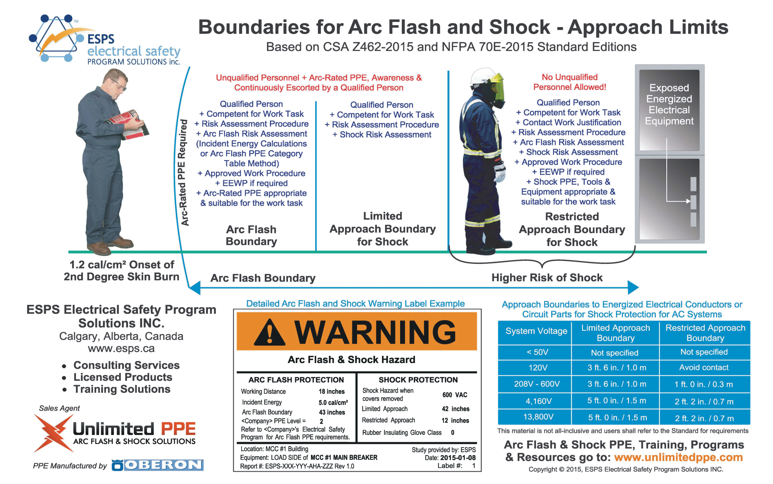

Slide 18
ENERGIZED ELECTRICAL WORK PERMIT...(contd.)
It is based on the Occupational Safety and Health Act (OSHA) Regulation for Industrial Establishments, Federal Register 29 CFR Part 1910 Subpart S; the National Electrical Code (NEC), ANSI/NFPA 70, Electrical Equipment Maintenance, ANSI/NFPA 70E; Electrical Safety Requirements for Employee.
Any person within the hazard label noted arc flash boundary and exposed to potentially energized components shall be qualified. An unqualified person is prohibited within this boundary.
Electrical panels may only be opened by qualified personnel. This includes, but is not limited to, control panels, local disconnects, MCC buckets, and junction boxes.
Electrical panels shall be kept closed unless a qualified person is within reasonable working distance of the panel. Should the panel door need to be left open and unattended, a yellow caution tape barrier or chain barricade shall be erected with a ten foot minimum radius. The barrier shall be tagged with the name, department, and extension of the person responsible for erecting the barrier. The date erected and the date to be removed shall also be included on the tag.

Slide 19
ENERGIZED ELECTRICAL WORK PERMIT...(contd.)
The hazard label noted arc flash boundary shall be enforced by electrically qualified personnel when executing the energized work. If the nature of the work is such that the individual cannot reasonably enforce the barrier boundary, a caution tape barricade or chain barrier shall be erected or a stand-by watch person shall be employed.
All exposed conductors are to be considered energized until de-energized, isolated, and verified. Qualified personnel shall be aware of remotely powered circuits.
All electrical field equipment shall be identified with its line source of power disconnect location. This includes MCC's, panel-boards, remote mounted transformers, and power distribution panels.
Appropriate PPE shall be worn, when working on energized or potentially energized electrical equipment.
Qualified employees shall determine when it is necessary to test or troubleshoot equipment without the application of an energized electrical work permit.
No person shall attempt to use any type of test equipment unless they are trained, qualified, and deemed competent, on the proper use and limitations of the equipment.

Slide 20
ENERGIZED ELECTRICAL WORK PERMIT...(contd.)
Test equipment, instruments, and their accessories shall be rated for the circuits to which they will be connected and shall be designed for the environment in which they will be used.
When servicing electrical storage batteries, all employees shall wear protective clothing to guard against chemical splashes and burns rubber boots, a rubber apron, chemical goggles, a face shield and rubber gloves in addition to any required PPE related to Arc Flash.
Electrical box and cabinet covers must be replaced when work is completed or when it is to be left for a long period of time. The established Arc Flash boundary notification materials must remain while covers are off at all times.
Any permit required electrical work on or near exposed live parts shall only be completed if all the following requirements are met. Additional requirements may also apply:
The need for energized electrical work shall be clearly communicated to the appropriate supervisor for approval.

Slide 21
ENERGIZED ELECTRICAL WORK PERMIT...(contd.)
  All training requirements for a Qualified Person have been met.
  Written approval on a job briefing work plan has been approved and documented.
  Appropriate PPE is available based on the arc flash hazard label.
  At least one additional qualified person is present.
  Control of Hazardous Energy Sources (Lockout/Tagout) and Electrical Safe Work Practices.
  Test equipment is ready.
  Hazard boundaries are identified and established.
  The area is dry and well lighted to 5 ft/cd minimum.
  Applicable electrical diagrams have been reviewed and the job briefing checklist has been reviewed, approved, and documented.
Qualified Employee Duties/Functions:
The following duties/functions may only be performed by Qualified Employee:
  Operate any circuit switching device 120 to 480 volts and above.
  Test or troubleshoot electrical equipment.
  Repair or alter electrical equipment.
  Testing, removal or installing fuses.
  Perform work on non-insulated energized circuits and apparatus over 50 volts.

Slide 22
ENERGIZED ELECTRICAL WORK PERMIT...(contd.)
Perform work within 10 feet of non-insulated energized circuits and apparatus that are not barricaded or covered or otherwise guarded to prevent electrical shock hazards and contact by tools, equipment, or personnel.
Only qualified employees may enter energized electrical substations and motor control centers. Unauthorized employees shall not be approved to enter these listed areas.
Alerting Techniques
The following alerting techniques shall be used to warn and protect employees from arc flash hazards, which could cause injury due to electric shock, non contact electric arc burns, or failure of electric equipment parts:
Safety signs and tags: Safety signs, safety symbols, or accident prevention tags shall be used where necessary to warn employees about arc flash hazards which may endanger them, as required by NFPA 70-E.
Barricades: Barricades shall be used in conjunction with safety signs where it is necessary to prevent or limit employee access to work areas exposing employees to the flash protection boundary from arc flash hazards. Conductive barricades may not be used where they might cause an electrical contact hazard.

Slide 23
ENERGIZED ELECTRICAL WORK PERMIT...(contd.)
Attendants: If signs and barricades do not provide sufficient warning and protection from electrical hazards, an attendant shall be stationed to warn and protect employees from entering the flash boundary area.
Live/Dead/Live Testing Procedure
All testing equipment shall be tested as follows:
(Live-Dead-Live)
  Test the equipment on a known appropriate voltage source to assure the testing equipment is operating properly.
  Test the field device or equipment for required for voltage energized or de-energized.
  Retest the testing equipment on the same known appropriate voltage to assure the meter is still operating. This procedure is to be used for all voltages over 50 volts each time a voltage testing is required.
  Work on energized or potentially energized electrical equipment 480 volts or above shall not be done unless the following conditions are met:

Slide 24
ENERGIZED ELECTRICAL WORK PERMIT...(contd.)
All work shall be performed in accordance with the provisions stated in the procedures and in compliance with all other applicable safety requirements.
A designated Electrical Standby Person shall be present and equipped with a level of protection equal to that of the qualified employee performing the work. Electrical Standby Persons shall be trained in energized electrical procedures and how to contact emergency rescue for electrical shock victims. They shall standby outside of the designated Arc Flash Boundary and only enter in the event of an event which would require assistance for the qualified worker. They shall, at a minimum, wear high voltage protective gloves and remain at the site of the work at all times while the work is in progress.
The supervisor of the Qualified employee performing the work shall be notified that such work shall be done, the exact location of the work, and when the work will begin. Once the work is complete, the supervisor shall also be notified.

Slide 25
Procedures for Diagnostic Testing of Energized Equipment.
Qualified employees shall determine when it is necessary to test, position, or troubleshoot equipment without safeguards being in place.
Only qualified employees may perform tests on energized or potentially energized electrical circuits or equipment 50 volts and above.
Diagnostic testing on live, energized parts is allowed, however if a problem is discovered during diagnostic testing and a component be removed or rework shall be performed, this is no longer diagnostic testing. At this time, the circuit shall be de-energized and lock/tagged out.
Test instruments, equipment rated for the proper voltage, and all associated test leads, cables, power cords, probes, and connectors shall be visually inspected for external defects an damage before the equipment is used. If there is a defect or evidence of damage that could expose someone to injury, the defective or damaged item shall be properly tagged out and removed from service. It may not be used again until repairs and tests to assure the equipment is safe to use have been made. When performing tests, these requirements shall be followed.
The test equipment shall be evaluated for proper operation immediately before and after the test.
Source: University of Toledo, Procedure No. S-08-014 Control of Hazardous Energy sources

Slide 26
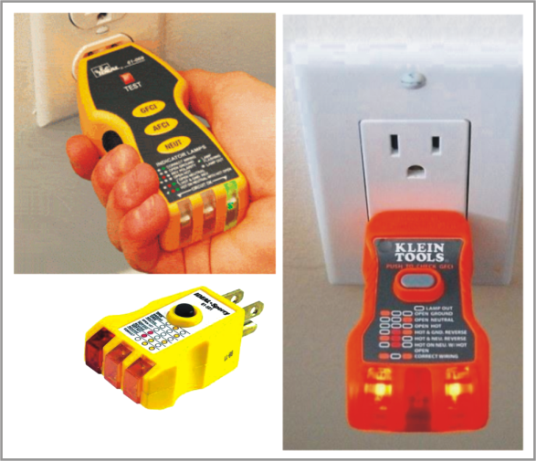
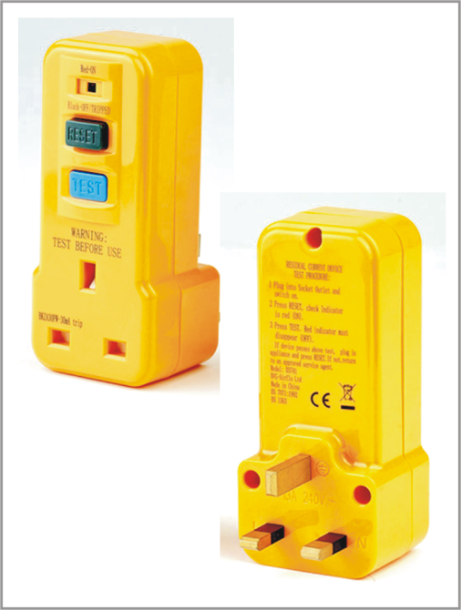
Use of Ground Fault Circuit Interrupters / RCD’s
Employees shall use Ground Fault Circuit Interrupter (GFCI) /Residual Current Devices (RCD’s) to protect against electrical hazards.
Requirements for and use of GFCI / RCD devices.
  GFCI / RCD devices should be handled carefully to avoid damage.
  A GFCI / RCD device should be located at the end of in- use extension cords and the load should be plugged directly into the GFCI / RCD.
  The GFCI / RCD should be tested before the first use each shift.
  Defective GFCI’s / RCD’s should not be used.
GFCI
RCD

Slide 27
PRE-JOB BRIEFING CHECKLIST
Identify
The hazards
The voltage levels involved
Skills required
Any secondary voltage source
Any unusual work conditions
Number of people needed to do the job
The shock protection boundaries
The available incident energy
Potential for arc flash (conduct a flash
hazard analysis?)
Flash protection boundary
ASK
Can equipment be de-energized?
Are backfeeds on circuits possible?
Is a “Stand-by person” required?
Check
Job Plans
Single-line diagrams and vendor prints
Status board
Information on plant and vendor
resources
Safety procedures
Vendor info
Individuals are familiar with the
facility
Know
What the job is
Who else needs to Know - Communicate
Who is in charge
Think
About the unexpected event
Lock – Tag – Try – Test
Test for voltage before touch
Use the right tools and equipment/PPE
Install and remove grounds
Install barriers and barricades
What else….?
What if……?
Prepare for an emergency
Are individuals CPR/First Aid trained?
Emergency equipment provided
and available?
Where is the nearest telephone?
Where is the fire alarm?
Is rescue equipment available?
What is work location?
Emergency shut-off for equipment?
Emergency telephone numbers
known or posted?
Where is fire extinguisher?
Are radio communications available?

Slide 28
ELECTRICIANS SAFETY CHECK LIST
DATE:____________________________________ TIME:_________________________________________
EMPLOYEE:______________________________________________________________________________
DESCRIPTION OF JOB:______________________________________________________________________
WORK LOCATION:_________________________________________________________________________
WORK ORDER OR LOG NUMBER:_____________________________________________________________
DATE & TIME SUPERVISOR VISITED JOB SITE FOR SAFETY CHECKS:___________________________________
YES | NO | ITEM TO CONSIDER | PERSONAL PROTECTIVE EQUIPMENT REQUIREMENTS
 |  | I have reviewed this job assignment with my supervisor and have been made aware of possible safety issues and proper procedures to follow. Do I know and understand the proper procedures to do the job? Do I have the right PPE and tools for the job I’ve been assigned? Have I informed the affected personnel that I will be de-energizing the panel, circuit, and/or equipment and have I relayed the approximate time of the outage? Is my work environment well list? Is my work are free of water, tripping hazards or any other hazards? If I have indentified any safety hazards, have I contacted my supervisor and/or other responsible parties to order to remedy the situation? If using extension cords or power tools, are the cords free from damage (cracked, cut, or taped)? Do I feel that I can do the job safely? Have I communicated this with my supervisor? Will I be alert and not rush the job by reaching blindly into areas containing live parts? What is the operating voltage? Are there internal safety mechanisms? After turning disconnecting means to the “OFF” position, have I checked to see if the conductors are de-energized using the appropriate tester? During trouble-shooting, if testing equipment in an energized state, have I used the proper PPE equipment and tools for the job? | Lockout/Tag Out Ground fault protection 500 V insulated gloves 5 KV gloves 15 KV gloves Protective sleeves Electrical hard hat Insulator boots Insulator mat Insulator blanket 1000V rated tools Insulator Coat Safety harness and tripod Force air machine Respirator Eye or face protection Long sleeved shirt Ear protection Caution tape or barriers Hot stick Other _____________________________
Print Name : _________________________________________________________ Print Name : ________________________________________________________
(Employee) (Supervisor)
Employee Signature : __________________________________________________ Supervisor Signature : ________________________________________________

Slide 29
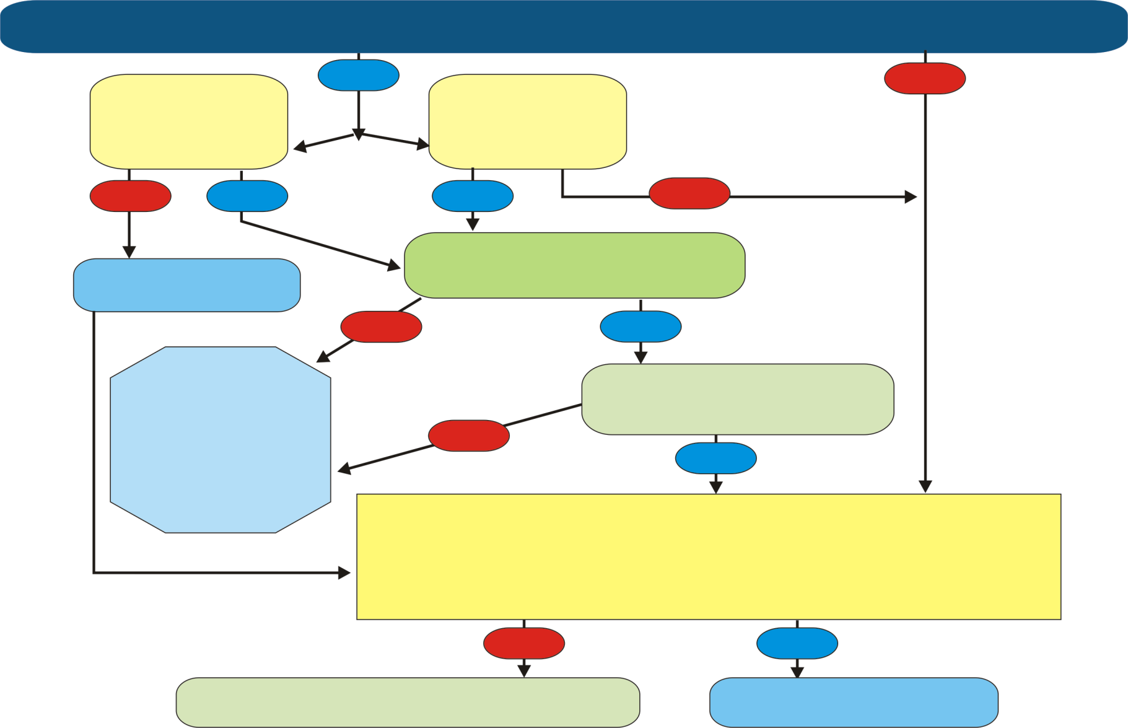
ELECTRICIANS SAFETY FLOW CHART
Does the task involve exposure to energized components with voltage greater than 50 volts?
Would there be
an increased
hazard if Circuit
is de-energized?
YES
Does the task
involve working
on an electrical
circuit?
NO
NO
YES
YES
NO
De-energize
the circuit
Are two or more people
working together as a team
NO
YES
STOP DO NOT
CONTINUE WORK.
CONSULT WITH
ELECTRICAL
SUPERVISOR
Has the authorization of
electrical supervisor been
obtained
NO
YES
1. Has proper illumination been verified?
2. Do you have the required personal protective equipment to complete the
job safely?
3. Is the job site clear from all safety hazards?
(tripping, wet conditions, are approach distances confirmed?)
4. Has the electrical safety procedure check list been filled out?
NO
YES
STOP- DO NOT CONTINUE WORK.
CONSULT WITH ELECTRICAL SUPERVISOR
PROCEED WITH
AUTHORIZED WORK.
A qualified employee is a person who possesses a recognized degree, certification, or professional standing, or who by expertise, knowledge, training, and experience has successfully demonstrated their ability to resolve problems relating to the work, subject matter, or the project.
ANYONE FAILING TO FOLLOW THESE STEPS SHALL BE SUBJECT TO SEVERE DISCIPLINARY ACTION UP TO TERMINATION.
Source: Kent State University, Control of Hazardous Energy, Revised April 2006

Slide 30

NFPA 70E(2012) MINIMUM CLOTHING REQUIREMENTS
Arc-Rated Clothing, Minimum Arc Rating of 4 cal/cm2
Arc-rated long-sleeve shirt and pants or arc rated coverall
Arc-rated face shield or arc flash suit hood
Arc-rated jacket, parka, rainwear, or hard hat liner
Hard hat
Safety glasses or safety goggles
Hearing protection (ear canal inserts)
Heavy duty leather gloves and Electrical Shock Resistant Footwear
HAZARD/RISK
CATEGORY - 1
4cal
Arc-Rated Clothing, Minimum Arc Rating of 8 cal/cm2
Arc-rated long-sleeve shirt and pants or arc rated coverall
Arc-rated flash suit hood or arc-rated face shield and arc rated balaclava
Arc-rated jacket, parka, rainwear, or hard hat liner
Hard hat
Safety glasses or safety goggles
Hearing protection (ear canal inserts)
Heavy duty leather gloves and Electrical Shock Resistant Footwear
HAZARD/RISK
CATEGORY - 2
8cal

Slide 31


Arc-Rated Clothing selected so that the System Arc Rating meets the
Required Minimum Arc Rating of 25 cal/cm2
Arc-rated long-sleeve shirt (AR) and arc rated pants
Arc-rated coverall (AR) and arc-rated flash suit jacket
Arc-rated arc flash suit pants (AR) and arc-rated arc flash suit hood
Arc-rated gloves, arc-rated jacket, parka, rainwear, or hard hat liner
Hard hat, Safety glasses or safety goggles
Hearing protection (ear canal inserts)
Electrical Shock Resistant Footwear
HAZARD/RISK
CATEGORY - 3
25cal
Arc-Rated Clothing selected so that the System Arc Rating meets the
Required Minimum Arc Rating of 40 cal/cm2
Arc-rated long-sleeve shirt (AR) and arc rated pants
Arc-rated coverall (AR) and arc-rated flash suit jacket
Arc-rated arc flash suit pants (AR) and arc-rated arc flash suit hood
Arc-rated gloves, arc-rated jacket, parka, rainwear, or hard hat liner
Hard hat, Safety glasses or safety goggles
Hearing protection (ear canal inserts)
Electrical Shock Resistant Footwear
HAZARD/RISK
CATEGORY - 4
40cal

Slide 32
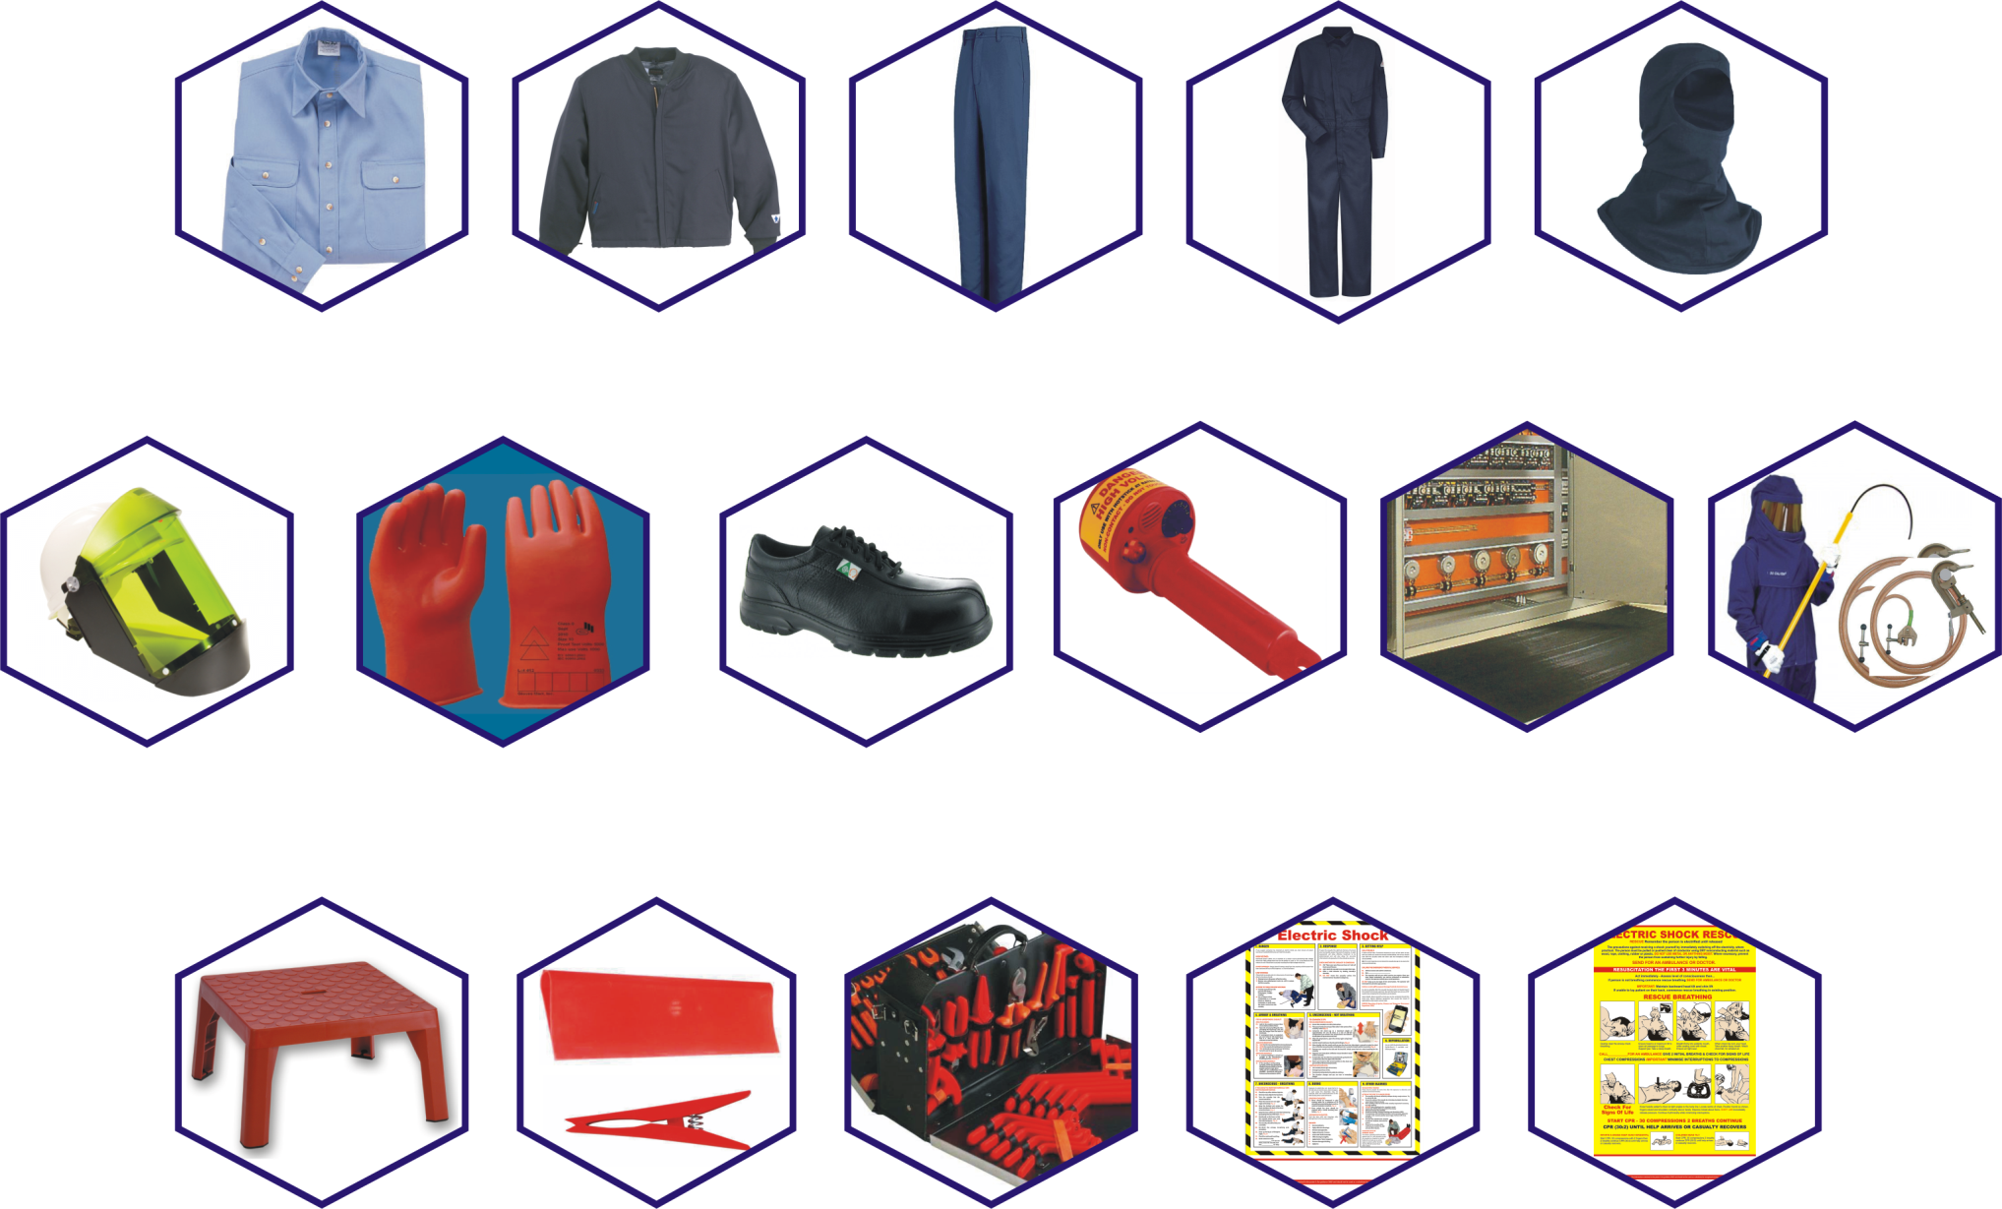
ARC FLASH PROTECTION PPE & ACCESSORIES
Arc Rated Shirt
Arc Rated Jacket
Arc Rated Pant
Arc Rated Coverall
Arc Rated Balaclava
Arc Rated Helmet
& Visor
Insulated Linemen's
Gloves
Di-Electric Safety Shoes
ESR 18000V
Contact & Non-contact
Voltage Detectors
Switchboard Matting
Class 2 & 4
40-100cal/cm2 PPE kits,
Rescue Sticks &
Earthing equipment
Insulated Platforms
Insulated Blanket
& Clamps
Insulated Tools 1000V
Electric Shock Rescue
Posters

Slide 33
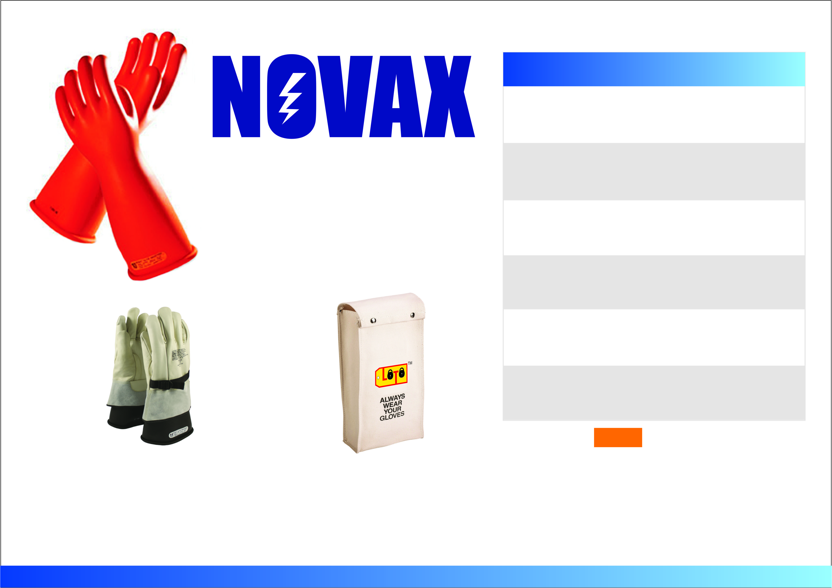
Description Length : mm inch Sizes
NOVAX CLASS 00
2,500 Volt Tested 280 11 9-10-11
500 Volt Working
ELECTRICAL SAFETY
NOVAX CLASS 0
5,00 Volt Tested 360 14 9-10
1000 Volt Working
Rubber Insulating Gloves
Beaded Cuff
NOVAX CLASS 1
10,00 Volt Tested 360 14 9-10
7,500 Volt Working
NOVAX CLASS 2
20,00 Volt Tested 360 14 9-10
17,000 Volt Working
NOVAX CLASS 3
30,00 Volt Tested 410 16 9-10
26,500 Volt Working 460 18 9-10
NOVAX CLASS 2
40,00 Volt Tested 460 18 9-10
36,000 Volt Working
Colour Available:
Orange
Leather Protector
Gloves
Glove Carry Bag
The contoured shape & softness reduces hand fatigue.
Every single NOVAX Glove is tested, inspected and packed according to the requirements in ASTM D120 and EN 60903.
The gloves are numbered individually for traceability and stamped with the factory manufacturing date by ink stamp.

Slide 34

ARC FLASH PPE
Featuring Oberon’s InovexFR Inherently Flame Resistant Arc Fabric
Ideal for user who will be wearing the garment frequently since it is incredibly light weight & launderable!!
Premium ARC Series Design including zipper closure on coat.
Polycarbonate Hood Window with Excellent VLT (Visible Light Transmission).
Window features Scratch Resistant outside / Antifog inside
Arc Flash Face Shield
HRC2+ 12+cal/cm2
ARC SUPPRESSION BLANKETS - 40KA
40kA Blanket tested to ASTM F2676.
Blanket standard (BTP Rating: 468).
For use in tight spaces such as underground vaults, creating a barrier between yourself and an arc flash hazard which may occur adjacent to your work.
Anchor the blanket to walls or ceilings and floors.
Blanket includes attached straps to tie down blanket and corner straps for handling.
All blankets come standard with storage bag.
Meets NFPA 70E, CSA Z462, ASTM F2676.
FRESH AIR
Hood
Ventilation
System
Arc Flash Thermographer Gloves are NOT a substitution for Rubber
Insulating Gloves or Leather Protector Gloves.
They DO NOT provide insulation from electric shock!!
Inherently Flame Resistant fabrics mean lighter weight
Model: ARCBKT-40KA-S, Size: 4’x5’
Model: ARCBKT-40KA-L, Size: 4’x8’

Slide 35

THE WORLD’S #1 FR BRAND.
WITHOUT QUESTION.
WITHOUT COMPROMISE.
FORMAL
POLO
BASE LAYER
SHIRTS, TEES
&
BASE LAYERS
SLU8LB
SMP2KH
MPU8GY
JACKETS
JEW2NV
JMJ4HV
JLB8BD
We are a people of No Compromise. We have no other choice. Because at the end of the day, real lives are on the line. And it's our pledge to do all we can to protect them. No Compromise. The result? A relentless drive to design, develop and distribute the best, most forward-thinking FR garments the world has ever seen.
Industry's Largest Inventory
As the world's largest manufacturer of flame-resistant apparel, Bulwark offers the industry's widest, deepest selection of fabrics, styles and colors. So regardless of their shape or size, every member of the crew is covered.
TROUSERS
COVERALLS
CARGO
FORMAL
JEANS
Total Traceability
Bulwark tracks every stitch of every garment across 60 manufacturing touch points. From this obsessive devotion to information management comes total visibility of the entire supply chain. And an assurance that what bears our patch makes good on its pledge. From fiber to factory.
CAD6OR
CED2NV
NORDIC STRIPE
CED2NV
D35 STRIPE
PMU2NV
PEW2NV
PEJMSD
CLD4NV
CLD6GY
CLD6RD

Slide 36

AWARD-WINNING FR TECHNOLOGY
Launched in May 2010, TECGEN® SELECT Flame Resistant Garments introduced light weight, breathability, and moisture-wicking capabilities to the US market. The fabric utilizes the patented TECGEN® fiber, which has exceptional flame resistance and thermal protection.
When woven with other inherently FR fibers, TECGEN® fiber provides advanced levels of safety and comfort.
LIGHTWEIGHT
Gents Shirt
Flame-resistant clothing has long been considered heavy to wear which can leave the wearer uncomfortable and vulnerable to heat-related illness.
TECGEN® SELECT fabric, at 5.5 ounces per square yard, is an ideal solution to this problem.
TECGEN® SELECT fabric is over 20% lighter weight without sacrificing protection, compared to other HRC2 FR fabric.
TECGEN® FIBER HELPS PROTECT YOU FROM RADIANT HEAT AND HEAT EXHAUSTION.
Ladies Shirt
Released Heat
Evaporative cooling
TECGEN fabric
Retained Heat
Body Heat
Gents Coverall
Gents Formal Trouser
Gents Denim Jeans

Slide 37

STAND-UP COLLAR:
Offers extra protection
And lined with soft,
Antimicrobial FR lining to wick moisture and prevent neck irritation.
AMERICAN MADE
MADE YOUR WAY
HEAVY DUTY
SUSPENDER SYSTEM:
Quick release for easy on/of.
REVOLITE HOOD
ArcGuard® RevoLiteTM is remarkably light weight and equally durable. Designed to be worn over daily wear and provides superior protection for Hazard Risk Category (HRC) 4.
Anti-fog faceshield
Visual light transmittance up to 50%,
for improved visibility
Faceshield is removable & replaceable
Optional CrossVent™ fan system available
Hood can be laundered
Faceshield Complies With: ANSI Z87.1-2003
ADJUSTABLE
DRAWSTRING:
With cord locks,
Provide a custom ft.
FEATURES:
Lightweight multi-layer tri-blend
Arc Rating = 40 cal / cm2, HRC 4
Inherently Flame Resistant (FR)
Designed with enhanced features
COMPLIES WITH:
FR KNIT WEISTS:
Provides a secure ft
Around the wrists.
50% lighter
than cotton
based systems
NFPA 70e – 2009
ASTM 1506 – 10a
OSHA 29 CFR 1910.269
REVOLITE SUIT
EXPERIENCE THE
REVOLITE DIFFERENCE:
Designed with FR hook & loop closures
FR knit wrists
Heavy duty suspender system
Enhanced Features Include:
Stand-up collar
Adjustable drawstring
State-of-the-Art fabric technology that is extremely
lightweight, combining the very best in both comfort
and protection.

Slide 38

Choose
Why
Mellow Walk?
Grade 1* toe and plate protection with Electric Shock Resistant (ESR) sole designed to witjstand 18,000 volts
GIVE YOUR
TIRED, SORE
FEET THE
BOOT!
Men’s Comfort Lace-Up
Men’s Dress Slip-On
Men’s Ankle Boot
Right out of the box.
Customers will often say that Mellow Walk safety shoes are more comfortable than their street shoes. It’s all part of our commitment to ensuring that every pair of Mellow Walk safety shoes fits right out of the box.
Wear them on the Weekend.
When a safety shoe doesn’t look or fit like an ordinary safety shoe it opens a world of possibilities. Mellow Walk’s comfort look means that customers can wear them outside of work.
Made in Canada.
Mellow Walk manufactures in Canada because we believe the care we take creates better fitting safety shoes.
Yes, that’s real leather.
At Mellow Walk we don’t believe in pulling the “leather” over the customers’ eyes. All of our shoes are made with natural, breathable quality cow leather and durable moisture wicking lining.
0 break-in
Out of the box comfort.
Men’s Dress Brogue
Men’s Metal-Free Slip-On
Women’s Slip-On
Grade 1 toe protection 125 joules with Static Dissipative (ESD) sole.
2. Form + Fit.
Comfort Ortho shoe lasts engineered to support all-day wear.
Men’s Ankle Boot
Men’s Casual Lace-Up
Women’s Sneaker
3. Triple Cushioning.
Integrated 3 year comfort
built in to every shoe.
Women’s Slip-On
Men’s Slip-On

Slide 39

Rubber Blankets & Clamps
Residual Current Device
Pneumatic Glove Tester
ELECTRICAL SAFETY
EQUIPMENT & ACCESSORIES
Live line working requires certified equipment robust enough to handle regular use whilst maintaining integrity & accuracy.
Equipment and accessories are certified and traceable to latest EN & ASTM standards.
Our offering includes Contact Voltage Detectors in several ranges from 3 - 420KV as well as Non Contact detectors, Insulating sticks, Earthing & Short Circuiting equipment manufactured and certified by leading international agencies.
Class ‘0’
1000V
STATIC
DISCHARGE
STICK WITH
GROUNDING
CLAMP
TELESCOPIC
SWITCH
DISCONNECT
INSULATED
STICK
CEI IEC 61243-1 Ed.2 2003-10
EARTHING &
SHORT CIRCUITING
KITS
CONTACT VOLTAGE DETECTORS
with audible & visual alarm
VOLTAGE RATING
GROUNDING CLAMPS
3 - 9KV
4 - 40KV
40 - 70KV
60 - 120KV
150 - 420KV
NON CONTACT VOLTAGE DETECTOR
with audible & visual alarm
VOLTAGE RATING
240V - 275KV
(8 different settings)
Voltage ratings can be
customized.
INSULATING ROD
40 - 120KV WITH
UNIVERSAL ADAPTOR

Slide 40

P R O T E C T Y O U R F E E T
Ideal for visitors & dignitaries
Z334 Steel Toe Overshoes by Steel-Flex®
Steel-Flex® Overshoes provide excellent temporary toe protection at an affordable price.
CSA Z334 Certified and CE Approved
Steel-Flex® Z334 Steel Toe Overshoes offer a time-tested and proven safety toe solution, where there is risk of accidental toe damage or where a steel toe cap is required.
Fully waterproof and crack resistant, each overshoe is manufactured from oil, acid and chemical resistant TPR material designed to be the perfect combination of stretch, slip resistance and durability
Length | Width at Toe | Depth at Toe | Width at Toe | Size
10-1/4” 10-3/4” 11-1/2” 11-7/8” 12-3/4” 13” 14” | 3-3/4” 3-3/4” 3-3/4” 4-1/4” 4-1/4” 4-1/2” 4-1/2” | 2-1/4” 2-1/4” 2-1/4” 2-1/2” 2-1/2” 2-3/4” 2-3/4” | 3-1/4” 3-1/4” 3-1/4” 3-5/8” 3-5/8” 4” 4” | X-Small Small Medium Large X-Large XX-Large XXX-Large

Slide 41








Electric Shock Rescue
Defibrillator
Wall Mounted
Rescue Kit
First Aid Kit
Portable Rescue Kit
Insulated Platform
In the event of unfortunate contact with a hot line, adequate safety measures should be in place to rescue personnel and administer first aid quickly.
It is the responsibility of each facility to ensure proper rescue equipment and first aid is available on site to prevent grievous injury or possible fatalities in the workplace.
LOTO Safety can help create a safer work place by providing tailor made solutions for each facility for Rescue equipment and First Aid designed specifically to treat electrical burn injuries.
First Aid Poster

Slide 42



LOTO Safety helps promote a safer work environment and is committed to providing durable tags and signs meeting industry standards.
We offer a wide selection of industrial tags and signs customized with logos, graphics and single or dual language text to convey job-specific information and identification.
Materials we work with include PVC, Polyethylene, Polypropylene, Traffolyte, Stainless Steel, Aluminium and Brass.
Our creative solutions are available in screen, digital and offset printing with UV cured inks and matt lamination to withstand harsh weather conditions and high ambient temperatures.
CUSTOM
TAGS & SIGNS

Slide 43




HAND TOOLS FOR LIVE WORKING
ON CABLE LINES AND CONNECTING BOXES
Certified insulated tool sets from LOTO Safety can help you work more safely. Insulated tools help protect electrical workers from accidental contact with energized circuits. These tool sets can protect against electrical shock up to 1,000 volts, in compliance with IEC, OSHA and DIN standards for insulated tools. Choose from a wide range of combinations
Insulated tool are designed for safety and are rated for live use up to 1000 VAC or 1500 VDC.

Slide 44

LOTO-MAT
ELECTRICAL INSULATION
ANTI-SKID RIBBED
SWITCHBOARD MATTING
MADE IN EU
Description L W T Color
(MM) (mm) (mm)
LOTO-MAT CLASS 0
2,500 Volt Tested
1000 Volt Working
1000
1000
1.0
Orenge
LOTO-MAT CLASS 2
20,000 Volt Tested
17,000 Volt Working
10000
1200
3.0
Gray
LOTO-MAT CLASS 4
40,000 Volt Tested
36,000 Volt Working
Gray
10000
1200
4.5

Slide 45





POSTERS
First Aid Posters
Electrical Safety
LOTO Posters
Crane Safety

Slide 46


DISCLAIMER
LOTO Safety Products DMCC, its owners and employees disclaims liability for any injury to persons or to property, or other damages of any nature whatsoever, whether special, indirect, consequential or compensatory, directly or indirectly resulting from the use of OR reliance on this information.
The information provided here is designed for educational use only and is not a substitute for specific training or experience.
LOTO Safety Products DMCC, its owners and employees also makes no guaranty or warranty as to the accuracy or completeness of any information published herein and assumes no liability for any individual's use of or reliance upon any material contained or referenced in this book.
The material contained in this book may not be the most current.
Quiz answers:
1-B, 2-D, 3-D, 4-B, 5-A, 6-B, 7-D, 8-B, 9-A, 10-A, 11-A, 12-A, 13-B, 14-A, 15-B, 16-D, 17-A, 18-A, 19-A, 20-A

