Slide 1
DC Systems, Hazards, & Standards
Lloyd B. Gordon
Los Alamos National Laboratory
LBGORDON@LANL.GOV

Slide 2
Objectives
To recognize and classify DC and Pulsed electrical hazards in R&D systems
To present current and evolving standards for DC electrical safety
To PROPOSE a hazard classification approach for all arc flash hazards
2

Slide 3
Current Standards
US standards historically ONLY cover 60 Hz ac hazards
  OSHA and NFPA 70E
IEC cover other waveforms for shock
2012 NFPA 70E begins to cover DC
  Shock boundary table, 100 V threshold
  Battery Bank DC arc flash calculations

Slide 4
DC systems
Input Power - most all R&D equipment is powered from the utility and facility power, 60 Hz, including voltage delivery systems of 120 V, 240 V, 480 V, 4160 V, 13 kV, etc.
Conversion to DC power - many types of R&D equipment require DC power, of voltages from 1 V to 1 MV, including:
  all microelectronics
  lasers, flashlamps
  x-ray sources, mass spectrometers, etc.
  accelerators, rf systems
  magnet systems, welders, furnaces, electroplating
  dielectric testing
  interface between many AC power systems
  electric transportation systems
  electric power generation and transmission
  and more
4

Slide 5
Some effects of current waveform
AC (50 or 60 Hz) causes ventricular fibrillation and clamping of the muscles at low levels compared to other waveforms
DC causes a muscle reflex at first contact and release; does NOT cause “no-let-go”; and, can cause heart paralysis at high enough levels (typically 5 times that of 60 Hz)
RF immediately passes through the skin, and can shock and burn at much lower voltages. Also, the burns are deeper, below the skin. However, rf does not cause fibrillation or no-let-go as does power frequencies
High voltage capacitor shocks usually involve high voltages causing skin breakdown. This leads to a high current shock and immediate deposition of damaging energy. This can cause immediate fibrillation and/or significant tissue damage.
5

Slide 6
Example Energies in facility system arcs
Bus voltage | Short Circuit Current | Power (peak) | Clearing Time of Fault | Energy in Arc | Typical Arc Flash Boundary
120 V | 3,000 A | 360 kW | 0.1 s | 36 kJ
240 V | 10,000 A | 2.4 MW | 0.1 s | 0.2 MJ
480 V | 15,000 A | 7.2 MW | 0.1 s | 0.7 MJ | 1 m
4160 V | 25,000 A | 104 MW | 0.1 s | 10 MJ | 2.2 m
13.8 kV | 31,000 A | 430 MW | 0.1 s | 42 MJ | 4 m
Note 1: Clearing time can be reduced by fast acting fuses
Note 2: Clearing time can be longer, if overcurrent protection fails to operate, or if it operates slowly for coordination purposes.
Notes:
6
some examples
LOTS of energy

Slide 7
Examples of Energies and Arc Flash Boundaries for various capacitors
The arc flash boundary for the ac input power must be calculated separately
Type | Voltage | Energy | Arc Flash Boundary
Cathode Ray Tube | 40,000 V | 0.1 J | 0.1 mm
High Pot Tester | 60,000 V | 0.1 J | 0.1 mm
Microwave Oven | 4,000 V | 10 J | 0.7 cm
High Power Laser | 10,000 V | 1000 J | 7 cm
X-ray Source | 100,000 V | 10 J | 0.7 cm
Energy storage Cap | 60,000 V | 200 kJ | 1 m
Capacitor Bank | 60,000 V | 1 MJ | 2 m
Note: most of these are well within the Prohibited Approach Boundary
Notes:
7
Go over each example, emphasize the very short arc flash boundaries for small equipment.
Arc flash boundaries are much smaller than shock boundaries for high voltage, R&D equipment

Slide 8
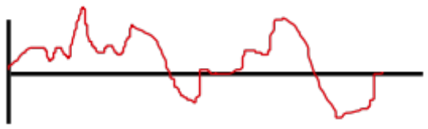
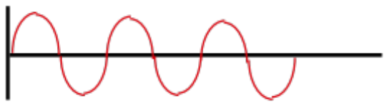
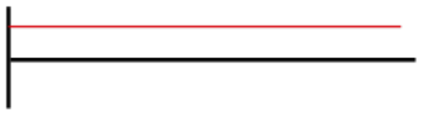
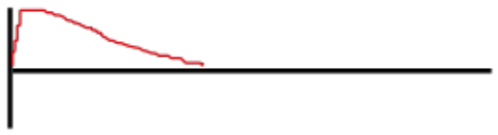
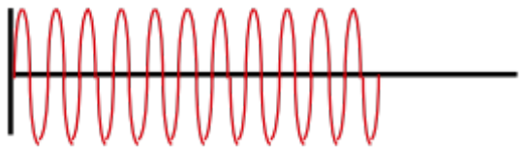
Basic Electrical Waveforms
waveform - The shape of a parameter (such as voltage or current), when displayed as a function of time
Power frequency (AC) - A periodic current or voltage, the average value of which over a period is zero. Power (50 or 60 Hz)
direct current (DC) - Usually a constant, non-time varying current or voltage. It may be positive or negative.
impulse - A pulse that begins and ends within a short time period. Although the time duration may be short, in high power impulses the current, voltage, and power can be very large.
Sub radiofrequency (subRF) - AC from 1 Hz to 3 kHz.
radiofrequency (rf) - A special term for high frequency ac (3 kHz to 300 GHz).
V or I
power
DC
impulse
sub RF
RF
time
Notes:
Go over each one, give example if you know them.

Slide 9
Electrical Hazard Classification
Class 1.x 60 Hz
Class 2.x DC
Class 3.x Capacitors
Class 4.x Battery Sources
Class 5.x RF
Class 6.x sub RF
Class 7.x Inductors
Class 8.x Solar Voltaic Arrays
9

Slide 10
Electrical Hazard Classification
Classify according to waveform and source
60 Hz
DC
capacitors
batteries
RF
3 kHz - 100 MHz
subRF
1 Hz – 3 kHz
inductors
1.x 2.x 3.x 4.x 5.x 6.x 7.x
General Categories
Notes:
10
Previously five major groups, today there are seven.
Class 2.x was split into DC and into 6.x, subRF
Class 7.x is new
All were slightly revised

Slide 11
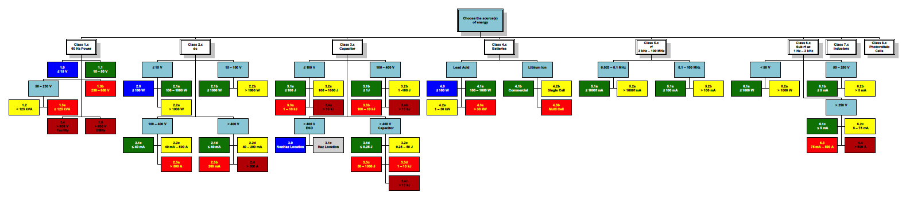
Electrical Hazard Classification Organizational Table
1.x 2.x 3.x 4.x 5.x 6.x
60 Hz DC capacitors batteries RF sub RF
hazards - covers ALL electrical hazards
Notes:
11
This is difficult to resolve, but each section is pulled out separately.
Note 7 Categories
use laser pointer here

Slide 12
Electrical Hazard Classification – shocks thresholds
1.x 2.x 3. x 4.x 5.x 6.x
60 Hz DC capacitors batteries RF sub RF
Shock hazard thresholds
50 V, 5 mA AC
100 V, 40 mA DC
400 V skin breakdown
100 mA – 200 mA RF
0.25 J capacitor, reflex
95% done
Notes:
12
This is difficult to resolve, but each section is pulled out separately.
Note 7 Categories
use laser pointer here

Slide 13
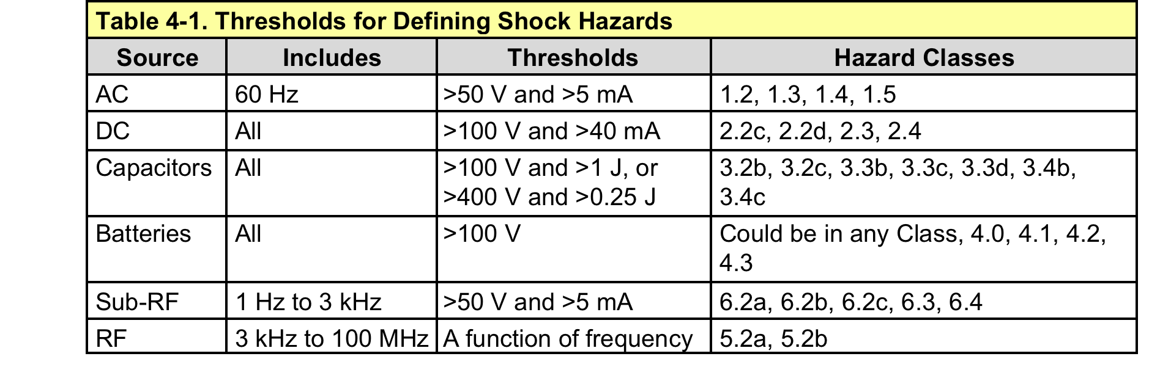
Shock Thresholds

Slide 14
Electrical Hazard Classification – thermal thresholds
1.x 2.x 3.x 4.x 5.x 6.x
60 Hz DC capacitors batteries RF sub RF
Thermal hazard thresholds
1000 W
100 J
85% done
Notes:
14
This is difficult to resolve, but each section is pulled out separately.
Note 7 Categories
use laser pointer here

Slide 15
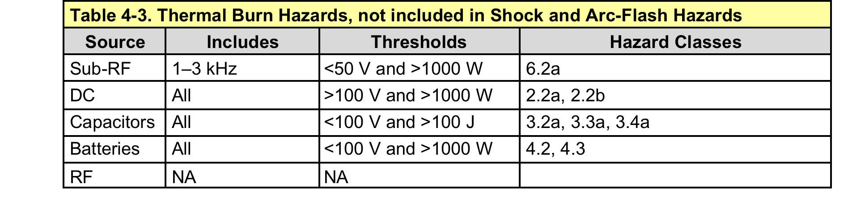
Thermal Hazard Thresholds

Slide 16
Electrical Hazard Classification – arc flash thresholds
1.x 2.x 3.x 4.x 5.x 6.x
60 Hz DC capacitors batteries RF sub RF
Arc Flash thresholds
125 kVA
DC – 100 V and 500 A
Caps – 10 kJ
subRF – 250 V and 500 A
45% done
Notes:
16
This is difficult to resolve, but each section is pulled out separately.
Note 7 Categories
use laser pointer here

Slide 17
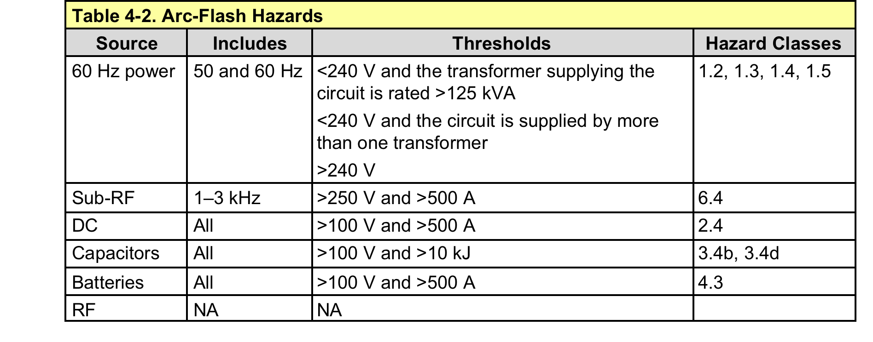
Arc Flash Thresholds

Slide 18
General Features of
Electrical Hazard Classification
X.0 = no hazard, no controls, no training (blue)
X.1 = minimum hazard, no injury, no controls, minimum training (green)
X.2 = can injure or kill, controls, some PPE (yellow)
X.3 = will injure or kill, controls, PPE (red)
X.4 = very serious, many controls, avoid work (maroon)
Notes:
18
progression from blue to maroon is increased injury and thus, increased controls.

Slide 19
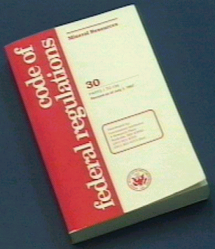
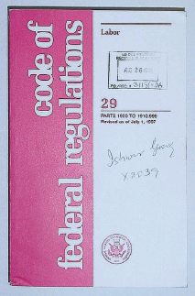
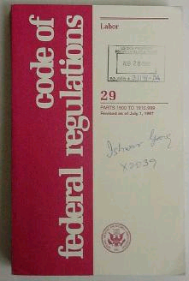
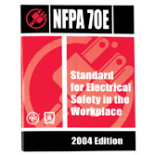
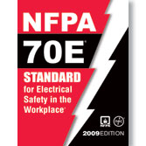
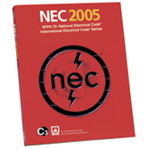
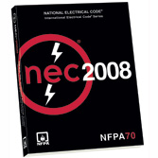
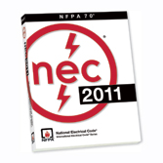
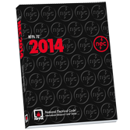
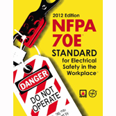
National Electrical Standards
OSHA - Code of Federal Regulations
NEC (National Electrical Code)
Standard for the safe installation of
electrical wiring & equipment
NFPA 70E, Standard for Electrical Safety in the Workplace
Notes:
19
The electrical regulations of OSHA address the employee in, around, and near his or her workplace. NFPA 70E was developed and tailored by the request of OSHA to aid OSHA with enforceable requirements that will provide electrical safety in employee workplaces.
NEC the “Bible” of the electrical construction industry. It contains specific rules & regulations intended to help in the practical safeguarding of persons & property from hazards arising from the use of electricity.
NEC standard contains a set of rules & guidelines.

Slide 20
Evolving Requirements
DOE’s 10CFR851, Worker Health and Safety
  If electrical requirements and safety are not sufficiently covered by the NEC and NFPA 70E, then the site must have an electrical safety program to cover those hazards
2009 NFPA 70E, Electrical Safety in the Workplace, new Article 350, “Safety-Related Work Requirements: Research and Development Laboratories”
2012 NFPA 70E, 3 new articles on DC
ISA Standards Committee on High Power R&D Electrical Hazards, writing new standards this year.
20

Slide 21
A Complete Approach to
Electrical Hazard Classification
Electrical Shock, Part I
Five years ago, at the IEEE Electrical Safety Workshop, the DOE Electrical Safety subgroup presented an approach for a complete electrical shock hazard classification system that included AC, DC, RF, sub RF, and impulse shocks.
The review paper published was based on the review of research from 1880 to 2007, covering all research on the effects of electrical shock.
The hazard classification system that was presented is based on the published works of Dalziel, Geddes, and 60 more researchers.
This complete shock hazard analysis system is now in use at many national research institutions, including DOE and DOD.
Elements (DC) are in the 2012 NFPA 70E and more (DC task tables) are proposed for the 2015 NFPA 70E.

Slide 22
Evolution of Shock Standards
50 V rms AC rule came from Charles Dalziel’s work in 1950s – 1960s
  Used in OSHA and NFPA 70E
IEC TS 60479-1, 2 covers other waveforms
  Utilized Dalziel’s work on DC, and others
DC differences
  NO let go threshold
  Fibrillation threshold is 5 times 50/60 Hz
No known electrocutions below 100 V DC
Review paper published in 2009

Slide 23
2009 NFPA 70E - Standard for Electrical Safety in the Workplace
Article 350 - Safety-Related Work Requirements: Research and Development Laboratories
  350.1 Scope. The requirements of this article shall apply to the electrical installations in those areas, with custom or special electrical equipment, designated by the facility management for research and development (R&D) or as laboratories.
This new article came out in the 2009 70E Standard, and was proposed by the DOE electrical safety task group.
23

Slide 24
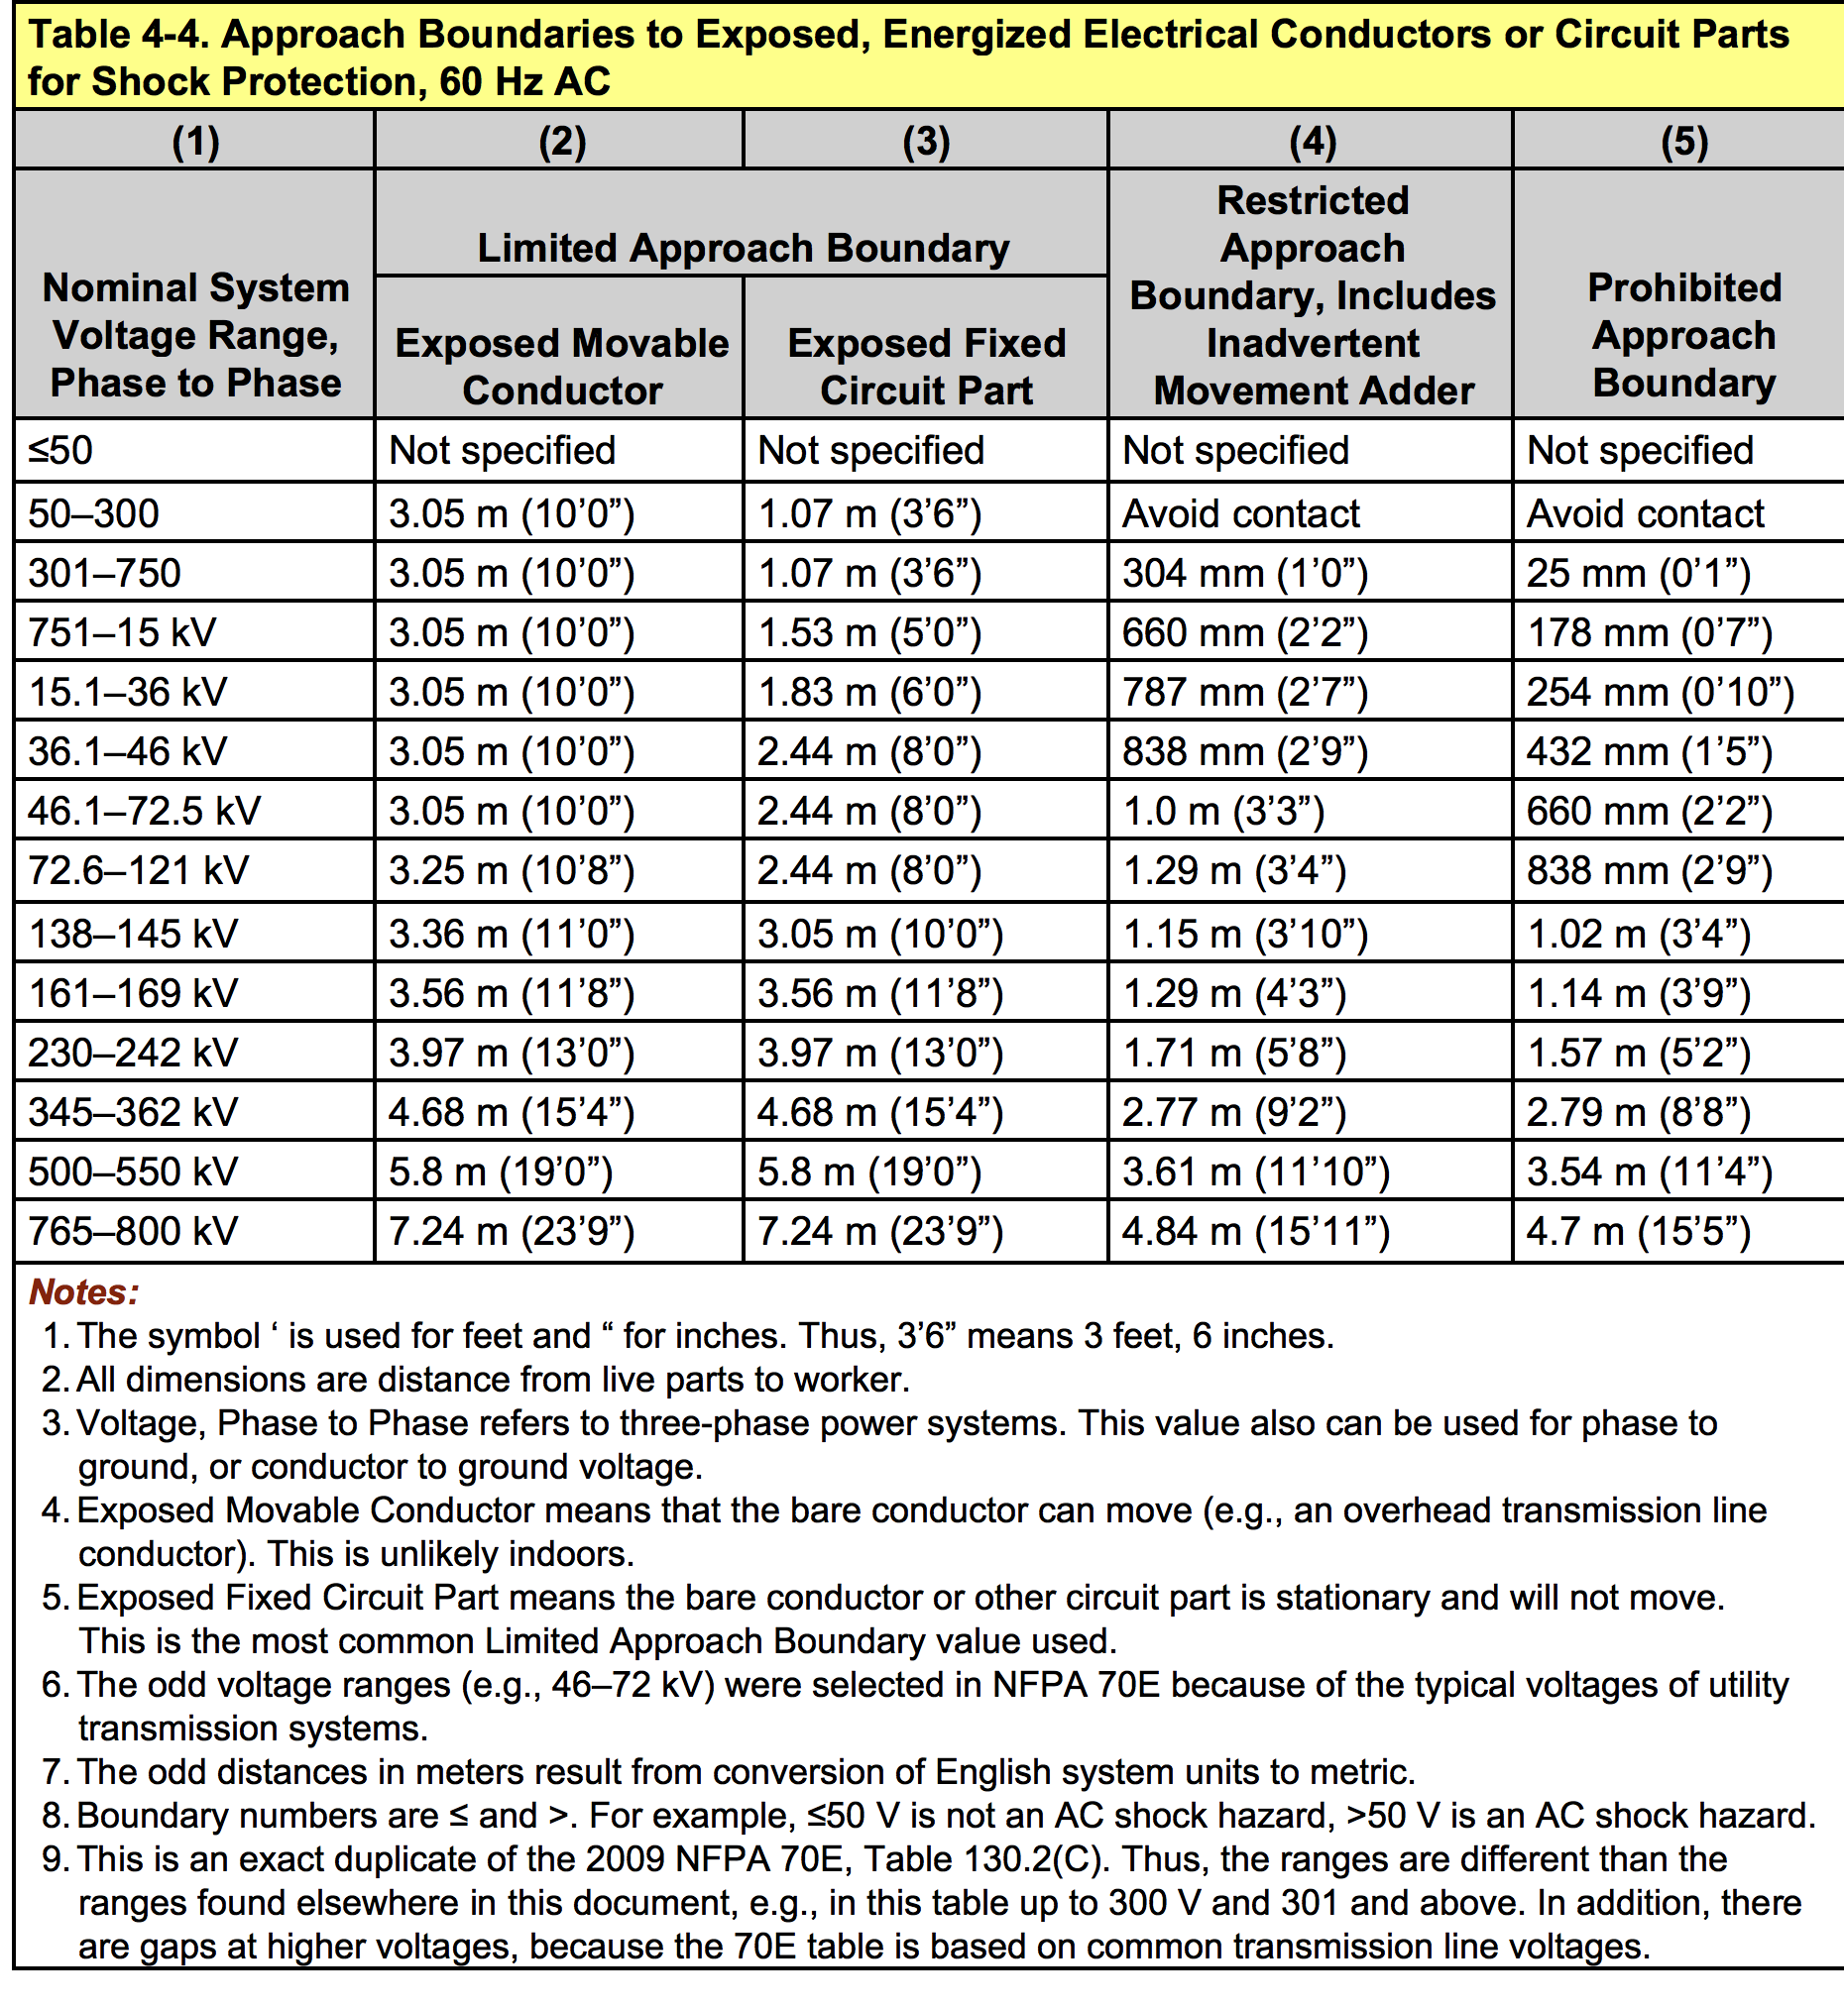
NFPA 70E Shock Boundaries for 60 Hz
Notes:
24
reproduced table from 70E, used for 60 Hz, rms

Slide 25
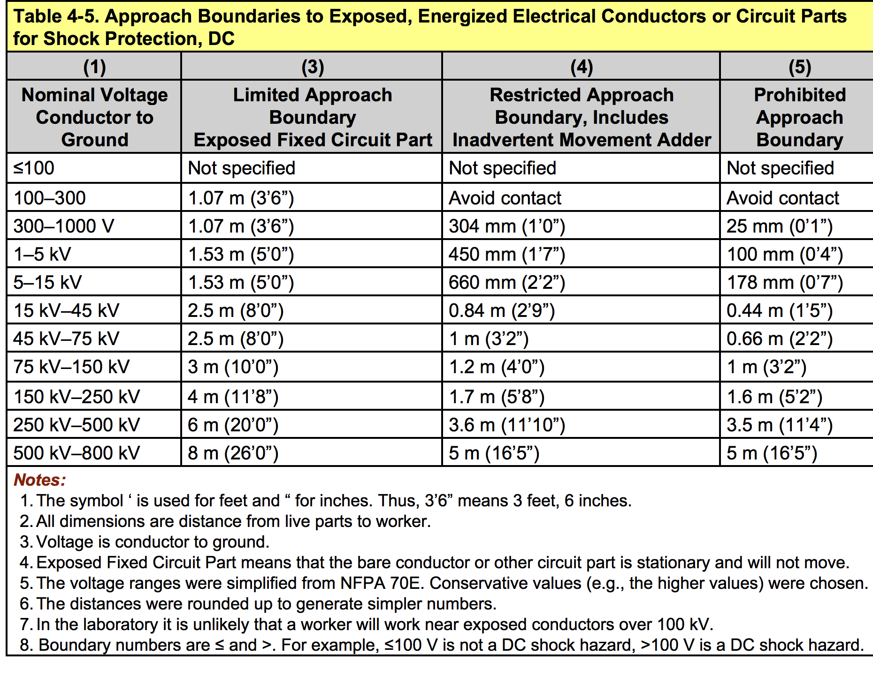
Shock Boundaries for DC, 2012 70E
Notes:
25
It is unlikely that there are exposed movable conductor in R&D equipment. Thus, column (2) may not be applicable. Use columns (1), (3), (4), and (5).

Slide 26
ISA 102 - High-Power Research and Development Electrical Systems Standards
Co-chair Lloyd Gordon, LANL
Co-chair Gary Dreifuerst, LLNL
Established at the DOE R&D Electrical Safety Workshop, July 2005
26

Slide 27
Proposed Standards
27
Ground Sticks - design, testing, certification, care, maintenance
Procedures for safing capacitors
Engineering controls to remotely discharge capacitive systems
Classification of DC, battery and capacitor hazards
Electrical Severity Measurement Tool

Slide 28
A Complete Approach to
Electrical Hazard Classification
Arc Flash - History
Now it is time to follow with a more complete method of classifying all forms of arc hazards, including arcs, arc flash, and arc blast, for all forms of electricity.
History
  2010 DOE Electrical Safety Workshop - Arc physics presentation
  2011 IEEE Electrical Safety Workshop - Expanded arc physics presentation
  2011 DOE Electrical Safety Workshop - Arc Waveforms
  2012 IEEE Electrical Safety Workshop - 4 hour tutorial on research, modeling, and classification of all arc hazards
IEEE 1584 and NFPA 70E
  Doan, Ammerman, PK Sen, W Lee
  2012 NFPA 70 - maximum power transfer
  Kinetrics, etc. – data
Future – 2015 IEEE, Louisville, Kentucky, Hugh Hoagland
  Poster paper - Analysis of all DC, capacitor, battery, & RF fatalities - 30 yrs
  4 hour tutorial – Methods of Arc Flash Calculations – AC and DC
  Oral paper – A Complete Arc Flash Hazard Classification

Slide 29
The identification and study of the arc flash hazard is NEW!
1960 - early paper highlighted the arc flash hazard - Kaufmann and Page
1982 - began to focus on the thermal injury at a distance - Lee, Doughty/Epperly/Jones
1991 - hazard added to OSHA, subpart S
1994 - added to subpart R, protective clothing
1995 - NFPA 70E established the arc flash protection boundary
2000 - NFPA 70E focused on arc flash protection
2002 - IEEE 1584 published
2012 - First inclusion of DC in NFPA 70E
Future - improved AC models, future DC models, capacitor models

Slide 30
“Burning” Arc Flash Questions
At what voltages do arcs result in significant arc flash hazards?
At what short circuit currents should we begin to worry about arc flash hazards?
How is electrical energy converted into arc, arc flash, and arc blast hazards?
What are the differences in arc flash thresholds and characteristics for AC, DC, and impulse arcs?
How does electrode geometry affect hazards?
Notes:
30
You have all seen arcs: lightning, arc welders, sparks, carpet shock arcs, etc.

Slide 31
More Arc Flash Questions
How do single phase and three phase arcs and arc flash differ?
What are the real hazards for large DC systems, including large battery banks and DC power supplies?
When does the arc begin to create an arc flash hazard, i.e., voltage, current, time, and waveshape?
How does current risetime affect the conversion of electrical energy into other forms of energy?
Notes:
31
You have all seen arcs: lightning, arc welders, sparks, carpet shock arcs, etc.

Slide 32
From Arcs to Arc Flash
The physics of arcs
Conversion of arc energy to arc flash energy
Comparing waveforms
A complete arc hazard classification system

Slide 33
Comparing Waveforms
Single phase 50/60 Hz
Three phase 50/60 Hz
DC
  Limited energy (DC power supplies)
  High energy (battery banks)
Impulse
  Capacitive (fast)
  Inductive (slow)
SubRF and RF

Slide 34
Comparing Waveforms
34
Single phase 50/60 Hz
Three phase 50/60 Hz
DC
  Limited energy (DC power supplies)
  High energy (battery banks)
Impulse
  Capacitive (fast)
  Inductive (slow)

Slide 35
Arc Flash, as a Function of Waveform
Waveform will have a significant effect on:
  Conversion into various forms of energy
  Thresholds for plasma cloud expansion
  Acoustic shock wave
  Creation and ejection of molten metal droplets
  Plasma sustaining processes
  Extinction processes
  Significance and magnitude of the arc flash

Slide 36
AC vs DC arcs
An 60 Hz arc passes through a current zero every 8 ms.
  Thus, substantial cooling from recombination and deionization occurs between current peaks.
  More voltage is needed to “reignite” the arc after each current zero than a DC arc.
  This effect is somewhat cancelled, however, in inductive circuits, as a voltage appears across the gap during a current zero.
DC arcs do not pass through current zeros and sustain ionization at lower voltages
Three phase AC arcs will behave more like DC arcs, since the average current flow is more constant, and there are no total current and voltage zeros.
Note that IEEE 1584 did not cover single phase or DC arcs

Slide 37
What is the voltage threshold for arc flash?
AC
  Often self extinguishes below about 250 V rms, for typical gaps
    Especially true for single phase arcs
    Less true for three phase arcs
  For low current systems, not enough energy is deposited in the arc to create a substantial arc flash hazard before the overcurrent protection operates
DC
  Under investigation
  May result in hotter plasmas for equivalent AC voltages
    One paper reported DC heat flux = 1.25 x AC heat flux
  May result in arc flash hazards at lower voltage thresholds
    130 V DC for short gaps
    260 V DC for 1 inch gaps

Slide 38
Capacitor Arcs
AC facility power arcs
  Risetime is slow, msec
  Conversion into acoustic energy is low (<5%)
  Simple hearing protection
  Few serious injuries from acoustics
  Currents 10s kA, magnetic forces low
Capacitor arcs
  Risetime very fast, µs
  Conversion into acoustic energy is high (>30%)
  Acoustic shock wave collapse lungs, break capilaries, burst eardrums, or kill
  Currents MAs, very strong magnetic forces and damage

Slide 39
Definitions – must improve
Arc
Arc flash
Arc Blast

Slide 40
Seven cases for arc flash hazard analysis
Single phase power
Three phase power
DC power supplies
Battery banks
Capacitors
Inductors
SubRF and RF

Slide 41
Characteristics of Sources
source | Energy | Impedance | Limiting factor | risetimes
1 Φ power | infinite | Low (ohms) | Overcurrent protection | 10s ms
3 Φ power | infinite | Low (ohms) | Overcurrent protection | 10s ms
DC supply | limited | High, x 10 | Fast interrupt, high Z trnfmr | 1 s ms
Battery bank | Huge, but finite | High resistance | Resistance, slow risetime | 100s ms
Capacitor | finite | Extremely low (mΩ) | Runs out | 10s µs
Inductor | finite | low | Runs out | 10s ms

Slide 42
Energy
For AC facility power arc flash analysis, there is a focus on voltage, short circuit current, and opening time
  The issue is really energy deposited
For DC, capacitor, inductor we will focus more on:
  Energy available
  Risetime
  Arc blast issues
    Acoustics, impulse light, magnetic forces

Slide 43
Arc Flash Thresholds Need to be Improved
AC power – 1584
  Single phase vs three phase
  Electrode spacing and geometry
  Voltage and short circuit current
  Interruption time (Energy)
DC power
  > 100 V
  Energy available (short circuit current and time)

Slide 44
Summary
The conversion of electrical energy into
  Thermal energy
  Acoustical energy
  Mechanical energy
in an arc is a strong function of
  Risetime
  Peak current
  Current zeros
  Energy deposited

Slide 45
Conclusions
A complete electrical arc hazard classification system should be developed that covers all classes of electrical arcs, including:
  AC, single phase
  AC, three phase
  DC, low energy (equipment)
  DC, high energy (batteries, huge systems)
  Impulse, fast (capacitor driven)
  Impulse, slow (inductor driven)

Slide 46
The Past and the Future
Efforts in the past 10 years has broadened our understanding and protection against ALL forms of electric shock
Efforts in the next few years will broaden our understanding and protection against ALL forms of arc hazards

Slide 47
Time for Proposals
Shock thresholds for capacitors, V and E
RF and subRF shock thresholds
Thermal hazard thresholds
Arc flash and arc blast classification
  DC
  Capacitors
  SubRF and RF?
  Projected arcs

