Slide 1

Significant Changes to NFPA 70E
Bobby Gray
NREL EFCOG Electrical Safety Meeting
July 15, 2014
Hoydar
Buck, Inc

Slide 2

Global Changes

Slide 3
Global Change Annex F: Provides clarity and accuracy.
2012 NFPA 70E®
2015 NFPA 70E®
Harm
Probability
injury or damage to health
Likelihood
Notes:
The term “harm” does not accurately reflect the result of exposure to an electrical hazard. The consequence attempting to be prevented by the assessment process in Annex F is “injury or damage to health.” Similarly, the term “probability” implies a mathematical concept. The word “likelihood” can refer to the chance of something happening, whether defined, measured or determined objectively or subjectively, qualitatively or quantitatively, and described using general terms or mathematically. Likelihood includes a probability or a frequency over a given time period.

Slide 4

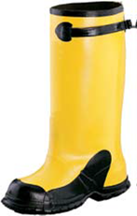

Global Change Document: Provides accuracy and harmonizes term with ASTM standards.
2012 NFPA 70E®
2015 NFPA 70E®
Work shoes
Footwear
Pictures used by permission of Salisbury
Notes:
This is an editorial change that provides the technical term most used in other industry standards.

Slide 5
Global Change Document: Provides accuracy and harmonizes term with other standards addressing risk and hazards.
2012 NFPA 70E®
2015 NFPA 70E®
Arc flash hazard analysis
Shock hazard analysis
Electrical hazard analysis
Hazard identification and risk assessment
Arc flash risk assessment
Shock risk assessment
Electrical hazard risk assessment
Risk assessment
Notes:
These changes are recommendations from the Risk and Assessment Working Group. The changes reflect the concept that injury due to electrical hazards is a product of the likelihood that a hazard will be present and the consequences of the hazard should an exposure occur. Protection from electrical hazards can be accomplished by either or a combination of reducing the risk of an event occurring or by providing protection should an event occur. The risk will identify whether a hazard is present and the likelihood of exposure based on the factors associated with the specific task and equipment. Controls will then be implemented to either reduce the risk of exposure or provide barriers between the worker and the hazard.

Slide 6
Global Change Document: Provides accuracy and harmonizes term with other standards addressing risk and hazards. The common practice of referring to HRC numbers as Categories will now accurately reflect the PPE category from Table 130.7(C)(16).
2012 NFPA 70E®
2015 NFPA 70E®
Hazard Risk Category
HRC
Arc flash PPE category
Eliminates term from standard
Notes:
These changes are recommendations from the Risk and Assessment Working Group. The changes reflect the concept that injury due to electrical hazards is a product of the likelihood that a hazard will be present and the consequences of the hazard should an exposure occur. Protection from electrical hazards can be accomplished by either or a combination of reducing the risk of an event occurring or by providing protection should an event occur. The risk will identify whether a hazard is present and the likelihood of exposure based on the factors associated with the specific task and equipment. Controls will then be implemented to either reduce the risk of exposure or provide barriers between the worker and the hazard. The same concept has been included in the arc flash tables, where the risk of an arc flash occurring is determined, then a PPE category number is assigned if the risk is reasonable or likely.

Slide 7
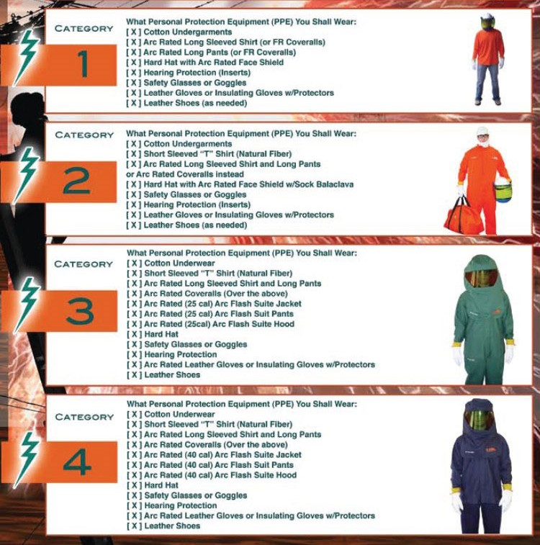
PPE Categories

Slide 8
Article 90

Slide 9
90.2(A) Change that shows 70E covers more than just work practices in keeping workers safe
2012 NFPA 70E®
2015 NFPA 70E®
(A) Covered. This standard addresses electrical safety-related work practices for employee workplaces that are necessary for the practical safeguarding of employees…
(A) Covered. This standard addresses electrical safety-related work practices, safety-related maintenance requirements, and other administrative controls for employee workplaces that are necessary for the practical safeguarding of employees…
Notes:
The intent of this revision is to clarify the intent of placing safety related maintenance requirements and other administrative controls including training and auditing on par with safety–related work practices.

Slide 10
90.2(A)(2): New Note explains why work on other parts of utility system requires application of NFPA 70E.
2012 NFPA 70E®
2015 NFPA 70E®
(2) Installations used by the electric utility, such as office buildings, warehouses, garages, machine shops, and recreational buildings that are not an integral part of a generating plant, substation, or control center
(2) Installations used by the electric utility, such as office buildings, warehouses, garages, machine shops, and recreational buildings that are not an integral part of a generating plant, substation, or control center
Note: This standard addresses safety of workers whose job responsibilities entail interaction with electrical equipment and systems with potential exposure to energized electrical equipment and circuit parts. Concepts in this standard are often adapted to other workers whose exposure to electrical hazards is unintentional or not recognized as part of their job responsibilities. The highest risk for injury from electrical hazards for other workers involve unintentional contact with overhead power lines and electric shock from machines, tools, and appliances.
Notes:
Based on analysis of OSHA and workers’ compensation claim data, approximately one half of electrical fatalities and injuries involve electrical workers. The new informational note is intended to alert employers that the electrical safety program must also address other workers. The intent of this revision is to provide awareness that strict application of this standard within the existing scope may overlook risk to other workers in the covered workplaces.

Slide 11
90.2(B)(2): Promotes the use of NFPA 70E by the Mine Safety and Health Administration since it has informally endorsed the application of NFPA 70E as “Arc Flash Accident Prevention Best Practice.”
2012 NFPA 70E®
2015 NFPA 70E®
(2) Installations underground in mines and self-propelled mobile surface mining machinery and its attendant electrical trailing cable
(2) Installations underground in mines and self-propelled mobile surface mining machinery and its attendant electrical trailing cable
Notes:
The committee understands that the Mine Safety and Health Administration has informally endorsed the application of NFPA 70E as “Arc Flash Accident Prevention Best Practices.”

Slide 12
90.3: Revises format for clarity and readability.
2012 NFPA 70E®
2015 NFPA 70E®
Chapter 1 applies generally for safety-related work-practice; Chapter 2 applies to safety-related maintenance requirements for electrical equipment and installations in workplaces; and Chapter 3 supplements or modifies Chapter 1 with safety requirements for special equipment.
Chapter 1 applies generally for safety-related work practices; Chapter 3 supplements or modifies Chapter 1 with safety requirements for special equipment. Chapter 2…
Notes:
This change simply puts the information in chronological order to match the way the information is presented in the standard. Also not shown on the slide is an editorial change to place the work Informative in front of annexes that was overlooking in the 2012 edition.

Slide 13
90.4(9): Changes here and in IA F to accurately reflect the information in the procedure.
2012 NFPA 70E®
2015 NFPA 70E®
(9) Informative Annex F, Risk Assessment Procedure
(9) Informative Annex F, Hazard Analysis, Risk Estimation, and Risk Evaluation Procedure
Notes:
This change is the first by the Risk and Analysis Working Group. Not all will be covered here, but the first provides an example of the incorporated changes.

Slide 14
Article 100

Slide 15
Article 100
2012 NFPA 70E®
2015 NFPA 70E®
Accessible, Readily (Readily Accessible).
Capable of being reached quickly for operation, renewal, or inspections without requiring those to whom ready access is requisite to climb over or remove obstacles or resort to…
Arc Flash Hazard.
Informational Note No. 2: See Table 130.7(C)(15)(e) and Table 130.7(C)(15)(a) for…
Accessible, Readily (Readily Accessible).
Capable of being reached quickly for operation, renewal, or inspections without requiring those to whom ready access is requisite to actions such as to use tools, to climb over or remove obstacles, or resort to…[NEC change]
Arc Flash Hazard.
Informational Note No. 2: See Table 130.7(C)(15)(A)(a) for…
Notes:
In addition to the changes in definitions, many bracketed references were updated to reflect 2014 NEC.

Slide 16
Article 100
2012 NFPA 70E®
2015 NFPA 70E®
Arc Flash Hazard Analysis. A study investigating a worker’s potential exposure to arc flash energy, conducted for the purpose of injury prevention and the determination of safe work practices, arc flash boundary, and the appropriate levels of personal protective equipment (PPE).
Arc Rating.
Informational Note No. 1: …Flame-Resistant (FR) clothing without an arc rating has not been tested for exposure to an electric arc.
Arc Flash Hazard Analysis. A study investigating a worker’s potential exposure to arc flash energy, conducted for the purpose of injury prevention and the determination of safe work practices, arc flash boundary, and the appropriate levels of personal protective equipment (PPE).
Arc Rating.
Informational Note No. 1: …Flame resistant clothing without an arc rating has not been tested for exposure to an electric arc. All arc-rated clothing is also flame-resistant.

Slide 17
Article 100
2012 NFPA 70E®
2015 NFPA 70E®
Bare Hand Work. A technique of performing work on energized electrical conductors or circuit parts, after the employee has been raised to the potential of the conductor or circuit part.
Barricade.
A physical obstruction such as tapes, cones, or A-frame-type wood or metal structures intended to provide a warning about and to limit access to a hazardous area.
Bare Hand Work. A technique of performing work on energized electrical conductors or circuit parts, after the employee has been raised to the potential of the conductor or circuit part.
Barricade.
A physical obstruction such as tapes, cones, or A-frame-type wood or metal structures intended to provide a warning about and to limit access to a hazardous area.
Notes:
Bare hand work is no longer a technique recognized in Chapter 1 of NFPA 70E.

Slide 18
Article 100
2012 NFPA 70E®
2015 NFPA 70E®
Boundary, Prohibited Approach. An approach limit at a distance from an exposed energized electrical conductor or circuit part within which work is considered the same as making contact with the electrical conductor or circuit part.
Device.
A unit of an electrical system that carries or controls electric energy as its principal function.
Boundary, Prohibited Approach. An approach limit at a distance from an exposed energized electrical conductor or circuit part within which work is considered the same as making contact with the electrical conductor or circuit part.
Device.
A unit of an electrical system, other than a conductor, that carries or controls electric energy as its principal function. [NEC change]
Notes:
Bare hand work is no longer a technique recognized in Chapter 1 of NFPA 70E, therefore the need for defining the PAB is gone.

Slide 19
Article 100
2012 NFPA 70E®
2015 NFPA 70E®
New definition
New definition
Incident Energy. The amount of energy impressed on a surface, a certain distance from the source generated during an electrical arc event. One of the units used to measure incident energy is calories per centimeter squared (cal/cm²).
Hazard. A source of possible injury or damage to health.
Hazardous.
  Involving exposure to at least one hazard.
Incident Energy. The amount of thermal energy impressed on a surface, a certain distance from the source generated during an electrical arc event. Incident energy is typically expressed in calories per square centimeter (cal/cm²).

Slide 20
Article 100
2012 NFPA 70E®
2015 NFPA 70E®
Luminaire. A complete lighting unit consisting of a lamp or lamps, together with the parts designed to distribute the light, to position and protect the lamps and ballast (where applicable), and to connect the lamps to the power supply…
Qualified Person. One who has skills and knowledge related to the construction and operation of the electrical equipment and installations and has received safety training to recognize and avoid the hazards involved.
Luminaire. A complete lighting unit consisting of a light source, such as a lamp or lamps, together with the parts designed to position the light source, and connect it to the power supply…[NEC change]
Qualified Person. One who has demonstrated skills and knowledge related to the construction and operation of electrical equipment and installations and has received safety training to identify and avoid the hazards involved.
Notes:
Definition of Qualified Person is changed to reflect changes in training requirements that match better with OSHA expectations. Now, the worker must demonstrate skills and employer must document confirmation of completion.

Slide 21
Article 100
2012 NFPA 70E®
2015 NFPA 70E®
Raceway. An enclosed channel of metal or nonmetallic materials designed expressly for holding wires, cables, or busbars, with additional functions as permitted in this standard. Raceways include, but are not limited to, rigid metal conduit, rigid nonmetallic conduit, intermediate metal conduit, liquidtight flexible conduit, flexible metallic tubing, flexible metal conduit, electrical metallic tubing, electrical nonmetallic tubing, underfloor raceways, cellular concrete floor raceways, cellular metal floor raceways, surface raceways, wireways, and busways.
New defintion
Raceway. An enclosed channel of metal or nonmetallic materials designed expressly for holding wires, cables, or busbars, with additional functions as permitted in this standard.[NEC change]
Risk. A combination of the likelihood of occurrence of injury or damage to health and the severity of injury or damage to health that results from a hazard.
Notes:
New definition of risk to reflect the approach to hazard analysis introduced in 2012.

Slide 22
Article 100
2012 NFPA 70E®
2015 NFPA 70E®
New definition
Ventilated. Provided with a means to permit circulation of air sufficient to remove an excess of heat, fumes, or vapors.
Risk Assessment. An overall process that identifies hazards, estimates the potential severity of injury or damage top health, estimates the likelihood of occurrence of injury or damage to health and determines if protective measures are required.
    Informational Note: As used in this standard, arc flash risk assessment and shock risk assessment are types of risk assessments.
Ventilated. Provided with a means to permit circulation of air sufficient to remove an excess of heat, fumes, or vapors.
Notes:
New definition of risk assessment to reflect the approach to hazard analysis introduced in 2012. The term ventilated is not used in the standard.

Slide 23
Article 100
2012 NFPA 70E®
2015 NFPA 70E®
Voltage, Nominal. A nominal value assigned to a circuit or system for the purpose of conveniently designating its voltage class (e.g., 120/240 volts, 480Y/277 volts, 600 volts). The actual voltage at which a circuit operates can vary from the nominal within a range that permits satisfactory operation of equipment.
Voltage, Nominal. A nominal value assigned to a circuit or system for the purpose of conveniently designating its voltage class (e.g., 120/240 volts, 480Y/277 volts, 600 volts). The actual voltage at which a circuit operates can vary from the nominal within a range that permits satisfactory operation of equipment. [NEC change]

Slide 24
Article 110

Slide 25
Article 110 is reformatted for usability
2012 NFPA 70E®
2015 NFPA 70E®
110.1 Relationships with Contractors (Outside Service Personnel, and So Forth).
110.2 Training Requirements.
110.3 Electrical Safety Program.
110.1 Electrical Safety Program.
110.2 Training Requirements.
110.3 Relationships with Contractors (Outside Service Personnel, and So Forth).

Slide 26
Language Added to Clarify Role of Electrical Safety Program
2012 NFPA 70E®
2015 NFPA 70E®
110.3(A) General. The employer shall implement and document an overall electrical safety program that directs activity appropriate for the electrical hazards, voltage, energy level, and circuit conditions.
110.1(A) The employer shall implement and document an overall electrical safety program that directs activity appropriate to the risk associated with electrical hazards, voltage, energy level, and circuit conditions. The electrical safety program shall be implemented as part of the employer’s overall occupational health and safety management system, when one exists.

Slide 27
Language added to provide examples of Safety-related work practices.
2012 NFPA 70E®
2015 NFPA 70E®
110.3(A) General.
  Informational Note No. 1: Safety-related work practices are just one component of an overall electrical safety program.
  Informational Note No. 2: ANSI/AIHA Z10-2005, American National Standard for Occupational Safety and Health Management Systems provides a framework for establishing a comprehensive electrical safety program as a component of an employer’s occupational safety and health program.
110.1(A) General.
  Informational Note No. 1: Safety-related work practices such as verification of proper maintenance and installation, alerting techniques, auditing requirements, and training requirements provided in this standard are administrative controls and part of an overall electrical safety program.
  Informational Note No. 2: ANSI/AIHA Z10-2005, American National Standard for Occupational Health and Safety Management Systems provides a framework for establishing a comprehensive electrical safety program as a component of an employer’s occupational safety and health program.

Slide 28
I.N.s provide more information for developing an electrical safety program
2012 NFPA 70E®
2015 NFPA 70E®
110.3(A) General.
  New Information Notes
110.1(A) General.
  Informational Note No. 3: IEEE 3007.1, Recommended Practice for the Operation and Management of Industrial and Commercial Power Systems, provides additional guidance for the implementation of the electrical safety program.
  Informational Note No. 4: IEEE 3007.3, Recommended Practice for Electrical safety in Industrial and Commercial Power Systems, provides additional guidance for electrical safety in the workplace.

Slide 29
Maintenance must be part of an overall electrical safety program to ensure proper operation
2012 NFPA 70E®
2015 NFPA 70E®
110.3(B) Awareness and Self-Discipline.
  Subsection (B) moved to (C) and all other subsections moved one level.
110.1(B) Maintenance.
The electrical safety program shall include elements that consider condition of maintenance of electrical equipment and systems.
Notes:
Several places in 70E require the employer to consider condition of maintenance when conducting electrical hazard analysis. Now, the employer must document the maintenance program as part of the overall program.

Slide 30
Paragraph removed as redundant and unnecessary.
2012 NFPA 70E®
2015 NFPA 70E®
(G) Job Briefing.
(1) General. Before starting each job, the employee in charge shall conduct a job briefing with the employees involved. The briefing shall cover such subjects as hazards associated with the job, work procedures involved, special precautions, energy source controls, personal protective equipment requirements, and the information on the energized electrical work permit, if required. Additional job briefings shall be held if changes that might affect the safety of employees occur during the course of the work.
(2) Repetitive or Similar Tasks. If the work or operations to be performed during the work day or shift are repetitive and similar, at least one job briefing shall be conducted before the start of the first job of the day or shift.
(3) Routine Work. Prior to starting work, a brief discussion shall be satisfactory if the work involved is routine and if the employee is qualified for the task. A more extensive discussion shall be conducted if either of the following apply:
(1) The work is complicated or particularly hazardous.
(2) The employee cannot be expected to recognize and avoid the hazards involved in the job.
(G) Job Briefing.
(1) General. Before starting each job, the employee in charge shall conduct a job briefing with the employees involved. The briefing shall cover such subjects as hazards associated with the job, work procedures involved, special precautions, energy source controls, personal protective equipment requirements, and the information on the energized electrical work permit, if required. Additional job briefings shall be held if changes that might affect the safety of employees occur during the course of the work.
(2) Routine Work. Prior to starting work, a brief discussion shall be satisfactory if the work involved is routine and if the employee is qualified for the task. A more extensive discussion shall be conducted if either of the following apply:
(1) The work is complicated or involves increased risk.
(2) The employee cannot be expected to recognize and avoid the hazards involved in the job.

Slide 31
Frequency of field audit established.
2012 NFPA 70E®
2015 NFPA 70E®
(H) Electrical Safety Auditing.
(2) Field Work. Field work shall be audited to verify the requirements contained in the procedures of the electrical safety program are being followed. When the auditing determines that the principles and procedures of the electrical safety program are not being followed, the appropriate revisions to the training program or revisions to the procedures shall be made.
(3) Documentation. The audit shall be documented.
(H) Electrical Safety Auditing.
(2) Field Work. Field work shall be audited to verify the requirements contained in the procedures of the electrical safety program are being followed. When the auditing determines that the principles and procedures of the electrical safety program are not being followed, the appropriate revisions to the training program or revisions to the procedures shall be made. The frequency of the audit shall not exceed 1 year.
(3) Documentation. The audits shall be documented.

Slide 32
Change better describes application of requirement
2012 NFPA 70E®
2015 NFPA 70E®
110.2 Training Requirements.
(A) Safety Training. The training requirements contained in this section shall apply to employees who face a risk of electrical hazard that is not reduced to a safe level by the applicable electrical installation requirements.
110.2 Training Requirements.
(A) Safety Training. The training requirements contained in this section shall apply to employees exposed to an electrical hazard when the risk associated with that hazard is not reduced to a safe level by the applicable electrical installation requirements.

Slide 33
Reformats section for usability. Adds requirements for refresher training and documentation.
2012 NFPA 70E®
2015 NFPA 70E®
110.2 Training Requirements.
(C) Emergency Procedures. Employees exposed to shock hazards and those employees responsible for taking action in case of emergency shall be trained in methods of release of victims from contact with exposed energized electrical conductors or circuit parts. Employees shall be regularly instructed in methods of first aid and emergency procedures, such as approved methods of resuscitation, if their duties warrant such training. Training of employees in approved methods of resuscitation, including cardiopulmonary resuscitation and automatic external defibrillator (AED) use, shall be certified by the employer annually.
110.2 Training Requirements.
(C) Emergency Response Training.
Contact Release. Employees exposed to shock hazards shall be trained in methods of safe release of victims from contact with exposed energized electrical conductors or circuit parts. Refresher training shall occur annually.
First Aid, Emergency Response, and Resuscitation.
  Employees responsible for responding to medical emergencies shall be trained in first aid and emergency procedures.
  Employees responsible for responding to medical emergencies shall trained in cardiopulmonary resuscitation (CPR). Refresher training shall occur annually.
  Employees responsible for responding to medical emergencies shall be trained in the use of an automated external defibrillator (AED) if an employer’s emergency response plan includes the use of this device. Refresher training shall occur annually.
Training Verification. Employers shall verify at least annually that employee training required by this section is current
Documentation. The employer shall document that the training required by this section has occurred.
Notes:
This section had a major overhaul. The format places the subsection into a list format for readability improvements. The changes clarified exactly which employees need which training. Annual refresher training was added to some elements and a requirement to document the training was added.

Slide 34
Clarifies and adds to list of knowledge for qualified person.
2012 NFPA 70E®
2015 NFPA 70E®
110.2 Training Requirements.
(D) Employee Training.
(1) Qualified Person.
(b) Such persons permitted to work within the limited approach boundary of exposed energized electrical conductors and circuit parts operating at 50 volts or more shall, at a minimum, be additionally trained in all of the following:
(1) Skills and techniques necessary to distinguish exposed energized electrical conductors and circuit parts from other parts of electrical equipment
(2) Skills and techniques necessary to determine the nominal voltage of exposed energized electrical conductors and circuit parts
(3) Approach distances specified in Table 130.4(C)(a) and Table 130.4(C)(b) and the corresponding voltages to which the qualified person will be exposed
(4) Decision-making process necessary to determine the degree and extent of the hazard and the personal protective equipment and job planning necessary to perform the task safely
110.2 Training Requirements.
(D) Employee Training.
(1) Qualified Person.
(b) Such persons permitted to work within the limited approach boundary shall, at a minimum, be additionally trained in all of the following:
(1) Skills and techniques necessary to distinguish exposed energized electrical conductors and circuit parts from other parts of electrical equipment
(2) Skills and techniques necessary to determine the nominal voltage of exposed energized electrical conductors and circuit parts
(3) Approach distances specified in Table 130.4(D) and Table 130.4(D)(b) and the corresponding voltages to which the qualified person will be exposed
(4) Decision-making process necessary to be able to do the following:
Perform the job safety planning
Identify electrical hazards
Assess the associated risk
Select the appropriate risk control methods from the hierarchy of control identified in 110.1(F), including personal protective equipment.

Slide 35
Clarifies wording.
2012 NFPA 70E®
2015 NFPA 70E®
110.2 Training Requirements.
(3) Retraining.
An employee shall receive additional training
(or retraining) under any of the following conditions:
(1) If the supervision or annual inspections indicate that the employee is not complying with the safety-related work practices
(2) If new technology, new types of equipment, or changes in procedures necessitate the use of safety-related work
practices that are different from those that the employee would normally use
(3) If he or she must employ safety-related work practices that are not normally used during his or her regular job duties
Retraining shall be performed at intervals not to exceed 3 years.
110.2 Training Requirements.
(3) Retraining.
Retraining in safety-related work practices and applicable changes in this standard shall be performed at intervals not to exceed three years. An employee hall receive additional training (or retraining) if any of the following conditions exists:
(1) The supervision or annual inspections indicate that the employee is not complying with the safety-related work practices
(2) New technology, new types of equipment, or changes in procedures necessitate the use of safety-related work
practices that are different from those that the employee would normally use
(3) The employee must employ safety-related work practices that are not normally used during his or her regular job duties

Slide 36
Moves section. Limits requirements for meeting to only knowledgeable host employers.
2012 NFPA 70E®
2015 NFPA 70E®
110.1 Relationships with Contractors (Outside Service
Personnel, and So Forth).
(A) Host Employer Responsibilities.
(B) Contract Employer Responsibilities.
(3) The contract employer shall advise the host employer of the following:
a. Any unique hazards presented by the contract employer’s work
b. Any unanticipated hazards found during the contract employer’s work that the host employer did not mention
c. The measures the contractor took to correct any violations reported by the host employer under 110.1(A)(2) and to prevent such violation from recurring in the future
(C) Documentation. There shall be a documented meeting between the host employer and the contract employer.
110.3 Relationships with Contractors (Outside Service
Personnel, and So Forth).
(A) Host Employer Responsibilities.
(B) Contract Employer Responsibilities.
(3) The contract employer shall advise the host employer of the following:
a. Any unique hazards presented by the contract employer’s work
b. Any unanticipated hazards found during the contract employer’s work that the host employer did not mention
c. The measures the contractor took to correct any violations reported by the host employer under 110.3(A)(2) and to prevent such violation from recurring in the future
(C) Documentation. Where the host employer has knowledge of hazards covered by this standard that are related to the contract employer’s work, there shall be a documented meeting between the host employer and the contract employer.
Notes:
Many times contractors are requested to perform work in facilities that have no electrical expertise. Requirement this meeting, designed to share information regarding hazards would be pointless. This change does not lessen requirements, only clarifies intent. Verbiage not shown was not changed from previous edition.

Slide 37
Wording changes for technical accuracy. Additional language to ensure competent persons make repairs
2012 NFPA 70E®
2015 NFPA 70E®
110.4 Use of Equipment.
(A) Test Instruments and Equipment.
(2) Rating. Test instruments, equipment, and their accessories shall be rated for circuits and equipment to which they will be connected.
(4) Visual Inspection. Test instruments and equipment and all associated test leads, cables, power cords, probes, and connectors shall be visually inspected for external defects
and damage before each use. If there is a defect or evidence of damage that might expose an employee to injury, the
defective or damaged item shall be removed from service, and no employee shall use it until repairs and tests necessary to render the equipment safe have been made.
(5) Operation Verification. When test instruments are used for testing the absence of voltage on conductors or circuit parts operating at 50 volts or more, the operation of the test instrument shall be verified before and after an absence of voltage test is performed.
110.4 Use of Electrical Equipment.
(A) Test Instruments and Equipment.
(2) Rating. Test instruments, equipment, and their accessories shall be rated for circuits and equipment where they are utilized.
(4) Visual Inspection and Repair. Test instruments and equipment and all associated test leads, cables, power cords, probes, and connectors shall be visually inspected for external defects
and damage before each use. If there is a defect or evidence of damage that might expose an employee to injury, the
defective or damaged item shall be removed from service. No employee shall use it until a person(s) qualified to perform the repairs and tests that are necessary to render the equipment safe has done so.
(5) Operation Verification. When test instruments are used for testing the absence of voltage on conductors or circuit parts operating at 50 volts or more, the operation of the test instrument shall be verified on a known voltage source before and after an absence of voltage test is performed.
Notes:
Injuries occur due to miss-applied or faulty test instruments. Changes in this section are intended to reduce the likelihood of injury due to test instruments.

Slide 38
Changes expand application to storage as well as use.
2012 NFPA 70E®
2015 NFPA 70E®
110.4 Use of Equipment.
(B) Portable Electric Equipment. This section applies to the use of cord- and plug-connected equipment, including
cord sets (extension cords).
(1) Handling and Storage. Portable equipment shall be handled and stored in a manner that will not cause damage. Flexible electric cords connected to equipment shall not be used for raising or lowering the equipment. Flexible cords shall not be fastened with staples or hung in such a fashion as could damage the outer jacket or insulation.
110.4 Use of Equipment.
(B) Portable Electric Equipment. This section applies to the use of cord- and plug-connected equipment, including
cord sets (extension cords).
(1) Handling. Portable equipment shall be handled in a
manner that will not cause damage. Flexible electric cords
connected to equipment shall not be used for raising or lowering the equipment. Flexible cords shall not be fastened with staples or hung in such a fashion as could damage the outer jacket or insulation.

Slide 39
Changes require qualified persons to repair portable electrical equipment.
2012 NFPA 70E®
2015 NFPA 70E®
110.4 Use of Equipment.
(B) Portable Electric Equipment. This section applies to the use of cord- and plug-connected equipment, including
cord sets (extension cords).
(3) Visual Inspection and Repair of Portable Cord- and Plug. Connected Equipment and Flexible Cord Sets.
(a) Frequency of Inspection. Before each use, portable
cord- and plug-connected equipment shall be visually inspected for external defects (such as loose parts or deformed and missing pins) and for evidence of possible internal damage (such as a pinched or crushed outer jacket).
Exception: Cord- and plug-connected equipment and flexible cord sets (extension cords) that remain connected once they are put in place and are not exposed to damage shall not be required to be visually inspected until they are relocated.
(b) Defective Equipment. If there is a defect or evidence of damage that might expose an employee to injury, the defective or damaged item shall be removed from service. No employee shall use it until a person(s) qualified to perform the repairs and tests necessary to render the equipment safe has done so.
110.4 Use of Equipment.
(B) Portable Electric Equipment. This section applies to the use of cord- and plug-connected equipment, including
cord sets (extension cords).
(3) Visual Inspection of Portable Cord- and Plug. Connected Equipment and Flexible Cord Sets.
(a) Frequency of Inspection. Before each use, portable
cord- and plug-connected equipment shall be visually inspected for external defects (such as loose parts or deformed and missing pins) and for evidence of possible internal damage (such as a pinched or crushed outer jacket).
Exception: Cord- and plug-connected equipment and flexible cord sets (extension cords) that remain connected once they are put in place and are not exposed to damage shall not be required to be visually inspected until they are relocated.
(b) Defective Equipment. If there is a defect or evidence of damage that might expose an employee to injury, the defective or damaged item shall be removed from service, and no employee shall use it until repairs and tests necessary to render the equipment safe have been made.
Notes:
List items (4), (5), and (6) dealing with wet locations was deleted from this subsection and given a separate list number in a level higher.

Slide 40
Format changes and additional rule to follow manufacturer’s instructions.
2012 NFPA 70E®
2015 NFPA 70E®
110.4 Use of Equipment.
(B) Portable Electric Equipment. (3) Visual Inspection of Portable Cord- and Plug. Connected Equipment and Flexible Cord Sets.
(d) Conductive Work Locations. Portable electric equipment used in highly conductive work locations (such as those inundated with water or other conductive liquids), or in job locations where employees are likely to contact water or conductive liquids, shall be approved for those locations. In job locations where employees are likely to contact or be drenched with water or conductive liquids, ground-fault circuit-interrupter protection for personnel shall also be used.
Informational Note: The hazard/risk evaluation procedure could also include identifying when the use of portable tools and equipment powered by sources other than 120 volts ac, such as batteries, air, and hydraulics, should be used to minimize the potential for injury from electrical hazards for tasks performed in conductive or wet locations.
(4) Connecting Attachment Plugs.
(a) Employees’ hands shall not be wet when plugging and unplugging flexible cords and cord- and plug-connected equipment if energized equipment is involved.
(b) Energized plug and receptacle connections shall be handled only with insulating protective equipment if the condition of the connection could provide a conductive path to the employee’s hand (for example, if a cord connector is wet from being immersed in water).
(c) Locking-type connectors shall be secured after connection.
110.4 Use of Equipment.
(B) Portable Electric Equipment (3) Visual Inspection and Repair of Portable Cord- and Plug. Connected Equipment and Flexible Cord Sets.
(4) Conductive Work Locations. Portable electric equipment used in highly conductive work locations (such as those inundated with water or other conductive liquids), or in job locations where employees are likely to contact water or conductive liquids, shall be approved for those locations. In job locations where employees are likely to contact or be drenched with water or conductive liquids, ground-fault circuit-interrupter protection for personnel shall also be used.
Informational Note: The hazard/risk evaluation procedure could also include identifying when the use of portable tools and equipment powered by sources other than 120 volts ac, such as batteries, air, and hydraulics, should be used to minimize the potential for injury from electrical hazards for tasks performed in conductive or wet locations
(6) Manufacturer’s Instructions. Portable equipment shall be used in accordance with the manufacturer’s instructions and safety warnings.

Slide 41
Added application for GFCI for activities rather than just location.
2012 NFPA 70E®
2015 NFPA 70E®
110.4 Use of Equipment.
(C) Ground-Fault Circuit-Interrupter (GFCI) Protection.
(1) General. Employees shall be provided with ground-fault circuit-interrupter (GFCI) protection where required by applicable state, federal, or local codes and standards. Listed cord sets or devices incorporating listed GFCI protection for personnel identified for portable use shall be permitted.
(2) Outdoors. GFCI protection shall be provided when an employee is outdoors and operating or using cord- and plug-connected equipment supplied by 125-volt, 15-, 20-, or 30-ampere circuits. Where employees working outdoors operate or use equipment supplied by other than 125-volt, 15-, 20-, or 30-ampere circuits, an assured equipment
grounding conductor program shall be implemented.
110.4 Use of Equipment.
(C) Ground-Fault Circuit-Interrupter (GFCI) Protection.
(1) General. Employees shall be provided with ground-fault circuit-interrupter (GFCI) protection where required by applicable state, federal, or local codes and standards. Listed cord sets or devices incorporating listed GFCI protection for personnel identified for portable use shall be permitted.
(2) Maintenance and Construction. GFCI protection shall be provided when an employee is operating or using cord- and plug-connected equipment supplied by 125-volt, 15-, 20-, or 30-ampere circuits. Where employees working outdoors operate or use equipment supplied by greater than 125-volt, 15-, 20-, or 30-ampere circuits, an assured equipment grounding conductor program shall be implemented.
(3) Outdoors. GFCI protection shall be provided when an employee is outdoors and operating or using cord- and plug-connected equipment supplied by 125-volt, 15-, 20-, or 30-ampere circuits. Where employees working outdoors operate or use equipment supplied by greater than 125-volt, 15-, 20-, or 30-ampere circuits, an assured equipment grounding conductor program shall be implemented.

Slide 42
Section moved to Article 130 and minor wording changes made for usability.
2012 NFPA 70E®
2015 NFPA 70E®
110.5 Underground Electrical Lines and Equipment.
Before excavation starts, and where there exists a reasonable possibility of contacting electrical lines or equipment, the employer shall take the necessary steps to contact the appropriate owners or authorities to identify and mark the location of the electrical lines or equipment. When it has been determined that a reasonable possibility for contacting electrical lines or equipment exists, a hazard analysis shall be performed to identify the appropriate safe work practices that shall be used during the excavation.
130.9 Underground Electrical Lines and equipment.
Before excavation starts, and where there exists a reasonable possibility of contacting electrical lines or equipment, the employer shall take the necessary steps to contact the appropriate owners or authorities to identify and mark the location of the electrical lines or equipment. When it has been determined that a reasonable possibility of contacting electrical lines or equipment exists, appropriate safe work practices and PPE shall be used during the excavation.

Slide 43
Article 120

Slide 44
Changes are for technical accuracy.
2012 NFPA 70E®
2015 NFPA 70E®
120.1 Process of Achieving an Electrically Safe Work Condition.
(5) Use an adequately rated voltage detector to test each
phase conductor or circuit part to verify they are deenergized. Test each phase conductor or circuit part both phase-to-phase and phase-to-ground. Before and after each test, determine that the voltage detector is operating satisfactorily.
120.1 Verification of an Electrically Safe Work Condition.
(5) Use an adequately rated test instrument to test each
phase conductor or circuit part to verify it is deenergized. Test each phase conductor or circuit part both phase-to-phase and phase-to-ground. Before and after each test, determine that the test instrument is operating satisfactorily through verification on a known voltage source.

Slide 45
The section has been revised to add requirements for retraining and documentation.
2012 NFPA 70E®
2015 NFPA 70E®
120.2 De-energized Electrical Conductors or Circuit Parts That Have Lockout/Tagout Devices Applied.
(2) Training. All persons who could be exposed shall be trained to understand the established procedure to control the energy and their responsibility in executing the procedure. New (or reassigned) employees shall be trained (or retrained) to understand the lockout/tagout procedure as it relates to their new assignment. Retraining shall be required as the established procedure is revised.
(No additional information)
120.2 De-energized Electrical Equipment That Has Lockout/Tagout Devices Applied.
(3) Retraining. Retraining shall be performed:
When the established procedure is revised
At intervals not to exceed 3 years.
(4) Training Documentation.
The employer shall document that each employee has received the training required by this section.
The documentation shall be made when the employee demonstrates proficiency in the work practices involved.
The documentation shall contain the content of the training, each employee’s name and the dates of the training.
Informational Note: Content of the training could include one or more of the following: course syllabus, course curriculum, outline, table of contents, or training objectives.

Slide 46
Additional rules for planning the placement of temporary grounding equipment.
2012 NFPA 70E®
2015 NFPA 70E®
120.3 Temporary Protective Grounding Equipment.
(A) Placement. Temporary protective grounding equipment shall be placed at such locations and arranged in such a manner as to prevent each employee from being exposed to hazardous differences in electrical potential.
120.3 Temporary Protective Grounding Equipment.
(A) Placement. Temporary protective grounding equipment shall be placed at such locations and arranged in such a manner as to prevent each employee from being exposed to a shock hazard (hazardous differences in electrical potential). The location, sizing, and application of temporary protective grounding equipment shall be identified as part of the employer’s job planning.
Notes:
Fatalities have resulted from poor planning of the placement of personnel grounds. The additional rules are intended to place emphasis on the need to consider ground placement a hazardous task.

Slide 47
Article 130

Slide 48
Reformatted for clarity and updated table references.
2012 NFPA 70E®
2015 NFPA 70E®
130.1 General. All requirements of this article shall apply whether an incident energy analysis is completed or if Table 130.7(C)(15)(a), Table 130.7(C)(15)(b), and Table 130.7(C)(16) are used in lieu of an incident energy analysis in accordance with 130.5, Exception.
130.1 General. Article 130 covers the following:
When an electrically safe work condition must be established
The electrical safety-related work practices when an electrically safe work condition cannot be established.
All requirements of this article shall apply whether an incident energy analysis is completed or if Table 130.7(C)(15)(A)(a), Table 130.7(C)(15)(A)(b), Table 130.7(C)(15)(B), and Table 130.7(C)(16) are used in lieu of an incident energy analysis in accordance with 130.5.
Notes:
References to the tables apply to the use of shock protection PPE requirements and Note 3 of Table 130.7(C)(15)(b). This obligates the user to apply shock protection even if the table does not prescribe it, if other parts of Article 130 requires it. This probably is no longer necessary since the revision of the tables removed shock protection PPE.

Slide 49
Added consideration for normal operation of energized electrical equipment.
2012 NFPA 70E®
2015 NFPA 70E®
130.2(A) Energized Work.
(1) Greater Hazard.
(2) Infeasibility.
(3) Less Than 50 Volts.
130.2(A) Energized Work.
(1) Additional Hazards or Increased Risk.
(2) Infeasibility.
(3) Less Than 50 Volts
(4) Normal Operation. Normal operation of electric equipment shall be permitted where all of the following conditions are satisfied:
The equipment is properly installed
The equipment is properly maintained
The equipment doors are closed and secured
All equipment covers are in place and secured
There is no evidence of impending failure
Notes:
This addition provides the answer to a long-standing question regarding the application of Article 130 to normal operation of energized electrical equipment. The following slide provides the added informational note that explains what is meant by properly installed and maintained.

Slide 50
Added Informational Note to explain phrases used in new rule.
2012 NFPA 70E®
2015 NFPA 70E®
130.2(A) Energized Work.
(1) Greater Hazard.
(2) Infeasibility.
(3) Less Than 50 Volts.
130.2(A) Energized Work.
(4) Normal Operations
Informational Note: The phrase properly installed means that the equipment is installed in accordance with the applicable industry codes and standards and the manufacturer’s recommendations. The phrase properly maintained means that the equipment has been maintained in accordance with the manufacturer’s recommendations and applicable industry codes and standards. The phrase evidence of impending failure means that there is evidence such as arcing, overheating, loose or bound equipment parts, visible damage, or deterioration.

Slide 51
Moves the boundary requirement for EEWP to Restricted Approach.
2012 NFPA 70E®
2015 NFPA 70E®
(B) Energized Electrical Work Permit.
(1) When Required. When working within the limited approach boundary or the arc flash boundary of exposed energized electrical conductors or circuit parts that are not placed in an electrically safe work condition [that is, for the reasons of increased or additional hazards or infeasibility per 130.2(A)], work to be performed shall be considered energized electrical work and shall be performed by written permit only.
(B) Energized Electrical Work Permit.
When Required. When energized work is permitted in accordance with 130.2(A), an energized electrical work permit shall be required under the following conditions:
When work is performed within the restricted approach boundary
When the employee interacts with the equipment when conductors or circuit parts are not exposed but an increased likelihood of injury from an exposure to an arc flash hazard exists
.
Notes:
This appears to be a large change, but in reality is consistent with other rules regarding shock hazards. For example, the need for shock protection PPE begins at the RAB, rather than LAB in 130.4(C). It does not change the requirement to justify work inside the LAB, but merely expands the excemptions in 130.2(B)(3).

Slide 52
Removes reference to Prohibited Approach Boundary and HRC since they no longer are applicable.
2012 NFPA 70E®
2015 NFPA 70E®
(2) Elements of Work Permit. The energized electrical work permit shall include, but not be limited to, the following items:
(4) Results of the shock hazard analysis [see 130.4(A)]
a. Limited approach boundary [see 130.4(B) and Table 130.4(C)(a) and Table 130.4(C)(b)]
b. Restricted approach boundary [see 130.4(B) and Table 130.4(C)(a) and Table 130.4(C)(b)]
c. Prohibited approach boundary [see 130.4(B) and Table 130.4(C)(a) and Table 130.4(C)(b)]
d. Necessary shock personal and other protective equipment to safely perform the assigned task [see 130.4(C), 130.7(C)(1) through (C)(16), Table 130.7(C)(15)(a), Table 130.7(C)(15)(b), and Table 130.7(C)(16), and 130.7(D)]
(5) Results of the arc flash hazard analysis [see 130.5]
a. Available incident energy or hazard/risk category
[see 130.5]
b. Necessary personal protective equipment to safely perform the assigned task. [see 130.5(B), 130.7(C)(1) through (C)(16), Table 130.7(C)(15)(a), Table 130.7(C)(15)(b), and Table 130.7(C)(16), and 130.7(D)]
c. Arc flash boundary [see 130.5(A)]
(2) Elements of Work Permit. The energized electrical work permit shall include, but not be limited to, the following items:
(4) Results of the shock risk assessment [see 130.4(A)]
Voltage to which personnel will be exposed
Limited approach boundary [see 130.4(B) and Table 130.4(D)(b)
Restricted approach boundary [see 130.4(B) and Table 130.4(D)(b)
Necessary shock personal and other protective equipment to safely perform the assigned task [see 130.4(C), 130.7(C)(1) through (C)(16), Table 130.7(C)(15)(A)(a), Table 130.7(C)(16), and 130.7(D)]
(5) Results of the arc flash risk assessment [see 130.5]
a. Available incident energy at the working distance or arc flash PPE category [see 130.5]
b. Necessary PPE to protect against the hazard. [see 130.5(E), 130. ), 7(C)(1) through (C)(16), Table 130.7(C)(15)(A)(a),Table 130.7(C)(16), and 130.7(D)]
c. Arc flash boundary [see 130.5(C)]
Informational Note: For an example of an acceptable energized work permit, see Figure J.1
.
Notes:
In addition to removing the PAB reference, the references are changed to reflect the new tables. Also, this is the first time the removal of the term “hazard/risk category” is encountered. An informational note was added that points to Informative Annex J.

Slide 53
Reformatted and adds items to exempt list.
2012 NFPA 70E®
2015 NFPA 70E®
130.2
(B) Energized Electrical Work Permit.
(3) Exemptions to Work Permit. Work performed within the limited approach boundary of energized electrical conductors or circuit parts by qualified persons related to tasks such as testing, troubleshooting, and voltage measuring shall be permitted to be performed without an energized electrical work permit, if appropriate safe work practices and personal protective equipment in accordance with Chapter 1 are provided and used. If the purpose of crossing the limited approach boundary is only for visual inspection and the restricted approach boundary will not be crossed, then an energized electrical work permit shall not be required.
130.2
(B) Energized Electrical Work Permit.
(3) Exemptions to Work Permit. An energized electrical work permit shall not be required if a qualified person is provided with and uses appropriate safe work practices and PPE in accordance with Chapter 1 under any of the following conditions:
Testing, troubleshooting, and voltage measuring
Thermography and visual inspections if the restricted approach boundary is not crossed
Access to and egress from an area with energized electrical equipment if no electrical work is performed and the restricted approach boundary is not crossed
General housekeeping and miscellaneous non-electrical tasks if the restricted approach boundary is not crossed.
Notes:
Subjectivity was removed by eliminating the terms “such as” and replacing them with specific tasks.

Slide 54
Change incorporates language and removes Item (B)(1) as redundant and relocates (B)(2) to 130.6(N).
2012 NFPA 70E®
2015 NFPA 70E®
130.3 Working While Exposed to Electrical Hazards.
(A) General. Safety-related work practices shall be used to safeguard employees from injury while they are exposed to electrical hazards from electrical conductors or circuit parts that are or can become energized. The specific safety related work practices shall be consistent with the nature and extent of the associated electrical hazards.
130.3 Working While Exposed to Electrical Hazards.
(A) General. Safety-related work practices shall be used to safeguard employees from injury while they are exposed to electrical hazards from electrical conductors or circuit parts that are or can become energized. The specific safety related work practices shall be consistent with the electrical hazards and the associated risk. Appropriate safety-related work practices shall be determined before any person is exposed to the electrical hazards involved by using both shock risk assessment and arc flash risk assessment. Only qualified persons shall be permitted to work on electrical conductors or circuit parts that have not been put into an electrically safe work condition.

Slide 55
Changes reflect new approach for risk assessment and clarifies 130.4 is specific to shock hazards.
2012 NFPA 70E®
2015 NFPA 70E®
130.4 Approach Boundaries to Energized Electrical Conductors or Circuit Parts.
(A) Shock Hazard Analysis. A shock hazard analysis shall determine the voltage to which personnel will be exposed, the boundary requirements, and the personal protective equipment necessary in order to minimize the possibility of electric shock to personnel.
130.4 Approach Boundaries to Energized Electrical Conductors or Circuit Parts for Shock Protection.
(A) Shock Hazard Risk Assessment. A shock risk assessment shall determine the voltage to which personnel will be exposed, the boundary requirements, and the PPE equipment necessary in order to minimize the possibility of electric shock to personnel.

Slide 56
Changes reflect removal of the Prohibited Approach Boundary and relocation of tables.
2012 NFPA 70E®
2015 NFPA 70E®
130.4(B) Shock Protection Boundaries. The shock protection boundaries identified as limited approach, restricted approach, and prohibited approach boundaries shall be applicable where approaching personnel are exposed to energized electrical conductors or circuit parts. Table 130.4(C)(a) shall be used for the distances associated with various ac system voltages. Table 130.4(C)(b) shall be used for the distances associated with various dc system voltages.
130.4(B) Shock Protection Boundaries. The shock protection boundaries identified as limited approach boundary and restricted approach boundary shall be applicable where approaching personnel are exposed to energized electrical conductors or circuit parts. Table 130.4(D)(a) shall be used for the distances associated with various ac system voltages. Table 130.4(D)(b) shall be used for the distances associated with various dc system voltages.
Notes:
The Prohibited Approach Boundary was removed from the document because it represented bare-hand live line work. Since the Standard does not deal with hazards associated with that particular work method, the committee concluded the boundary designation is not necessary. Bare-hand work is unique to workplaces outside the scope of NFPA 70E. It was agreed that much safer work practices can be employed by applying the hierarchy of controls that begins with establishing an electrically safe work condition and ends with insulating the worker with PPE for most work places with in the scope of the Standard.

Slide 57
Section moved and retitled to reflect requirements for crossing Limited Approach Boundary.
2012 NFPA 70E®
2015 NFPA 70E®
130.4(D) Approach by Unqualified Persons. Unless permitted by 130.4(D)(2), no unqualified person shall be permitted to approach nearer than the limited approach boundary of energized conductors and circuit parts.
(1) Working At or Close to the Limited Approach Boundary. Where one or more unqualified persons are working at or close to the limited approach boundary, the designated person in charge of the work space where the electrical hazard exists shall advise the unqualified person(s) of the electrical hazard and warn him or her to stay outside of the limited approach boundary.
130.4(C) Limited Approach Boundary.
(1) Unless permitted by 130.4(C)(3), no unqualified person shall be permitted to approach nearer than the limited approach boundary of energized conductors and circuit parts.
(2) Working At or Close to the Limited Approach Boundary. Where one or more unqualified persons are working at or close to the limited approach boundary, the designated person in charge of the work space where the electrical hazard exists shall advise the unqualified person(s) of the electrical hazard and warn him or her to stay outside of the limited approach boundary.
Notes:
The section was reformatted to reflect in order that requirements and restrictions as each of the boundaries are crossed. The requirements for crossing the Limited Approach Boundary did not change, only the location for identifying the requirments.

Slide 58
Section moved and retitled to reflect requirements for crossing Limited Approach Boundary.
2012 NFPA 70E®
2015 NFPA 70E®
130.4(D) Approach by Unqualified Persons.
(2) Entering the Limited Approach Boundary. Where there is a need for an unqualified person(s) to cross the limited approach boundary, a qualified person shall advise him or her of the possible hazards and continuously escort the unqualified person(s) while inside the limited approach boundary. Under no circumstance shall the escorted unqualified person(s) be permitted to cross the restricted approach boundary.
130.4(C) Limited Approach Boundary.
(3) Entering the Limited Approach Boundary. Where there is a need for an unqualified person(s) to cross the limited approach boundary, a qualified person shall advise him or her of the possible hazards and continuously escort the unqualified person(s) while inside the limited approach boundary. Under no circumstance shall the escorted unqualified person(s) be permitted to cross the restricted approach boundary.
Notes:
This is a continuation of the previous slide.

Slide 59
Section moved and retitled to reflect requirements for crossing Restricted Approach Boundary.
2012 NFPA 70E®
2015 NFPA 70E®
130.4(C) Approach to Exposed Energized Electrical Conductors or Circuit Parts Operating at 50 Volts or More. No qualified person shall approach or take any conductive object closer to exposed energized electrical conductors or circuit parts operating at 50 volts or more than the restricted approach boundary set forth in Table 130.4(C)(a) and Table 130.4(C)(b), unless any of the following apply:
(1) The qualified person is insulated or guarded from the energized electrical conductors or circuit parts operating at 50 volts or more. insulating gloves or insulating gloves and sleeves are considered insulation only with regard to the energized parts upon which work is being performed. If there is a need for an uninsulated part of the qualified person’s body to cross the prohibited approach boundary, a combination of 130.4(C)(1), 130.4(C)(2), and 130.4(C)(3) shall be used to protect the uninsulated body parts.
(2) The energized electrical conductors or circuit part operating at 50 volts or more are insulated from the qualified person and from any other conductive object at a different potential.
(3) The qualified person is insulated from any other conductive object as during live-line bare-hand work.
130.4(D) Restricted Approach Boundary. No qualified person shall approach or take any conductive object closer to exposed energized electrical conductors or circuit parts operating at 50 volts or more than the restricted approach boundary set forth in Table 130.4(D)(a) and Table 130.4(D)(b), unless one of the following conditions applies:
(1) The qualified person is insulated or guarded from the energized electrical conductors or circuit parts operating at 50 volts or more. insulating gloves or insulating gloves and sleeves are considered insulation only with regard to the energized parts upon which work is being performed. If there is a need for an uninsulated part of the qualified person’s body to cross the prohibited approach boundary, a combination of 130.4(D)(1), 130.4(D)(2), and 130.4(D)(3) shall be used to protect the uninsulated body parts.
(2) The energized electrical conductors or circuit part operating at 50 volts or more are insulated from the qualified person and from any other conductive object at a different potential.
(3) The qualified person is insulated from any other conductive object.
Notes:
The sections were reversed to make the application logical with respect to the boundaries. The table references changed and the reference to bare-hand work was removed.

Slide 60
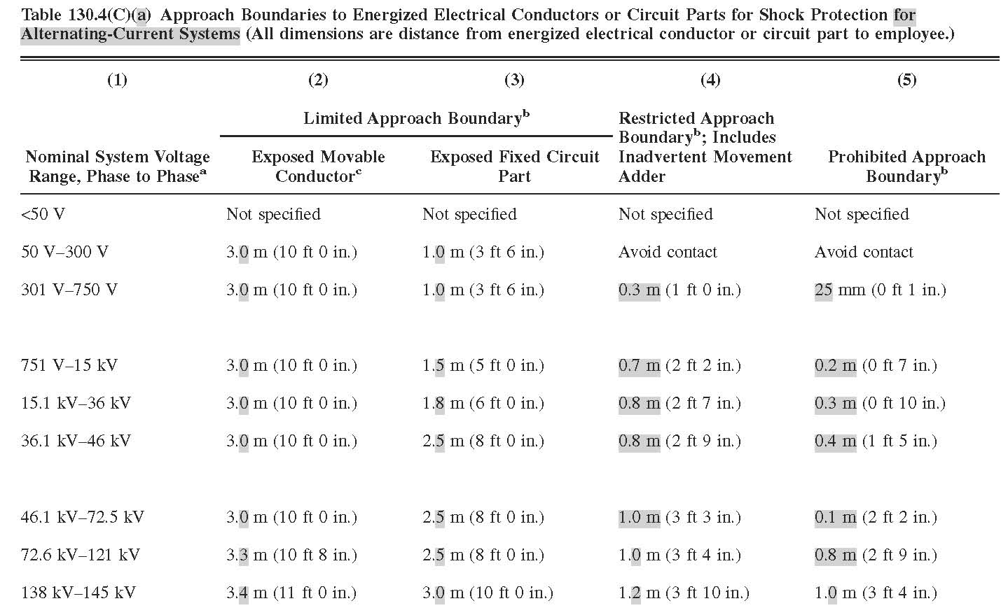
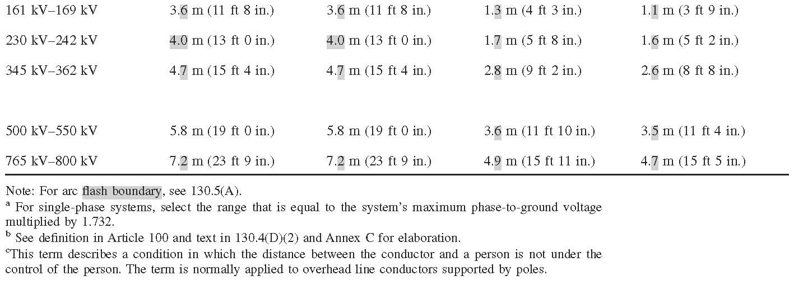
2012 NFPA 70E®
Notes:
Table 130.4(C)(a) (pg 24)

Slide 61
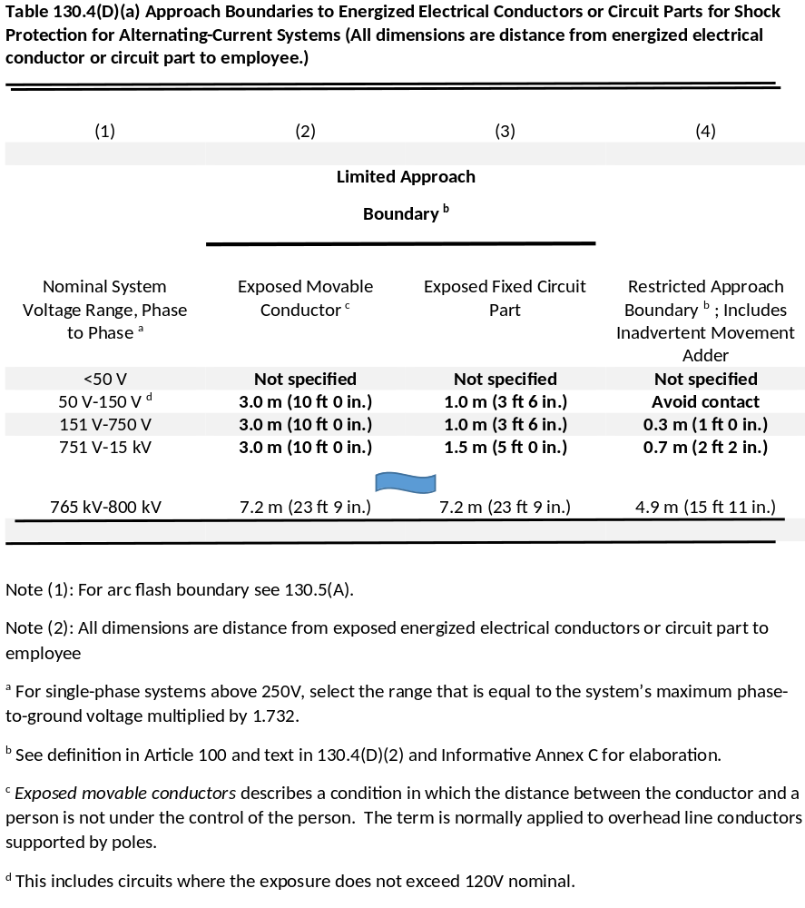
2015 NFPA 70E®
Notes:
Table 130.4(D)(a)
The slide reflects an abbreviated table, but none of the missing information is different than the 2012 edition. Note the elimination of the Prohibited Approach Boundary. The changes to the notes are discussed in the following slide.

Slide 62
Notes revised to account for 240 volt systems and clarification of existing language.
2012 NFPA 70E®
2015 NFPA 70E®
Table 130.4(C)(a)
Note: For arc flash boundary, see 130.5(A).
ª For single-phase systems, select the range that is equal to the system’s maximum phase-to-ground voltage multiplied by 1.732.
^{b} See definition in Article 100 and text in 130.4(D)(2) and Annex C for elaboration.
^{C} This term describes a condition in which the distance between the conductor and a person is not under the control of the person. The term is normally applied to overhead line conductors supported by poles.
Table 130.4(D)(a)
Note (1): For arc flash boundary see 130.5(A).
Note (2): All dimensions are distance from exposed energized electrical conductors or circuit part to employee
ª For single-phase systems above 250V, select the range that is equal to the system’s maximum phase-to-ground voltage multiplied by 1.732.
^{b} See definition in Article 100 and text in 130.4(D)(2) and Informative Annex C for elaboration.
^{c} Exposed movable conductors describes a condition in which the distance between the conductor and a person is not under the control of the person. The term is normally applied to overhead line conductors supported by poles.
^{d} This includes circuits where the exposure does not exceed 120V nominal.
Notes:
The change to note a and addition of note d, accounts for locations where the standard usable voltage is single phase 240, as is the case in many countries outside the U.S. Note (2) is moved from the introduction for usability.

Slide 63
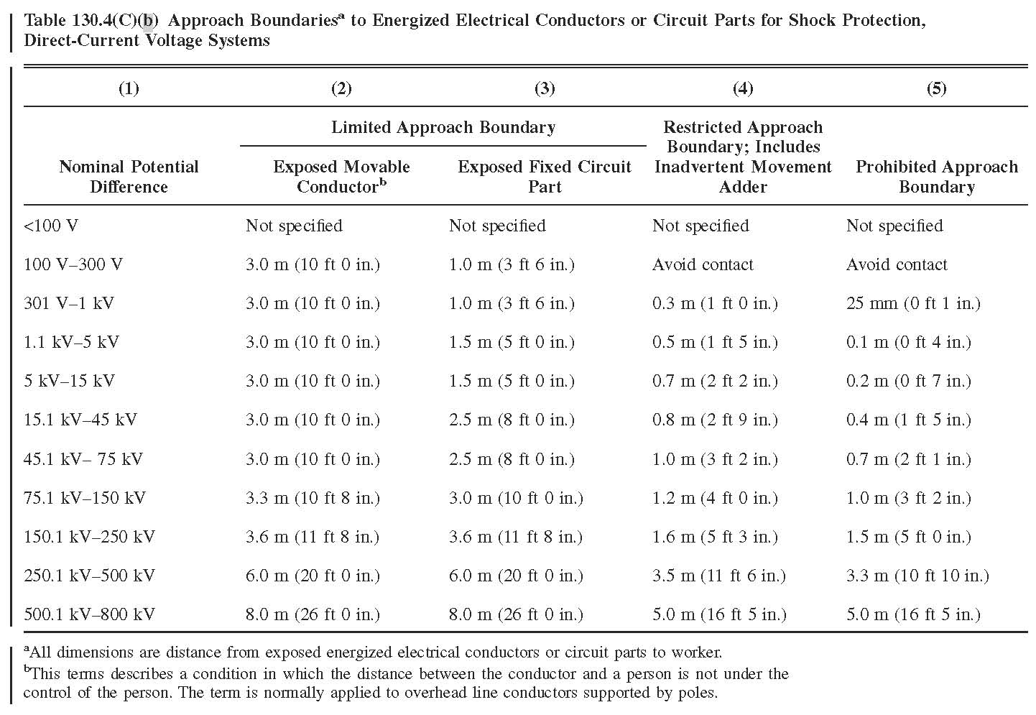
2012 NFPA 70E®
Notes:
Table 130.4(C)(b) (pg 25)

Slide 64
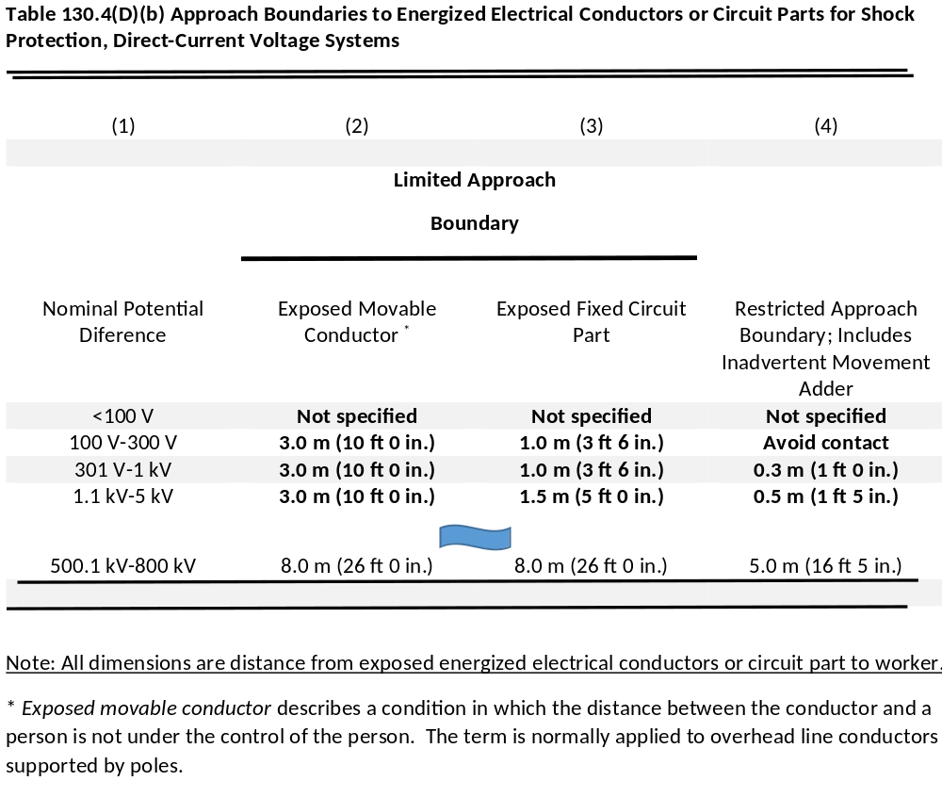
2015 NFPA 70E®
Notes:
Table 130.4(D)(b)
The slide reflects an abbreviated table, but none of the missing information is different than the 2012 edition. Note the elimination of the Prohibited Approach Boundary. The changes to the notes are basically the same as for AC.

Slide 65
Section reformatted for readability. Exception and requirement for incident energy determination relocated
2012 NFPA 70E®
2015 NFPA 70E®
130.5 Arc Flash Hazard Analysis. An arc flash hazard analysis shall determine the arc flash boundary, the incident energy at the working distance, and the personal protective equipment that people within the arc flash boundary shall use.
The arc flash hazard analysis shall be updated when a major modification or renovation takes place. It shall be reviewed periodically, not to exceed 5 years, to account for changes in the electrical distribution system that could affect the results of the arc flash hazard analysis.
The arc flash hazard analysis shall take into consideration the design of the overcurrent protective device and its opening time, including its condition of maintenance.
Exception: The requirements of 130.7(C)(15) and 130.7(C)(16) shall be permitted to be used in lieu of determining the incident energy at the working distance.
130.5 Arc Flash Risk Assessment. An arc flash risk assessment shall be performed and shall:
Determine if an arc flash hazard exists. If an arc flash hazard exists, the risk assessment shall determine:
  Appropriate safety-related work practices
  The arc flash boundary
  The PPE to be used within the arc flash boundary
Be updated when a major modification or renovation takes place. It shall be reviewed periodically, at intervals not to exceed 5 years, to account for changes in the electrical distribution system that could affect the results of the arc flash risk assessment.
Take into consideration the design of the overcurrent protective device and its opening time, including its condition of maintenance.
Notes:
This section received a major overhaul to the format. The changes will make it easier to read and understand. By removing the reference to incident energy, the need for the exception disappeared.

Slide 66
Change explains the results of not installing or maintaining equipment properly.
2012 NFPA 70E®
2015 NFPA 70E®
130.5 Arc Flash Hazard Analysis. Informational Note No. 1: Improper or inadequate maintenance can result in increased opening time of the overcurrent protective device, thus increasing the incident energy.
130.5 Arc Flash Risk Assessment. Informational Note No. 1: Improper or inadequate maintenance can result in increased opening time of the overcurrent protective device, thus increasing the incident energy. Where equipment is not properly installed or maintained, PPE selection based on incident energy analysis or the PPE category method may not provide adequate protection from arc flash hazards.
Notes:
This and the following two slides discuss the changes with the informational notes to 130.5. It only address the notes that had revisions. disappeared.

Slide 67
Wording is clarified and a new reference to Informative Annex O added.
2012 NFPA 70E®
2015 NFPA 70E®
130.5 Arc Flash Hazard Analysis.
Informational Note No. 3: The occurrence of an arcing fault inside an enclosure produces a variety of physical phenomena very different from a bolted fault. For example, the arc energy resulting from an arc developed in the air will cause a sudden pressure increase and localized overheating. Equipment and design practices are available to minimize the energy levels and the number of at-risk procedures
that require an employee to be exposed to high-level energy sources. Proven designs such as arc-resistant switchgear, remote racking (insertion or removal), remote opening and closing of switching devices, high-resistance
grounding of low-voltage and 5-kV (nominal) systems, current limitation, and specification of covered bus or covered conductors within equipment are techniques available to reduce the hazard of the system
130.5 Arc Flash Risk Assessment.
Informational Note No. 3: The occurrence of an arcing fault inside an enclosure produces a variety of physical phenomena very different from a bolted fault. For example, the arc energy resulting from an arc developed in the air will cause a sudden pressure increase and localized overheating. Equipment and design practices are available to minimize the energy levels and the number of procedures that could expose an employee to high levels of incident energy. Proven designs such as arc-resistant switchgear, remote racking (insertion or removal), remote opening and closing of switching devices, high-resistance
grounding of low-voltage and 5000 volts (nominal) systems, current limitation, and specification of covered bus or covered conductors within equipment are available to reduce the risk associated with an arc flash incident. See Informative Annex O for Safety-Related Design Requirements.

Slide 68
Reference to less than 240 volts removed for accuracy.
2012 NFPA 70E®
2015 NFPA 70E®
130.5 Arc Flash Hazard Analysis.
Informational Note No. 5: See IEEE 1584 for more information regarding arc flash hazards for three-phase systems rated less than 240 volts.
130.5 Arc Flash Risk Assessment.
Informational Note No. 5: See IEEE 1584 for more information regarding arc flash hazards for three-phase systems.
Notes:
The reference to IEEE 1584 implied the standard would discuss how to perform arc flash at lower levels. The opposite is true. The 1584 Standard does not address arc flash hazards below 240 volts, since voltage at those levels were not tested.

Slide 69
Added requirement to document assessment and reformatted section.
2012 NFPA 70E®
2015 NFPA 70E®
130.5 Arc Flash Hazard Analysis.
(A) Arc Flash Boundary. The arc flash boundary for systems
50 volts and greater shall be the distance at which the incident energy equals 5 J/cm² (1.2 cal/cm²).
Informational Note: For information on estimating the arc flash boundary, see Annex D.
130.5 Arc Flash Risk Assessment.
(A) Documentation. The results of the arc flash risk assessment shall be documented.
(B) Arc Flash Boundary.
The arc flash boundary shall be the distance at which the incident energy equals 5 J/cm² (1.2 cal/cm²).
Informational Note: For information on estimating the arc flash boundary, see Annex D.
The arc flash boundary shall be permitted to be determined by Table 130.7(C)(15)(A)(b) or Table 130.7(C)(15)(B), when the requirements of these tables apply.
Notes:
The arc flash risk assessment must now be documented whether an incident energy or table method is used to determine the boundary and PPE. Also, here an other places more emphasis is added to ensure the bounding criteria is considered before the tables are allowed to be used.

Slide 70
Added greater emphasis to requirement that both analysis methods are not permitted simultaneously.
2012 NFPA 70E®
2015 NFPA 70E®
130.5 Arc Flash Hazard Analysis.
(B) Protective Clothing and Other Personal Protective Equipment (PPE) for Application with an Arc Flash Hazard Analysis. Where it has been determined that work will be performed within the arc flash boundary, one of the following methods shall be used for the selection of protective clothing and other personal protective equipment (PPE):
(1) Incident Energy Analysis. The incident energy analysis shall determine, and the employer shall document, the incident energy exposure of the worker (in calories per square centimeter). The incident energy exposure level shall be based on the working distance of the employee’s face and chest areas from a prospective arc source for the specific task to be performed. Arc-rated clothing and other PPE shall be used by the employee based on the incident energy exposure associated with the specific task. Recognizing that incident energy increases as the distance from the arc flash decreases, additional PPE shall be used for any parts of the body that are closer than the distance at which the incident energy was determined.
130.5 Arc Flash Risk Assessment.
(C) Arc Flash PPE. One of the following methods shall be used for the selection of PPE. Either, but not both, methods shall be permitted to be used on the same piece of equipment. The results of an incident energy analysis to specify an arc flash PPE Category in Table 130.7(C)(16) shall not be permitted.
(1) Incident Energy Analysis Method. The incident energy exposure level shall be based on the working distance of the employee’s face and chest areas from a prospective arc source for the specific task to be performed. Arc-rated clothing and other PPE shall be used by the employee based on the incident energy exposure associated with the specific task. Recognizing that incident energy increases as the distance from the arc flash decreases, additional PPE shall be used for any parts of the body that are closer than the distance at which the incident energy was determined.
Notes:
It appears that once an incident energy analysis is performed on a particular piece of equipment, all future work activities requirement the incident energy analysis method to determine arc flash PPE.

Slide 71
Revisions reflect new approach to use of tables for selection of arc flash PPE.
2012 NFPA 70E®
2015 NFPA 70E®
130.5 Arc Flash Hazard Analysis.
(B)(2) Hazard/Risk Categories. The requirements of 130.7(C)(15) and 130.7(C)(16) shall be permitted to be used for the selection and use of personal and other protective equipment.
130.5 Arc Flash Risk Assessment.
(C)(2) Arc Flash PPE Categories Method. The requirements of 130.7(C)(15) and 130.7(C)(16) shall apply when the arc flash PPE category method is used for the selection of arc flash PPE.
Notes:
The term: “hazard/risk category” is no longer used in the standard. The revisions to the tables reflected in the following slides indicate a new approach to selecting PPE using the tables.

Slide 72
Revisions to labels reflect new approach to use of tables for selection of arc flash PPE.
2012 NFPA 70E®
2015 NFPA 70E®
130.5(C) Equipment Labeling. Electrical equipment such as switchboards, panelboards, industrial control panels, meter socket enclosures, and motor control centers that are in other than dwelling units, and are likely to require examination, adjustment, servicing, or maintenance while energized, shall be field marked with a label containing all the following information:
(1) At least one of the following:
a. Available incident energy and the corresponding working distance
b. Minimum arc rating of clothing
c. Required level of PPE
d. Highest Hazard/Risk Category (HRC) for the equipment
(2) Nominal system voltage
(3) Arc flash boundary
130.5(D) Equipment Labeling. Electrical equipment such as switchboards, panelboards, industrial control panels, meter socket enclosures, and motor control centers that are in other than dwelling units, and are likely to require examination, adjustment, servicing, or maintenance while energized, shall be field marked with a label containing all the following information:
Nominal system voltage
Arc flash boundary
At least one of the following:
a. Available incident energy and the corresponding working distance, or the arc flash PPE category in Table 130.7(C)(15)(A)(b) or 130.7(C)(B) for the equipment but not both
b. Minimum arc rating of clothing
c. Site-specific level of PPE
Notes:
The list was reversed to make the subsection easier to read. In addition, the changes clarified what is meant by “level of PPE.” The level is determined by the user. One method could be to use Table H.3.b to establish levels of PPE.

Slide 73
A new requirement that establishes responsibility for installing and maintaining labels.
2012 NFPA 70E®
2015 NFPA 70E®
130.5(C) Equipment Labeling.
New Requirement.
130.5(D) Equipment Labeling.
The owner of the electrical equipment shall be responsible for the documentation, installation, and maintenance for the field-marked label.
Notes:
This is one of two places where responsibility is assigned to the equipment owner. The second place will be addressed in Chapter 2 information.

Slide 74
Clarified that the boundary that is considered a shock hazard for qualified persons is the RAB.
2012 NFPA 70E®
2015 NFPA 70E®
130.6(D) Conductive Articles Being Worn. Conductive articles of jewelry and clothing (such as watchbands, bracelets, rings, key chains, necklaces, metalized aprons, cloth with conductive thread, metal headgear, or metal frame glasses) shall not be worn where they present an electrical contact hazard with exposed energized electrical conductors or circuit parts.
130.6(D) Conductive Articles Being Worn. Conductive articles of jewelry and clothing (such as watchbands, bracelets, rings, key chains, necklaces, metalized aprons, cloth with conductive thread, metal headgear, or metal frame glasses) shall not be worn within the restricted approach boundary or where they present an electrical contact hazard with exposed energized electrical conductors or circuit parts.
Notes:
.There are a number of changes that clarified the safe approach boundary for a qualified person is the restricted approach boundary. The safe approach boundary for unqualified persons is the limited approach boundary. This was clear in Informative Annex C, but now that information is moved into the mandatory language to remove ambiguity.

Slide 75
New subsection added to keep area in front of electrical equipment clear.
2012 NFPA 70E®
2015 NFPA 70E®
130.6
New Subsection.
130.6(H) Clear Spaces. Working space in front of electrical equipment required by other codes and standards shall not be used for storage. This space shall be kept clear to permit safe operation and maintenance of electrical equipment.
Notes:
.This change, as well as a similar addition in Chapter 2, is intended to maintain the working space in front of equipment clear. This is an NEC requirement (110.26(B)), but difficult to enforce after initial installation and inspection. Making this a work practice will enable enforcement.

Slide 76
Replaces language removed for 2012. Corresponds to OSHA language.
2012 NFPA 70E®
2015 NFPA 70E®
130.6(L) Reclosing Circuits After Protective Device Operation. After a circuit is de-energized by the automatic operation of a circuit protective device, the circuit shall not be manually reenergized until it has been determined that the equipment and circuit can be safely energized. The repetitive manual reclosing of circuit breakers or reenergizing circuits through replaced fuses shall be prohibited. When it is determined that the automatic operation of a device was caused by an overload rather than a fault condition, examination of the circuit or connected equipment shall not be required before the circuit is reenergized.
130.6(M) Reclosing Circuits After Protective Device Operation. After a circuit is de-energized by the automatic operation of a circuit protective device, the circuit shall not be manually reenergized until it has been determined that the equipment and circuit can be safely energized. The repetitive manual reclosing of circuit breakers or reenergizing circuits through replaced fuses shall be prohibited. When it is determined from the design of the circuit and the overcurrent devices involved that the automatic operation of a device was caused by an overload rather than a fault condition, examination of the circuit or connected equipment shall not be required before the circuit is reenergized.
Notes:
This new language is simply a replacement of the action taken in 2012. Taken literally, a person qualified or unqualified, could have made the assumption that the trip or blown fuse was caused by an overload without further investigation. The reinserted language now requires someone knowledgeable of the circuit or device to determine whether it is safe to reenergize the circuit. This also should be considered with the requirement in 225.3 to retest circuit breakers that experience a fault near their interrupting rating.

Slide 77
Clarifies the concern is not just shock hazards.
2012 NFPA 70E®
2015 NFPA 70E®
130.7(A) Personal and Other Protective Equipment.
Informational Note No. 3: When incident energy exceeds 40 cal/cm² at the working distance, greater emphasis may be necessary with respect to de-energizing before working within the limited approach boundary of the exposed electrical conductors or circuit parts.
130.7(A) Personal and Other Protective Equipment.
Informational Note No. 3: When incident energy exceeds 40 cal/cm² at the working distance, greater emphasis may be necessary with respect to de-energizing when exposed to electrical hazards.
Notes:
The informational note expressed concern regarding the incident exposure level, but established the threshold at a shock approach boundary. The language now includes both hazards as a concern.

Slide 78
Shock PPE is no longer part of the arc flash tables.
2012 NFPA 70E®
2015 NFPA 70E®
130.7(C)(7)(a) Shock Protection.
Informational Note: Table 130.7(C)(15)(a) and Table 130.7(C)(15)(b) provide further information on tasks where rubber insulating gloves are required.
130.7(C)(7)(a) Shock Protection.
Informational Note: Table 130.7(C)(15)(a) and Table 130.7(C)(15)(b) provide further information on tasks where rubber insulating gloves are required.
Notes:
The informational note is no longer applicable since the columns in the arc flash tables addressing shock protection PPE has been deleted.

Slide 79
Corrects missing information from previous language.
2012 NFPA 70E®
2015 NFPA 70E®
130.7(C)(9) Factors in Selection of Protective Equipment.
(d) Coverage. Clothing shall cover potentially exposed areas as completely as possible. Shirt sleeves shall be fastened at the wrists, and shirts and jackets shall be closed at the neck.
130.7(C)(9) Factors in Selection of Protective Equipment.
(d) Coverage. Clothing shall cover potentially exposed areas as completely as possible. Shirt and coverall sleeves shall be fastened at the wrists, shirts shall be tucked into pants, and shirts, coveralls, and jackets shall be closed at the neck.
Notes:
The added language clarifies the intent that all openings be closed and includes coveralls to the clothing items that must be closed.

Slide 80
Removes reference to Hazard/Risk Category 0 that no longer exists.
2012 NFPA 70E®
2015 NFPA 70E®
130.7(C)(12) Clothing and Other Apparel Not Permitted.
Exception No. 1: Nonmelting, flammable (non–arc-rated) materials shall be permitted to be used as underlayers to arc-rated clothing, as described in 130.7(C)(11), and also shall be permitted to be used for Hazard/Risk Category 0 as described in Table 130.7(C)(16).
130.7(C)(12) Clothing and Other Apparel Not Permitted.
Exception No. 1: Nonmelting, flammable (non–arc-rated) materials shall be permitted to be used as underlayers to arc-rated clothing, as described in 130.7(C)(11).
Notes:
This slide removes the reference to HRC 0. Neither the HRC or a PPE Category 0 exists with the revision to the arc flash tables.

Slide 81
Requires decision for proper PPE to be based on a risk assessment, not approval of AHJ.
2012 NFPA 70E®
2015 NFPA 70E®
130.7(C)(12) Clothing and Other Apparel Not Permitted.
Exception No. 2: Where the work to be performed inside the arc flash boundary exposes the worker to multiple hazards, such as airborne contaminants, under special permission by the authority having jurisdiction and where it can be shown that the level of protection is adequate to address the arc flash hazard, non–arc-rated personnel protective equipment shall be permitted.
130.7(C)(12) Clothing and Other Apparel Not Permitted.
Exception No. 2: Where the work to be performed inside the arc flash boundary exposes the worker to multiple hazards, such as airborne contaminants, and the risk assessment identifies that the level of protection is adequate to address the arc flash hazard, non–arc-rated PPE shall be permitted.
Notes:
The responsibility to perform a risk assessment to determine the PPE when there are conflicting requirements is the responsibility of the employer, not the AHJ.

Slide 82
New Informational Note references provide laundering information.
130.7(C)(13) Clothing and Other Apparel Not Permitted.
New Informational Note.
130.7(C)(13) Clothing and Other Apparel Not Permitted.
Informational Note No. 2: Additional guidance is provided in ASTM F 1449, Standard Guide for Industrial Laundering of Flame, Thermal, and Arc Resistant Clothing, and ASTM F 2757, Standard Guide for Home Laundering Care and Maintenance of Flame, Thermal and Arc Resistant Clothing.
2012 NFPA 70E®
2015 NFPA 70E®

Slide 83
Changes reflect new approach to PPE tables.
130.7(C)(15) Selection of Personal Protective Equipment When Required for Various Tasks. Where selected in lieu of the incident energy analysis of 130.5(B)(1), Table 130.7(C)(15)(a) and Table 130.7(C)(15)(b) shall be used to determine the hazard/risk category and requirements for use of rubber insulating gloves and insulated and insulating hand tools for a task. The assumed maximum short-circuit current capacities and maximum fault clearing times for various tasks are listed in Table 130.7(C)(15)(a). For tasks not listed, or for power systems with greater than the assumed maximum short-circuit current capacity or with longer than the assumed maximum fault clearing times, an incident energy analysis shall be required in accordance with 130.5.
130.7(C)(15) Selection of Personal Protective Equipment When Required for Various Tasks.
(A) Alternating Current (ac) Equipment. Where selected in lieu of the incident energy analysis of 130.5(B)(1), Table 130.7(C)(15)(A)(a) shall be used to identify when arc flash PPE is required. Table 130.7(C)(15)(A)(b) shall be used to determine the arc flash PPE category. The estimated maximum available short-circuit current, maximum fault clearing times, and minimum working distances for various ac equipment types or classifications are listed in Table 130.7(C)(15)(A)(b).
2012 NFPA 70E®
2015 NFPA 70E®
Notes:
This slide and the one following provide the introduction to the new tables for determination of arc flash PPE.

Slide 84
Changes reflect new approach to PPE tables.
130.7(C)(15) Selection of Personal Protective Equipment When Required for Various Tasks. Where selected in lieu of the incident energy analysis of 130.5(B)(1), Table 130.7(C)(15)(a) and Table 130.7(C)(15)(b) shall be used to determine the hazard/risk category and requirements for use of rubber insulating gloves and insulated and insulating hand tools for a task. The assumed maximum short-circuit current capacities and maximum fault clearing times for various tasks are listed in Table 130.7(C)(15)(a). For tasks not listed, or for power systems with greater than the assumed maximum short-circuit current capacity or with longer than the assumed maximum fault clearing times, an incident energy analysis shall be required in accordance with 130.5.
130.7(C)(15) Selection of Personal Protective Equipment When Required for Various Tasks.
CONTINUED FROM PREVIOUS SLIDE
An incident energy analysis shall be required in accordance with 130.5 for the following:
Tasks not listed in Table 130.7(C)(15)(A)(a)
Power systems with greater than the estimated maximum available short-circuit current
Power systems with longer than the maximum fault clearing times
Tasks with less than the minimum working distance.
2012 NFPA 70E®
2015 NFPA 70E®

Slide 85
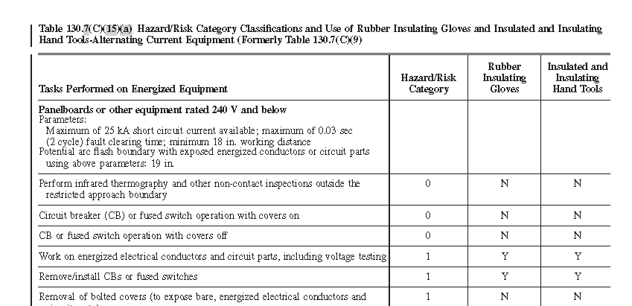
2012 NFPA 70E®
Notes:
Table 130.7C)(15)(a)

Slide 86
2012 NFPA 70E®
Notes to Table 130.7(C)(15)(a)
Y = Yes (required). N: No (not required).
Notes:
(1) Rubber insulating gloves are gloves rated for the maximum line-to-line voltage upon which work will be
done.
(2) Insulated and insulating hand tools are tools rated and tested for the maximum line-to-line voltage upon
which work will be done, and are manufactured and tested in accordance with ASTM F 1505, Standard
Specification for Insulated and Insulating Hand Tools.
(3) The use of “N” does not indicate that rubber insulating gloves and insulated and insulating hand tools are not
required in all cases. Rubber insulating gloves and insulated and insulating hand tools may be required by 130.4,
130.8 (C) (7), and 130.8(D).
(4) For equipment protected by upstream current limiting fuses with arcing fault current in their current limiting
range (1⁄2 cycle fault clearing time or less), the hazard/risk category required may be reduced by one number.
(5) For power systems up to 600 V the arc flash boundary was determined by using the following information:
When 0.03 second trip time was used, that indicated MCC or panelboard equipment protected by a molded-case
circuit breaker. Working distance used was 18 in. (455 mm). Arc gap used was 32 mm for switchgear and 25 mm for
MCC and protective device type 0 for all. When 0.33 or 0.5 second trip time was used, that indicated a LVPCB
(drawout circuit breaker) in switchgear. Working distance was 24 in. (610 mm). Arc gap used was 32 mm and
protective device type 0 for all. All numbers were rounded up or down depending on closest multiple of 5.
(6) For power systems from 1 kV to 38 kV the arc flash boundary was determined by using the following information:
No maximum values were given in the 2009 edition of NFPA 70E for short-circuit current or operating time.
Two sets of equations were performed: 35 kA AIC and 0.2 second operating time and 26 kA AIC and 0.2 second
operating time. 0.2 seconds was used by adding the typical maximum total clearing time of the circuit breaker to an
estimated value for relay operation. This coincides with the IEEE 1584 values of 0.18 second operating time and 0.08
tripping time rounded off. A short-circuit current of 35 kA was used as a maximum (HRC-4 @ ~ 40 cal/cm²) and
26 kA was used to compare the effects of lowering the short circuit current (HRC-4 @ ~ 30 cal/cm²). Working
distance used was 36 in. (909 mm), arc gap was 6 in. (455 mm), and protective device type 0 for all.
Notes:
Table 130.7C)(15)(a)

Slide 87
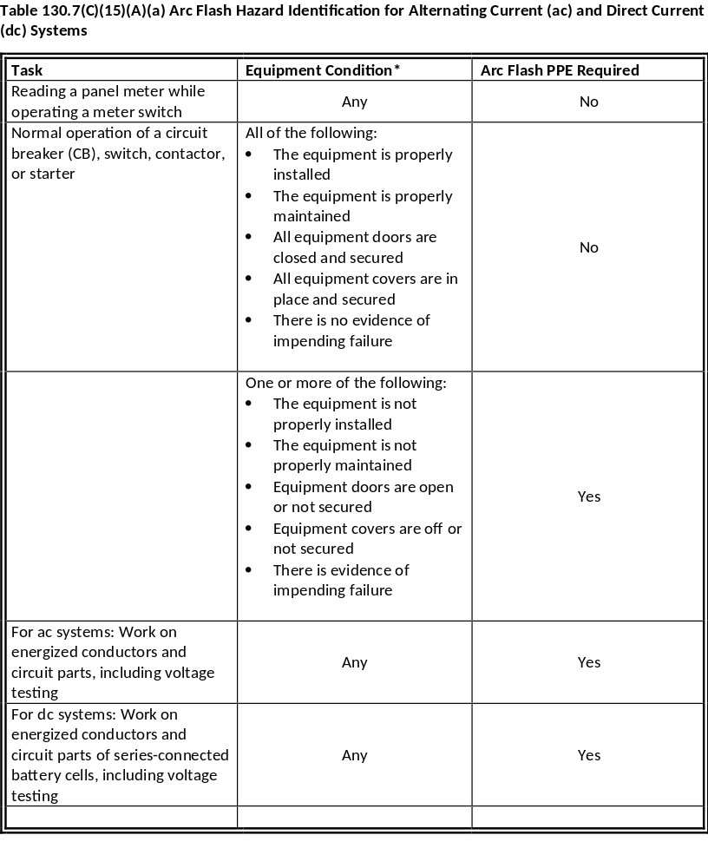
2015 NFPA 70E®
Notes:
Table 130.7C)(15)(A)(a)

Slide 88
2015 NFPA 70E®
Notes to Table 130.7(C)(15)(A)(a)
Note: Hazard identification is one component of risk assessment. Risk assessment involves a determination of the likelihood of occurrence of an incident resulting from a hazard that could cause injury or damage to health. The assessment of the likelihood of occurrence contained in this table does not cover every possible condition or situation. Where this table indicates that arc flash PPE is not required, an arc flash is not likely to occur.
*The phrase properly installed, as used in this table, means that the equipment is installed in accordance with applicable industry codes and standards and the manufacturer’s recommendations. The phrase properly maintained, as used in this table means that the equipment has been maintained in accordance with the manufacturer’s recommendations and applicable industry codes and standards. The phrase evidence of impending failure, as used in this table, means that there is evidence of arcing, overheating, loose or bound equipment parts. Visible damage, deterioration, or other damage.
Notes:
Table 130.7C)(15)(A)(a)

Slide 89
Activities Not Requiring Arc Flash PPE
2015 NFPA 70E®
Reading meter while operating switch | Normal operation of CB, switch, contactor, or starter | Voltage testing on individual battery cells or individual multi-cell units
Removal or installation of covers for equipment not exposing bare, energized parts | Removal of battery inter-cell connector covers | Performing inspection (include thermography) outside RAB, not including opening covers/doors
Work on <120 V, including opening doors/covers | Insulated cable inspection without manipulation | Remove/install cells in an open rack
Maintaining battery cells in open rack | Certain tasks for qualified Arc-resistant switchgear
Notes:
List of activities from Table 130.7(C)(15)(A)(a) that under qualifying conditions do not require the use of arc-flash clothing. Remind the students that other hazards such as shock, thermal burns, and arc-blast effects could still warrant PPE.

Slide 90
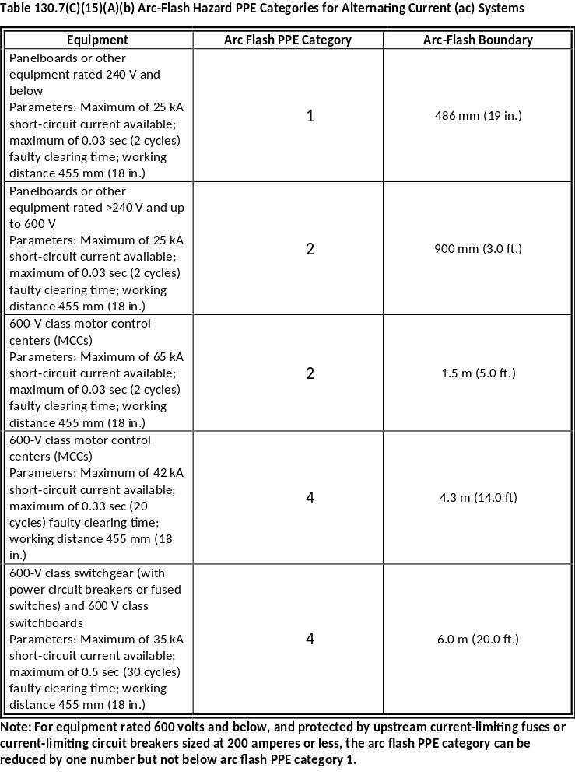
2015 NFPA 70E®
Notes:
Table 130.7C)(15)(A)(b)

Slide 91
Changes reflect new approach to PPE tables.
130.7(C)(15) Selection of Personal Protective Equipment When Required for Various Tasks. Where selected in lieu of the incident energy analysis of 130.5(B)(1), Table 130.7(C)(15)(a) and Table 130.7(C)(15)(b) shall be used to determine the hazard/risk category and requirements for use of rubber insulating gloves and insulated and insulating hand tools for a task. The assumed maximum short-circuit current capacities and maximum fault clearing times for various tasks are listed in Table 130.7(C)(15)(a). For tasks not listed, or for power systems with greater than the assumed maximum short-circuit current capacity or with longer than the assumed maximum fault clearing times, an incident energy analysis shall be required in accordance with 130.5.
130.7(C)(15) Selection of Personal Protective Equipment When Required for Various Tasks.
(B) Direct Current (dc) Equipment. Where selected in lieu of the incident energy analysis of 130.5(B)(1), Table 130.7(C)(15)(A)(a) shall be used to identify when arc flash PPE is required. Table 130.7(C)(15)(B) shall be used to determine the arc flash PPE category. The estimated maximum available short-circuit current, maximum arc duration, and working distances for various dc equipment are listed in Table 130.7(C)(15)(B).
2012 NFPA 70E®
2015 NFPA 70E®
Notes:
This slide and the one following provide the introduction to the new tables for determination of arc flash PPE for dc systems.

Slide 92
Changes reflect new approach to PPE tables..
130.7(C)(15) Selection of Personal Protective Equipment When Required for Various Tasks. Where selected in lieu of the incident energy analysis of 130.5(B)(1), Table 130.7(C)(15)(a) and Table 130.7(C)(15)(b) shall be used to determine the hazard/risk category and requirements for use of rubber insulating gloves and insulated and insulating hand tools for a task. The assumed maximum short-circuit current capacities and maximum fault clearing times for various tasks are listed in Table 130.7(C)(15)(a). For tasks not listed, or for power systems with greater than the assumed maximum short-circuit current capacity or with longer than the assumed maximum fault clearing times, an incident energy analysis shall be required in accordance with 130.5.
130.7(C)(15)(B) Direct Current (dc) Equipment.
CONTINUED FROM PREVIOUS SLIDE
An incident energy analysis shall be required in accordance with 130.5 for the following:
Tasks not listed in Table 130.7(C)(15)(A)(a)
Power systems with greater than the estimated maximum available short-circuit current
Power systems with longer than the maximum fault clearing times
Tasks with less than the minimum working distance.
2012 NFPA 70E®
2015 NFPA 70E®

Slide 93
Informational Note reflects changes to the task tables.
130.7(C)(15) Selection of Personal Protective Equipment When Required for Various Tasks.
Informational Note No. 1:The hazard/risk category, work tasks, and protective equipment identified in Table 130.7(C)(15)(a) were identified by a task group, and the hazard/risk category, protective clothing, and equipment selected were based on the collective experience of the task group. The hazard/risk category protective clothing and equipment are generally based on determination of estimated exposure levels.
In several cases, where the risk of an arc flash incident is considered low, very low, or extremely low by the task group, the hazard/risk category number has been reduced by 1, 2, or 3 numbers, respectively.
130.7(C)(15) Selection of Personal Protective Equipment When Required for Various Tasks.
Informational Note No. 1:The arc flash PPE category, work tasks, and protective equipment provided in Table 130.7(C)(15)(A)(a), Table 130.7(C)(15)(A)(b), and Table 130.7(C)(15)(B) were identified and selected, based on the collective experience of the NFPA 70E Technical Committee. The arc flash PPE category of the protective clothing and equipment is generally based on determination of the estimated exposure level.
2012 NFPA 70E®
2015 NFPA 70E®
Notes:
Notes 2 and 3 remain generally as worded in 2012.

Slide 94
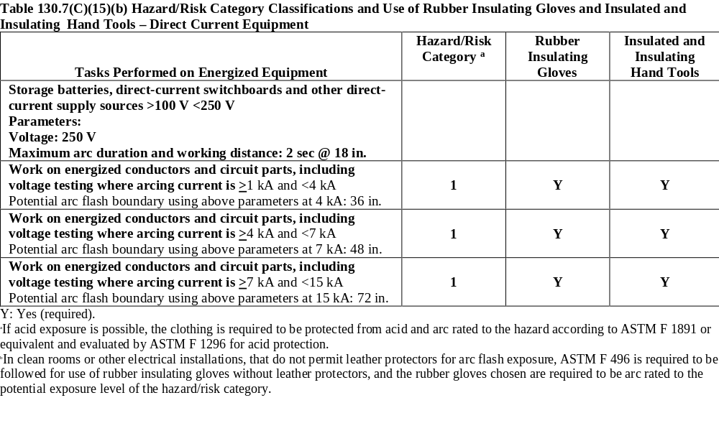
2012 NFPA 70E®
Notes:
Table 130.7C)(15)(a)

Slide 95
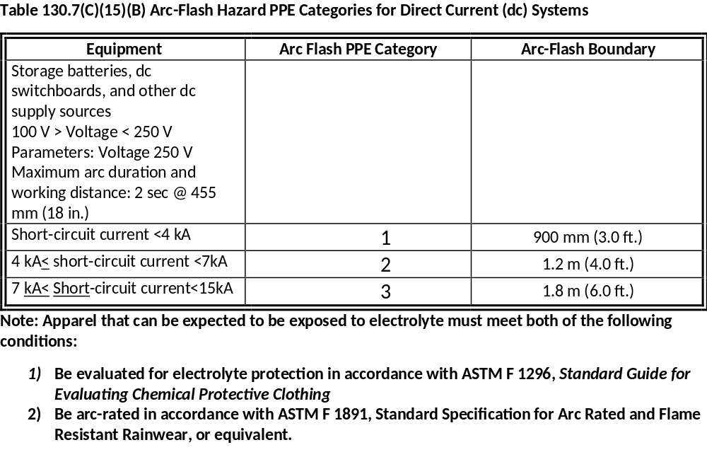
2015 NFPA 70E®
Notes:
Table 130.7C)(15)(B) Note the current is listed in short-circuit current rather than arcing current as in the 2012 edition. Short circuit current is easier to obtain than arcing current, which requires calculation.

Slide 96
Informational Note to explain assumed short-circuit current values to use with the table.
Table 130.7(C)(15)(b) Hazard/Risk Category Classifications and Use of Rubber Insulating Gloves and Insulated and Insulating Hand Tools – Direct Current Equipment.
New Informational Notes
130.7(C)(15)(B) Direct Current (dc) Equipment.
Informational Note No. 1: “Short-circuit current,” as used in this table, is determined from the dc power system maximum available short-circuit, including the effects of cables and any other impedances in the circuit Power system modeling is the best method to determine the available short-circuit current at the point of the arc. Battery cell short-circuit current can be obtained from the battery manufacturer. See Informative Annex D.5 for the bass for table values and alternative methods to determine dc incident energy. Methods should be used with good engineering judgment.
2012 NFPA 70E®
2015 NFPA 70E®

Slide 97
Informational Note to explain assumptions made to develop the table.
Table 130.7(C)(15)(b) Hazard/Risk Category Classifications and Use of Rubber Insulating Gloves and Insulated and Insulating Hand Tools – Direct Current Equipment.
New Informational Notes
130.7(C)(15)(B) Cont.
Informational Note No. 2: The methods for estimating the dc arc flash incident energy that were used to determine the categories for this table are based on open-air incident energy calculations. Open-air calculations were used because many battery systems and other dc process systems are in open areas or rooms. If the specific task is within an enclosure, it would be prudent to consider additional PPE protection beyond the value shown in th table. Research with ac arc flash has shown a multiplier of as much as 3X for ac-in-a-box [508 mm (20 in.) cube] versus open air. Engineering judgment is required when reviewing the specific conditions of the equipment and task to be performed, including the dimensions of the enclosure and working distance involved.
2012 NFPA 70E®
2015 NFPA 70E®

Slide 98
Changes reflect elimination of category 0 and revisions to the task tables.
130.7(C)(16) Protective Clothing and Personal Protective Equipment.
Once the hazard/risk category has been identified from Table 130.7(C)(15)(a) and Table 130.7(C)(15)(b) (including associated notes) and the requirements of 130.7(C)(15), Table 130.7(C)(16) shall be used to determine the required PPE for the task. Table 130.7(C)(16) lists the requirements for protective clothing and other protective equipment based on Hazard/Risk Categories 0 through 4. This clothing and equipment shall be used when working within the arc flash boundary.
130.7(C)(16) Protective Clothing and Personal Protective Equipment.
Once the arc flash PPE category has been identified from Table 130.7(C)(15)(A)(a), or Table 130.7(C)(15)(B); Table 130.7(C)(16) shall be used to determine the required PPE for the task. Table 130.7(C)(16) lists the requirements for PPE based on PPE categories 1 through 4. This clothing and equipment shall be used when working within the arc flash boundary.
2012 NFPA 70E®
2015 NFPA 70E®

Slide 99
Changes reflect elimination of category 0.
Table 130.7(C)(16) Protective Clothing and Personal Protective Equipment.
Included HRC 0
Table 130.7(C)(16) Protective Equipment (PPE).
PPE 1-4 (No Category 0)
2012 NFPA 70E®
2015 NFPA 70E®

Slide 100
Moves shock hazard for qualified person to the restricted approach boundary.
130.7(D) Other Protective Equipment.
(1) Insulated Tools and Equipment. Employees shall use insulated tools or handling equipment, or both, when working inside the limited approach boundary of exposed energized electrical conductors or circuit parts where tools or handling equipment might make accidental contact. Table 130.7(C)(15)(a) and Table 130.7(C)(15)(b) provide further information for tasks that require insulated and insulating hand tools. Insulated tools shall be protected from damage to the insulating material.
130.7(D) Other Protective Equipment.
(1) Insulated Tools and Equipment. Employees shall use insulated tools or handling equipment, or both, when working inside the restricted approach boundary of exposed energized electrical conductors or circuit parts where tools or handling equipment might make accidental contact. Table 130.7(C)(15)(a) and Table 130.7(C)(15)(b) provide further information for tasks that require insulated and insulating hand tools. Insulated tools shall be protected from damage to the insulating material.
2012 NFPA 70E®
2015 NFPA 70E®

Slide 101
Increases distance for barricade to the greater of LAB or AFB.
130.7(E) Alerting Techniques.
(2) Barricades. Barricades shall be used in conjunction with safety signs where it is necessary to prevent or limit employee access to work areas containing energized conductors or circuit parts. Conductive barricades shall not be used where it might cause an electrical hazard. Barricades shall be placed no closer than the limited approach boundary given in Table 130.4(C)(a) and Table 130.4(C)(b).
130.7(E) Alerting Techniques.
(2) Barricades. Barricades shall be used in conjunction with safety signs where it is necessary to prevent or limit employee access to work areas containing energized conductors or circuit parts. Conductive barricades shall not be used where it might increase the likelihood of exposure to an electrical hazard. Barricades shall be placed no closer than the limited approach boundary given in Table 130.4(D)(a) and Table 130.4(D)(b). Where the arc flash boundary is greater than the limited approach boundary, barricades shall not be placed closer than the arc flash boundary.
2012 NFPA 70E®
2015 NFPA 70E®

Slide 102
New section addressing drilling into surfaces that might contain energized conductors.
2012 NFPA 70E®
2015 NFPA 70E®
130.10 New Section
130.10 Cutting or Drilling.
Before cutting or drilling into equipment, floors, walls, or structural elements where a likelihood of contacting energized electrical lines or parts exists, the employer shall perform a risk assessment to:
Identify and mark the location of conductors, cables, raceways, or equipment,
Create an electrically safe work condition, and
Identify safe work practices and PPE to be used.

Slide 103
Chapter 2

Slide 104
Adds requirement to keep equipment in safe condition while energized.
2015 NFPA 70E®
2012 NFPA 70E®
205.7 Guarding of Energized Conductors and Circuit Parts. Enclosures shall be maintained to guard against accidental contact with energized conductors and circuit parts and other electrical hazards.
205.7 Guarding of Energized Conductors and Circuit Parts. Enclosures shall be maintained to guard against accidental contact with energized conductors and circuit parts and other electrical hazards. Covers and doors shall be in place with all associated fasteners and latches secured.
Notes:
Unless fasteners are installed and doors are closed securely, the engineered barriers placed with properly installed equipment cannot be relied on to guard workers from electrical shock.

Slide 105
New requirement that qualified persons repair equipment that will be used by unqualified persons.
2015 NFPA 70E®
2012 NFPA 70E®
205.14 Flexible Cords and Cables.
(3) New Item
205.14 Flexible Cords and Cables.
(3) Repair and Replacement. Cords and cord caps for portable electrical equipment shall be repaired and replaced by qualified personnel and checked for proper polarity grounding, and continuity prior to returning to service.
Notes:
Many unqualified persons are shocked each year due to contact with improperly repaired portable tools.

Slide 106
New requirement intended to reduce the number of electrocutions due to contact with overhead lines.
2015 NFPA 70E®
2012 NFPA 70E®
205.15 Overhead Line Clearances.
New Section
205.15 Overhead Line Clearances.
For overhead electrical lines under the employer’s control, grade elevation shall be maintained to preserve no less than the minimum designed vertical and horizontal clearances necessary to minimize risk of unintentional contact.
Notes:
More fatalities are caused by contact with overhead lines than any other reason. Work sites, especially construction sites, sometimes ignore when the grade below overhead lines becomes higher than at original installation.

Slide 107
Revised informational note clarifies the importance of maintaining protective devices.
2015 NFPA 70E®
2012 NFPA 70E®
210.5 Protective Devices
Informational Note: Failure to properly maintain protective devices can have an adverse effect on the arc flash hazard analysis incident energy values.
210.5 Protective Devices
Informational Note: Improper or inadequate maintenance can result in increased opening time of the overcurrent protective device, thus increasing the incident energy.
Notes:
Previous language was not clear on what the adverse effect on the arc flash analysis would be.

Slide 108
Added language to exand requirement to both fuses and fuse holders.
2015 NFPA 70E®
2012 NFPA 70E®
225.1 Fuses. Fuses shall be maintained free of breaks or cracks in fuse cases, ferrules, and insulators. Fuse clips shall be maintained to provide adequate contact with fuses. Fuseholders for current-limiting fuses shall not be modified to allow the insertion of fuses that are not current-limiting.
225.1 Fuses. Fuses shall be maintained free of breaks or cracks in fuse cases, ferrules, and insulators. Fuse clips shall be maintained to provide adequate contact with fuses. Fuseholders for current-limiting fuses shall not be modified to allow the insertion of fuses that are not current-limiting. Non-current limiting fuses shall not be modified to allow their insertion into current-limiting fuseholders.
Notes:
Current-limiting fuseholders have a pin through the holder that prevents the insertion of non-current limiting fuses. A notch can be made into a non-current liiting fuse to allow it to fit into the holder.

Slide 109
Add test instruments to the maintenance program, in addition to functional checks at each use.
2012 NFPA 70E®
2015 NFPA 70E®
250.4 Test Instruments. Test Instruments and associated test leads used to verify the absence or presence of voltage shall be maintained to assure functional integrity. The maintenance program shall include functional verification as described in 110.4(A)(5).
250.4 Test Instruments.
New Section.
Notes:
.

Slide 110
Chapter 3

Slide 111
Revises language for grammar correction and consistency with other changes in standard.
2012 NFPA 70E®
2015 NFPA 7l0E®
Article 310.
Article 310 ONLY EDITORIAL AND GLOBAL CHANGES.
Notes:
Introduces risk assessment concept.

Slide 112
Clarifies language.
2012 NFPA 70E®
2015 NFPA 70E®
  320.2 Prospective Short-Circuit Current. The highest level of fault current that could theoretically occur at a point on a circuit. This is the fault current that can flow in the event of a zero impedance short circuit and if no protection devices operate.
  320.2 Prospective Fault Current. The highest level of fault current that can occur at a point on a circuit. This is the fault current that can flow in the event of a zero impedance short circuit and if no protection devices operate.
Notes:
The change is intended to emphasize that the fault current that is considered in the highest potential short circuit that could be experienced with the published internal resistance with the battery. This is similar to the concept of “bolted-fault current” for ac systems.

Slide 113
New requirement to perform task-specific battery risk assessment before beginning work.
2012 NFPA 70E®
2015 NFPA 70E®
  320.3 General Safety Hazards.
  New Subsection. Replaces (1) and moves each subsection down one position.
  320.3 General Safety Hazards.
  (1) Battery Risk Assessent
    Prior to any work on a battery system, a risk assessment shall be performed to identify the chemical, electrical shock, and rc flash hazards and assess the rislks associated with the type of tasks to be performed.
Notes:
This is another example of attention to dc hazards is expanding.

Slide 114
Reduces restrictions when no liquid electrolyte is present.
2012 NFPA 70E®
2015 NFPA 70E®
320.3(B)(2) Batteries with Solid or Immobilized Electrolyte. The following protective equipment shall be available to employees performing any type of service on a nonspillable battery with solid or immobilized electrolyte:
(1) Goggles or face shield appropriate for the electrical hazard
(2) Gloves appropriate for the electrical and chemical hazards
(3) Protective clothing appropriate for electrical hazard.
320.3(B)(2) Activities That Do Not Include Handling of Electrolyte. Employees performing any activity not involving the handling of electrolyte shall wear safety glasses.
Informational Note: Battery maintenance activities usually do not involve handling electrolyte. Batteries wit solid electrolyte (such as most lithium batteries: or immobilized electrolyte (such as valve-regulated lead acid batteries) preset little or no electrolyte hazard. Most modern density meters expose a worker to a quantity of electrolyte too minute to considered hazardous, if at all. Such work would not be considered handling electrolyte. However, if specific gravity readings are taken using a bulb hydrometer, the risk of exposure is higher – this could be considered to be handling electrolyte, and the requirements of 320.3(B)(1) would apply.
Notes:
The requirements in 2012 when the possibility of exposure to liquid electrolyte is not present was considered overly restrictive.

Slide 115
Removed requirement to contact manufacturer because not enforceable in all cases.
2012 NFPA 70E®
2015 NFPA 70E®
320.3 (C) Testing, Maintenance, and Operation.
(1) Battery Short-Circuit Current. The battery manufacturer shall be consulted regarding the sizing of the battery short-circuit protection and for battery short-circuit current values.
320.3 (C) Testing, Maintenance, and Operation.
(1) Battery Short-Circuit Current. The battery manufacturer shall be consulted regarding the sizing of the battery short-circuit protection and for battery short-circuit current values.
Notes:
Sometimes it may not be possible to contact the manufacturer. The suggestion is made in an informational note to 320.3(A).

Slide 116
Article 330

Slide 117
Removed requirement that could become a safety hazard.
2012 NFPA 70E®
2015 NFPA 70E®
330.3 (C) Proof of Qualification. Proof of qualification of the laser equipment operator shall be available and in possession of the operator at all times.
330.3 (C) Proof of Qualification. Proof of qualification of the laser equipment operator shall be readily available. and in possession of the operator at all times.
Notes:
The previous language had the operator having qualification on their person even if it created a hazard. The revised language meets the intent of the original rule.

Slide 118
Article 340
Only Editorial Changes

Slide 119
Article 350
NO TECHNICAL ADDITIONS!!!

Slide 120
Questions?
Thank You!

