Slide 1

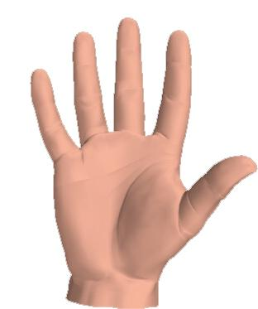

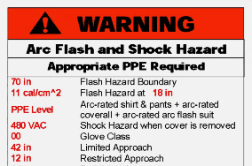
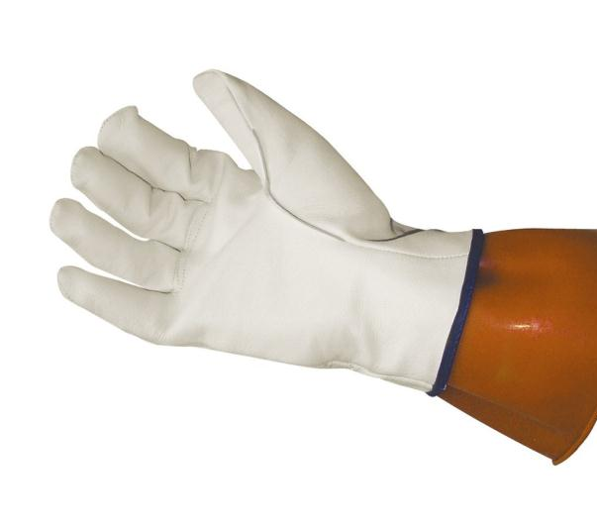

What in the heck does that Label mean?
Flash Hazard Boundary
11 Cal/cm 2
At 18 in
(Working Distance)
“Sparky”
12 in
42 in
Equipment
480 VAC
Heat?
Limited
Restricted
Restricted
70 in
(1.2 Cal/cm2)
176 F
Onset of 2nd degree burn
Class 00 500v
Min 11 cal
79
Available incident energy and the corresponding working distance or the arc flash PPE category in 130.7(C)(15)(A)(b) or 130.7(C)(15)(B) for the equipment, but not both”

