Slide 1
Control of Hazardous Energy
Lockout/Tagout

Slide 2
Why bother with lockout/tagout?
Lockout and tagout procedures are
designed and implemented to protect
you from an accidental release of
energy.

Slide 3
What is an “energy source?”
Energy sources include:
Electrical
Mechanical
Pneumatic
Hydraulic
Chemical
Thermal
Pressurized water or steam
Gravity

Slide 4
Hazardous Energy
Problems associated with hazardous energy include:
Accidental start-ups
Electrical shock
Release of stored or residual energy

Slide 5
Control of Hazardous Energy
The following slides demonstrate
some of the potential hazards
associated with energy sources.

Slide 6
What is the difference between lockout and tagout?
Lockout – a padlock and locking
device are used to physically “hold” an
energy control point, such as a switch,
lever or valve handle. This makes it
impossible for energy to be released.

Slide 7
Types of lockout devices
Plug Locks
Ball Valve Lockout
Gate Valve Lockout
Group Hasp
Electrical
Hydraulic, pneumatic, and other pressurized systems.

Slide 8
What is the difference between lockout and tagout?
Tagout – a written warning that tells
operators not to operate a switch,
lever or valve that could release
hazardous energy. Tagouts DO NOT
physically prevent someone from
releasing potentially hazardous
energy.

Slide 9


Examples of Tags

Slide 10
When should you lockout?
A lockout should be used when
working around systems where an
unexpected release of energy could
occur, causing injury or equipment
damage.

Slide 11
Common examples of when lockouts should be used:
Clearing jammed or blocked mechanisms
Preventive Maintenance
Working in confined spaces
Repairs on electrical circuits

Slide 12
Isolate ALL energy sources
Prior to starting a job, all energy
sources must be identified
(mechanical, electrical, etc.). Each
energy source must be locked out.

Slide 13
Multiple or Group Lockout
Lockout boxes are frequently used so
that multiple employees can install their
personal safety locks. These boxes are
typically stored in close proximity to
the associated piece of equipment.
Boxes are usually labeled to identify the
corresponding plant system.

Slide 14
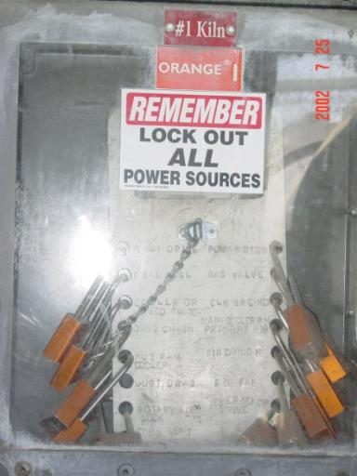
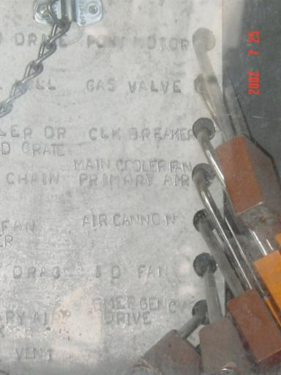
Multiple Lockout

Slide 15
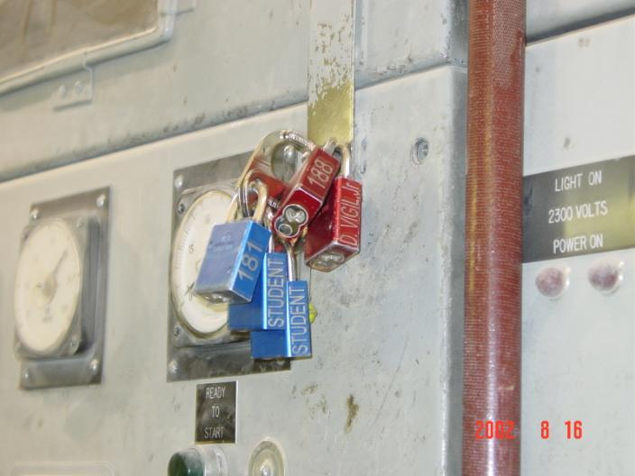
Group Lock

Slide 16
How to de-energize equipment
Prepare for shutdown
Shut down the machine or equipment
Safely release all stored or residual energy
Isolate the machine or equipment from ALL energy sources
Apply the Lockout or Tagout Device(s) to the Energy Isolating Device(s)
Verify isolation by physically attempting to “run” the machine or equipment.
Notes:
If you have any doubt call for an electrician to check it out.
If you are unsure you have the right piece of equipment ask for help.

Slide 17
“Real World” Example
Repairman attempted to lockout raw mill separator
Repairman properly installed lock on associated MCC breaker
Repairman properly attempted to start equipment to verify lockout
Equipment started because breaker was still energized (although it appeared to be open)

Slide 18
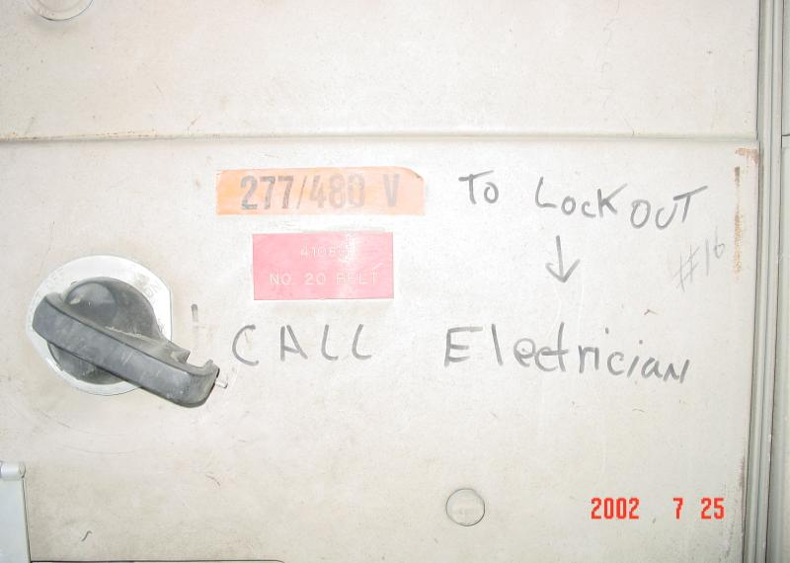
Clinker Sample Bldg MCC

Slide 19
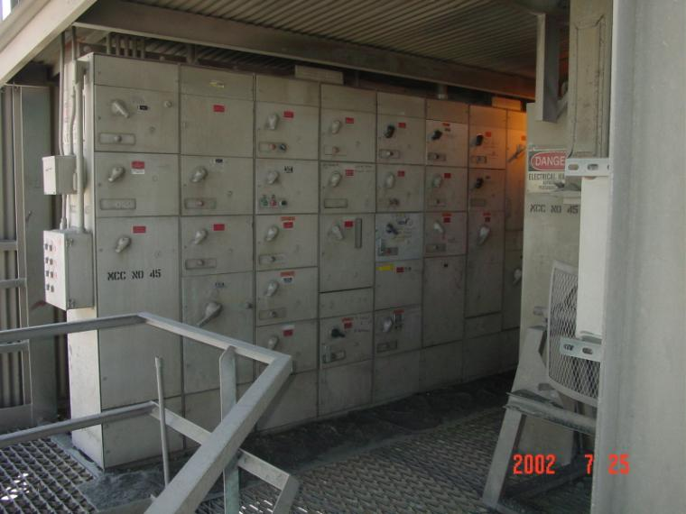
Clinker Sample Bldg MCC

Slide 20
High Voltage Switchgear
When de-energizing a high voltage switchgear, employees must contact a qualified electrician. Only qualified electricians are authorized to work on these systems.

Slide 21
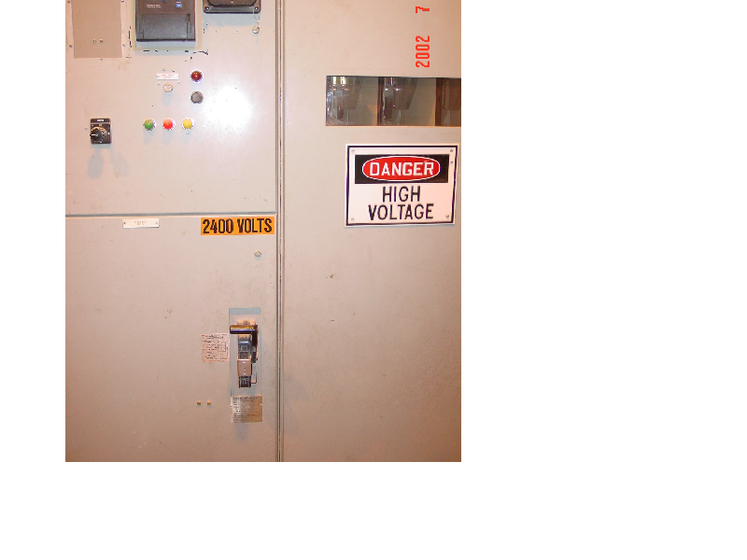
High Voltage Switchgear

Slide 22
Lock & Lockout Protocol
Every employee working in the plant
has been issued his or her own lock.
A specific lock color is assigned to each department.
Locks SHOULD NOT be used to secure personal lockers, tool boxes, etc.
An individual should NEVER ask a co-worker to install or remove his or her personal lock.

Slide 23
Plant Lockout Policy (taken from Plant Manager’s memo dated 13 June 2002)
“In lieu of these issues I want to make sure every employee understands that if they leave their lock, for any reason, on a piece of equipment and leave the plant site and that lock has to be removed either by getting the employee back to remove it, or cutting the lock off, disciplinary action will be taken against that employee. Further, that employee will be responsible to purchase the new lock after it has been cut off.”

Slide 24
Lockout/Tagout Standards
OSHA regulates lockout/tagout
through the “Control of Hazardous
Energy” standard, 29 CFR 1910.147.
MSHA regulates lockout/tagout
through 30 CRF 56.12016, .12017.

Slide 25
Employer responsibilities under the “Control of Hazardous Energy” standard
Establish an energy control program
Establish energy control procedures for machines and equipment
Provide employee training
Conduct periodic inspections or audits of the energy control program

Slide 26
When the standard applies
An employee is required to remove or bypass a guard or other safety device.
An employee is required to place any part of their body in contact with the point of operation of an operational machine or piece of equipment.
An employee is required to place any part of their body into a “Danger Zone” associated with a machine operating cycle.

Slide 27
Exceptions to the standard
Work on electric equipment controlled by plugging in or unplugging the equipment. The plug is under exclusive control of the employee performing maintenance.
“Hot Tap” operations involving transmission and distribution systems for gas, steam, water, petroleum products, etc.

Slide 28
Minor Servicing Tasks
Employees performing minor tool changes
and adjustments that are routine, repetitive,
and integral to the use of the equipment and
that occur during normal operations are
not covered by the Lockout/Tagout
Standard, provided the work is performed
using alternative measures that provide
effective protection.

Slide 29
Outside Contractors
Whenever outside contractors are engaged in activities covered by Lockout/Tagout, the on-site employer and the outside contractor shall inform each other of their respective Lockout or Tagout procedures.

Slide 30
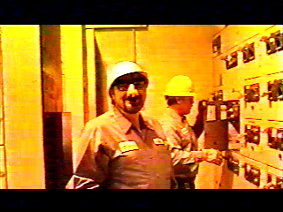
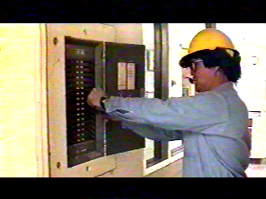

Slide 31

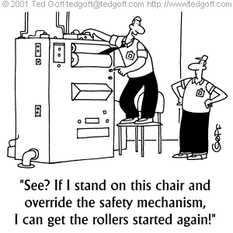

Slide 32
“FATAL FIVE”
(main causes of injury)
Failure to stop equipment.
Failure to disconnect from power source.
Failure to dissipate (bleed, neutralize) residual energy.
Accidental restarting of equipment.
Failure to clear work areas before restarting.

Slide 33
Electrical Energy Hazards
Arc flash
Arc flash light
Arc blast

Slide 34
Arc flash
Temperature can escalate rapidly near the center of an arc flash, reaching 35,000 F. Copper melts at 1,981 F.
The skin is very sensitive to temperature; while sitting in the sun for only six hours at 110 F, cell structure will start to break down. At 158 F, cell destruction occurs in one second. At 200 F, incurable third degree burns are incurred in one-tenth of a second.

Slide 35
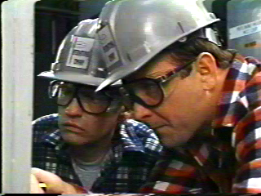

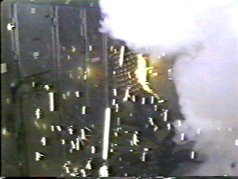
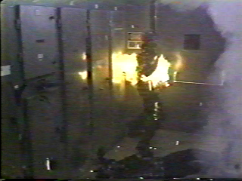
Arc flash

Slide 36
Arc Flash Light
At 35,000 degrees Fahrenheit, an arc flash can generate enough light to cause serious injury to the eyes. It is not uncommon for an electrician to develop cataracts three years after visual exposure to an arc flash.

Slide 37
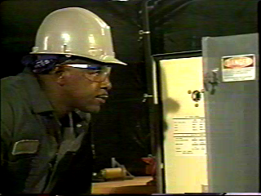

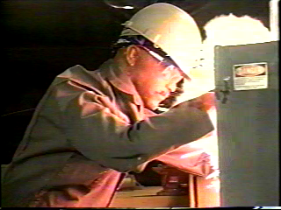
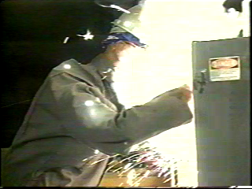
Arc flash

Slide 38
Arc Blast
Arc blast is a force caused by the rapid expansion of air due to the transition of solid conducting material into vapor. This rapid expansion can occupy 67,000 times the initial volume of the transitioning material. The blast can easily knock a person across a room, and the sound from the explosion can destroy a person’s ability to hear.

Slide 39
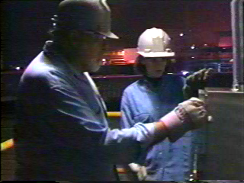
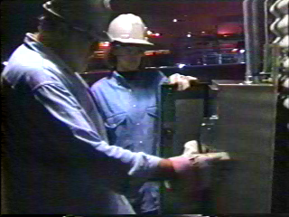

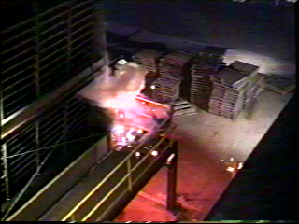
Arc Blast

Slide 40
Plugging in Electrical
Equipment
When “plugging in” or “disconnecting” 480 volt electrical equipment,
THE DISCONNECT SWITCH MUST BE OPENED.
The following pictures will demonstrate the reasons why!!

Slide 41
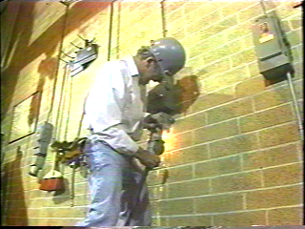
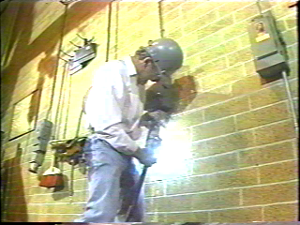

Slide 42



Electrical Burns

Slide 43
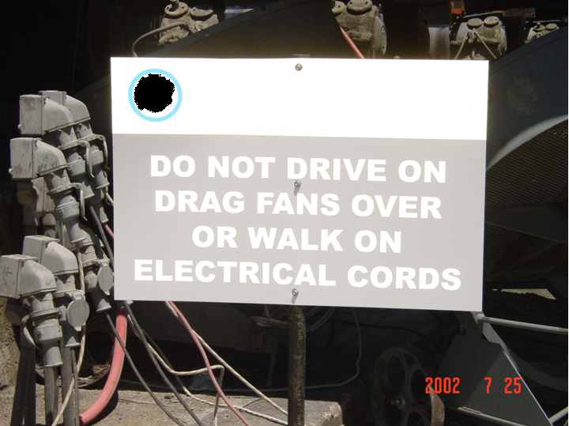
Site specific electrical hazards

Slide 44
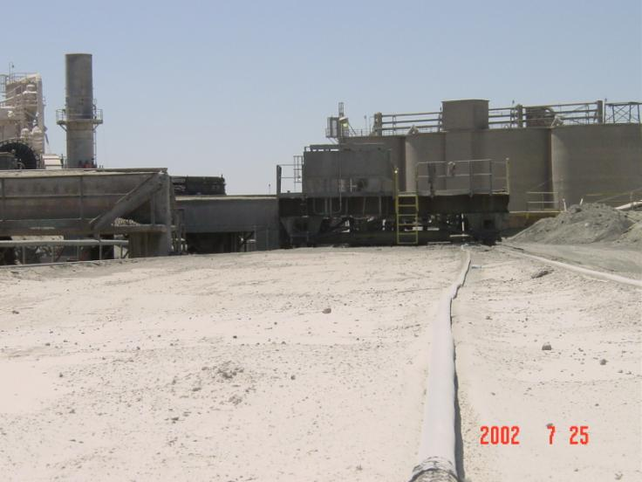
Site specific electrical hazards

Slide 45
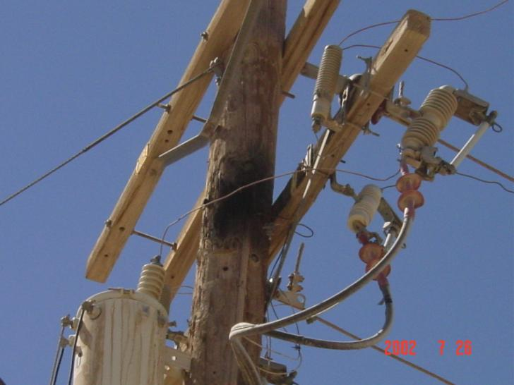
Site specific electrical hazards

Slide 46
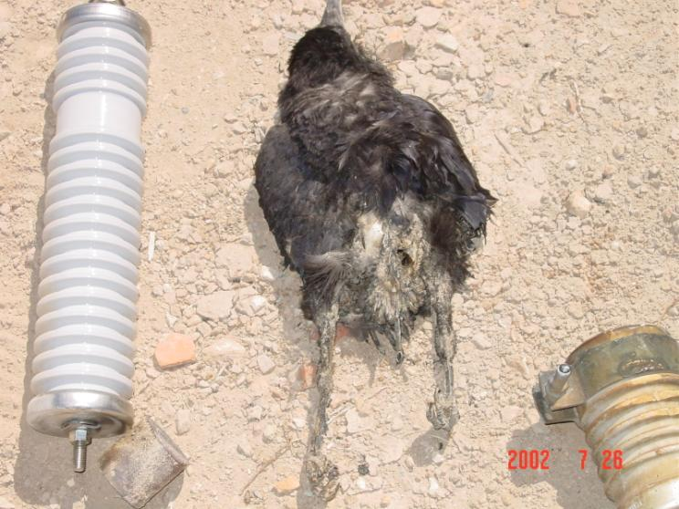
Site specific electrical hazards

Slide 47
ANY QUESTIONS?
THANKS FOR YOUR ATTENTION!

